Slide 1
Mission u 2024
The Kin-dom is Among You
WNCC UWF August 2, 2024
Notes:
Title slide with four levels of content. Use this to start your presentation.

Slide 2
Welcome Home
Mission Study, 2024
Martha Efird, Study Leader
Michelene Matthews
Sylvia M. Sekle-Dueh
Nancy Litton

Slide 3
WORDS TO CONTEMPLATE
KINGDOM
KIN-DOM
SOVEREIGNTY
SUBMISSION
INDIVIDUAL
FRESH EXPRESSIONS

Slide 4
BRAVE SPACES FOR WNCC MISSION U 2024
WE WANT OUR TIME TOGETHER TO BE TRANSFORMATIVE
TRANSFORMATIVE LEARNING AND SHARING THRIVES WHEN THE SETTING AND THE PARTICIPANTS CREATE THE SPACE . TODAY AND THROUGH OUR STUDY WE CONVENANT AND CREATE OUR BRAVE SPACE, A SPACE DIFFERENT FROM A “SAFE-SPACE”.
WHAT IS A BRAVE SPACE?
NOT ALWAYS COMFORTABLE
MAY INVOLVE TAKING A RISK IN THOUGHT, SHARING, AND LISTENING
THOUGHTS MAY BE COUNTER TO WHAT WE ALWAYS HELD AS TRUE
BE RESPECTFUL AND CONCERNED FOR YOUR SISTER PARTICIPANTS
A SACRED SPACE WHERE GOD ENTERS, HOLDS US, CONVICTS US, LOVES US, AND CHANGES US

Slide 5
BRAVE SPACES FOR WNCC MISSION U 2024
AS FACILITAORS WE WILL:
BE AVAILABLE , ATTUNED, AND PRAYERFUL
ENCOURAGE SHARING AND PARTICIPATE IN SHARING
BE VULNERABLE AND SHARE OUR OWN STORIES, FEELINGS, PERSPECTIVES
BE FUN
BE AND ENCOURAGE AUTHENTICITY
REMEMBER WE ARE NOT THE EXPERTS IN THE ROOM
BE HUMBLE
AND MORE………

Slide 6
AS FACILITATORS & PARTICIPANTS WE WILL:
BE HUMBLE
AGREE TO DISAGREE
LOVE EACH OTHER
DON’T TAKE THINGS PERSONALLY
CHALLENGE BY CHOICE – CHOOSING HOW YOU REACT AND COMMUNICATE
BE RESPECTFUL
HONOR – EACH OTHER, YOURSELF, AND GOD!
Sourced from: Program Book, appendix pp 69 & 70 and Arao B. and Clemens, K., “From Safe Spaces to Brave Spaces:
A New Way to Frame Dialogue Around Diversity and Social Justice. ”
In The Art of Effective Facilitation: Reflections From Social Justice Educators, Edited by L. Landreman. Sterling, VA: Stylus, 2013.

Slide 7
Spirit of the Living God, UM Hymnal 393
Spirit of the living God, fall a-fresh on me. Spirit of the living God, fall a-fresh on me. Melt me, mold me, fill me, use me. Spirit of the living God, fall a-fresh on me.
(repeat, once)

Slide 8
Who’s in Charge? Understanding God’s Sovereignty
Exploration 1:
Michelene Matthews, presenter

Slide 9
Luke 15:11-32
¹¹ Jesus said, “A certain man had two sons. ¹² The younger son said to his father, ‘Father, give me my share of the inheritance.’ Then the father divided his estate between them. ¹³ Soon afterward, the younger son gathered everything together and took a trip to a land far away. There, he wasted his wealth through extravagant living.

Slide 10
¹⁴ “When he had used up his resources, a severe food shortage arose in that country and he began to be in need. ¹⁵ He hired himself out to one of the citizens of that country, who sent him into his fields to feed pigs. ¹⁶ He longed to eat his fill from what the pigs ate, but no one gave him anything. ¹⁷ When he came to his senses, he said, ‘How many of my father’s hired hands have more than enough food, but I’m starving to death! ¹⁸ I will get up and go to my father, and say to him, “Father, I have sinned against heaven and against you. ¹⁹ I no longer deserve to be called your son. Take me on as one of your hired hands.”

Slide 11
²⁰ “So he got up and went to his father. While he was still a long way off, his father saw him and was moved with compassion. His father ran to him, hugged him, and kissed him. ²¹ Then his son said, ‘Father, I have sinned against heaven and against you. I no longer deserve to be called your son.’ ²² But the father said to his servants, ‘Quickly, bring out the best robe and put it on him! Put a ring on his finger and sandals on his feet! ²³ Fetch the fattened calf and slaughter it. We must celebrate with feasting ²⁴ because this son of mine was dead and has come back to life! He was lost and is found!’ And they began to celebrate.

Slide 12
²⁵ “Now his older son was in the field. Coming in from the field, he approached the house and heard music and dancing. ²⁶ He called one of the servants and asked what was going on. ²⁷ The servant replied, ‘Your brother has arrived, and your father has slaughtered the fattened calf because he received his son back safe and sound.’ ²⁸ Then the older son was furious and didn’t want to enter in, but his father came out and begged him. ²⁹ He answered his father, ‘Look, I’ve served you all these years, and I never disobeyed your instruction. Yet you’ve never given me as much as a young goat so I could celebrate with my friends. ³⁰ But when this son of yours returned, after gobbling up your estate on prostitutes, you slaughtered the fattened calf for him.’ ³¹ Then his father said, ‘Son, you are always with me, and everything I have is yours. ³² But we had to celebrate and be glad because this brother of yours was dead and is alive. He was lost and is found.’

Slide 13
Authoritarian
Authoritative
Permissive
Uninvolved

Slide 14
Group Reflection questions
What do you notice about where on the spectrum the parent in parable falls throughout the story?
How might the story change if the parent fell further to the authoritarian side?
Why do you think this parent so quickly embraced the prodigal son?
What would it mean to fully embrace the opportunity to engage with God as the parent represented in this parable?
How might your church community be transformed by it?

Slide 15
Reflecting the Image of our Sovereign God
Exploration 2:
Sylvia M. Sekle-Dueh, presenter

Slide 16
Reflecting the Images of Our Sovereign God

Slide 17
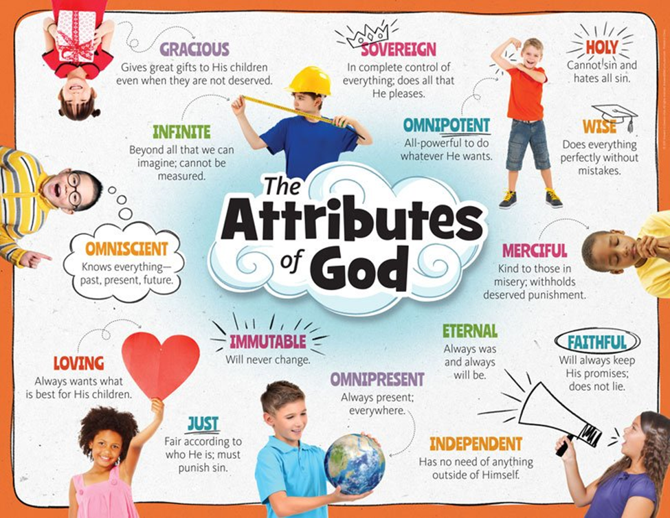
Questions:
What does it feel like to be a member of God’s family?
What characteristics shape the family of God?

Slide 18
Exodus 6:2-4
² God also said to Moses: “I am the Lord. ³ I appeared to Abraham, Isaac, and Jacob as God Almighty,^{[a]} but I didn’t reveal myself to them by my name ‘The Lord.’ ⁴ I also set up my covenant with them to give them the land of Canaan where they lived as immigrants.
Colossians 1:9-13
⁹ Because of this, since the day we heard about you, we haven’t stopped praying for you and asking for you to be filled with the knowledge of God’s will, with all wisdom and spiritual understanding. ¹⁰ We’re praying this so that you can live lives that are worthy of the Lord and pleasing to him in every way: by producing fruit in every good work and growing in the knowledge of God; ¹¹ by being strengthened through his glorious might so that you endure everything and have patience; ¹² and by giving thanks with joy to the Father. He made it so you could take part in the inheritance, in light granted to God’s holy people. ¹³ He rescued us from the control of darkness and transferred us into the kingdom of the Son he loves.

Slide 19
God is relational with us and invites us into new relationships with others. The nature of God is complex, and his greatest desire is to draw us to wholeness and communal living.
As we move into this second presentation, let us move into engagement with one another, reframing our position as experienced members in the community.

Slide 20
Activity I: Work through the simple chart on p.20
Ways we typically Engage with Children/Others | Connections we want to form Today
Koinonia - "Who is my community / partnership in the kin-dom?"
(pass your stoles around the table and have each other sign their first name).
1 Peter 2:9-10 - “What is my relationship with God?“ (write on stole)

Slide 21
1 Peter 2:9-10
⁹ But you are a chosen race, a royal priesthood, a holy nation, a people who are God’s own possession. You have become this people so that you may speak of the wonderful acts of the one who called you out of darkness into his amazing light. ¹⁰ Once you weren’t a people, but now you are God’s people. Once you hadn’t received mercy, but now you have received mercy.

Slide 22
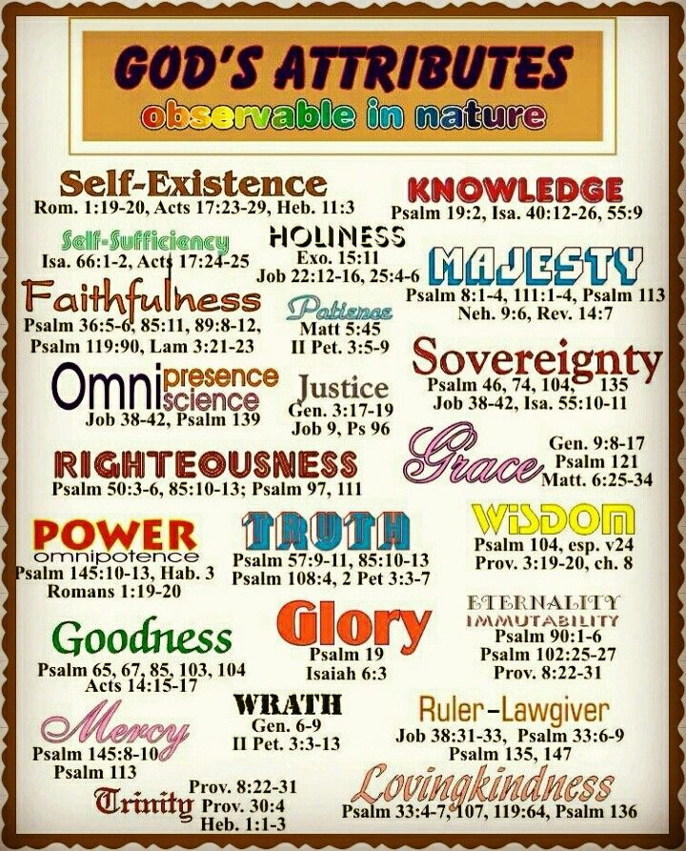

Slide 23
Psalm Of David 103
Let my whole being^{[a]} bless the Lord! Let everything inside me bless his holy name! ² Let my whole being bless the Lord and never forget all his good deeds: ³ how God forgives all your sins, heals all your sickness, ⁴ saves your life from the pit, crowns you with faithful love and compassion,
⁵ and satisfies you with plenty of good things so that your youth is made fresh like an eagle’s.
⁶ The Lord works righteousness; does justice for all who are oppressed. ⁷ God made his ways known to Moses; made his deeds known to the Israelites. ⁸ The Lord is compassionate and merciful, very patient, and full of faithful love.

Slide 24
Activity II: Nature of God’s Scavenger Hunt
Introduce yourself by sharing your name and something you learned in the first presentation.
Scavenger Hunt
Read the names/characteristic on each index card
Any questions about any of the names, characteristics or passage. Anyone ones to share.
Share a name or characteristics that you really like
Write the name or characteristics of God on your stole.
Brief sharing in the larger group.

Slide 25
Embracing Kinship
Exploration 3:
Nancy Litton, presenter

Slide 26
At your table, identify practices you can engage in to foster the formation of healthy and unified communities

Slide 27
Matthew 7:21-27
Entrance requirements
²¹ “Not everybody who says to me, ‘Lord, Lord,’ will get into the kingdom of heaven. Only those who do the will of my Father who is in heaven will enter. ²² On the Judgment Day, many people will say to me, ‘Lord, Lord, didn’t we prophesy in your name and expel demons in your name and do lots of miracles in your name?’ ²³ Then I’ll tell them, ‘I’ve never known you. Get away from me, you people who do wrong.’
Two foundations
²⁴ “Everybody who hears these words of mine and puts them into practice is like a wise builder who built a house on bedrock. ²⁵ The rain fell, the floods came, and the wind blew and beat against that house. It didn’t fall because it was firmly set on bedrock. ²⁶ But everybody who hears these words of mine and doesn’t put them into practice will be like a fool who built a house on sand. ²⁷ The rain fell, the floods came, and the wind blew and beat against that house. It fell and was completely destroyed.”

Slide 28
Isaiah 56:1-8 Keepers of God’s Sabbath
The Lord says: Act justly and do what is righteous, because my salvation is coming soon, and my righteousness will be revealed. ² Happy is the one who does this, the person who holds it fast, who keeps the Sabbath, not making it impure, and avoids doing any evil.
³ Don’t let the immigrant who has joined with the Lord say, “The Lord will exclude me from the people.” And don’t let the eunuch say, “I’m just a dry tree.”
⁴ The Lord says: To the eunuchs who keep my sabbaths, choose what I desire, and remain loyal to my covenant.

Slide 29
Isaiah continued
⁵ In my temple and courts, I will give them a monument and a name better than sons and daughters. I will give to them an enduring name that won’t be removed. ⁶ The immigrants who have joined me,^{[a]} serving me and loving my name,^{[b]} becoming my servants,^{[c]} everyone who keeps the Sabbath without making it impure, and those who hold fast to my covenant: ⁷ I will bring them to my holy mountain, and bring them joy in my house of prayer. I will accept their entirely burned offerings and sacrifices on my altar. My house will be known as a house of prayer for all peoples, ⁸ says the Lord God, who gathers Israel’s outcasts. I will gather still others to those I have already gathered.

Slide 30
Small group reflection questions:
Why is it so hard for individual church communities to consider inviting new people into fellowship with them?
What happens when we consider shifting leadership roles to new people
What thoughts of resistance stir when we consider merging resources with neighboring congregations?
What objections do you hear to modifying church activities for: 1.) younger people, 2.) language other than English, 3.) people with disabilities?
What signs of resistance to change have you seen?

Slide 31
Youth responses to adults of their church
How can adults in the church/your life better support
relationships that feel equal and symbiotic?
Don’t use words that we don’t understand.
Listen to us when we have ideas.
Give everyone the same support.
Appreciate the diversity we bring.
Encourage us to ask questions.
What kind of support do you want/need from the adults in your life?
Accept us the way we are.
How can adults in the church/in your life support your leadership?
Let us participate in worship and church activities and even lead.
Let us talk in church.

Slide 32
‘Help Us Accept Each Other’
Help us accept each other as Christ accepted us;
Teach us as sister, brother, each person to embrace.
Be present Lord, among us, and bring us to believe
We are ourselves accepted and meant to love and live.
Lord, for today's encounters with all who are in need,
Who hunger for acceptance, for righteousness and bread,
We need new eyes for seeing, new hands for holding on;
Renew us, with your Spirit; Lord, free us, make us one!

Slide 33
Untangling Personal Tensions
Exploration 4:
Martha Efird, presenter

Slide 34
Small Group Reflection
If the person who knows you the best were to introduce you to an unknown crowd, what do you imagine they would say? Prepare a 3-4 sentences response to this prompt.

Slide 35
Self -Portrait Activity
Matthew 5:14
¹⁴ You are the light of the world. A city on top of a hill can’t be hidden.

Slide 36
Psalms 139:13-14
¹³You are the one who created my innermost parts; you knit me together while I was still in my mother’s womb. ¹⁴ I give thanks to you that I was marvelously set apart. Your works are wonderful—I know that very well.

Slide 37
John 15:14-16
¹⁴ You are my friends if you do what I command you. ¹⁵ I don’t call you servants any longer, because servants don’t know what their master is doing. Instead, I call you friends, because everything I heard from my Father I have made known to you. ¹⁶ You didn’t choose me, but I chose you and appointed you so that you could go and produce fruit and so that your fruit could last. As a result, whatever you ask the Father in my name, he will give you.

Slide 38
Psalm 8:3-9
³ When I look up at your skies, at what your fingers made— the moon and the stars that you set firmly in place— ⁴ what are human beings that you think about them; what are human beings that you pay attention to them? ⁵ You’ve made them only slightly less than divine, crowning them with glory and grandeur.
⁶ You’ve let them rule over your handiwork, putting everything under their feet— ⁷ all sheep and all cattle, the wild animals too, ⁸ the birds in the sky, the fish of the ocean, everything that travels the pathways of the sea. ⁹ Lord, our Lord, how majestic is your name throughout the earth

Slide 39
Sending Prayer:
One: We cry out to you from the depths, Lord –
All: Lord, listen to our voice!
One: Let your ears pay close attention
All: to our request for mercy!
One: If you kept track of sins, Lord -
All: Lord, who would stand a chance?
One: But forgiveness is with you -
All: that is why you are honored.
One: We hope, Lord.
All: Our whole being hopes,
One: and we wait for God’s promise.
All: Our whole being waits for our Lord -
One: more than the night watch waits for morning.
All: yes, more than the night watch waits for morning!

Slide 40
‘Just as I am’
Just as I am , without one plea,
But that thy blood was shed for me,
And that thou bidst me come to thee,
O Lamb of God, I come, I come.
Just as I am, poor wretched, blind;
Sight riches, healing of the mind,
Yea, all I need in thee to find,
O Lamb of God I come, I come.
Just as I am, thou wilt receive,
Wilt welcome, pardon, cleanse, relieve;
Because thy promise I believe,
O Lamb of God I come, I come.

Slide 41
WORDS TO CONTEMPLATE
KINGDOM
KIN-DOM
SOVEREIGNTY
SUBMISSION
INDIVIDUAL
FRESH EXPRESSIONS
H O M E
W E L C O M E H O M E

Slide 42
Receiving the Kin-dom at Hand
Exploration 5:
Martha Efird, presenter

Slide 43
Have Thy Own Way, Lord UM Hymnal 382
Have thy own way, Lord. Have thy own way!(refrain)
Thou art the potter; I am the clay. Mold me and Make me after thy will, while I am waiting, yielded and still. (refrain)
Wounded and weary, help me I pray! Power all power, surely is thine! Touch me and heal me, Savior divine! (refrain)
Hold o’er my being, absolute sway. Fill with thy Spirit till all shall see Christ only, always, living in me!

Slide 44
How is God currently at work in your life and/or community?
What aspects of life serve as a source of hope, joy, love, or peace?

Slide 45
Prayer
Most merciful God, we confess that we have sinned against you in thought, work and deed, and by what we have done, and what we have left undone.
We have not loved you with our whole heart; we have not loved our neighbors as ourselves.
We are truly sorry and we humbly repent.
(continue next slide)

Slide 46
For the sake of your Son Jesus Christ, have mercy on us and forgive us; that we may delight in your will, and walk in your ways, to the glory of your name Amen
All pray in silence
Almighty God have mercy on you, forgive all your sins through our Lord Jesus Christ, strengthen you in all goodness, and by the power of the Holy Spirit keep you in eternal life. Amen

Slide 47
Do any of these signs and symptoms show up in community?
What are healthy ways of working through these signs and symptoms in communities?
What could it mean to fully trust God to be present in one of the situations identified?

Slide 48
Mark 12:28-34
²⁸ One of the legal experts heard their dispute and saw how well Jesus answered them. He came over and asked him, “Which commandment is the most important of all?”
²⁹ Jesus replied, “The most important one is Israel, listen! Our God is the one Lord, ³⁰ and you must love the Lord your God with all your heart, with all your being, with all your mind, and with all your strength.^{[a]} ³¹ The second is this, You will love your neighbor as yourself.^{[b]} No other commandment is greater than these.”
³² The legal expert said to him, “Well said, Teacher. You have truthfully said that God is one and there is no other besides him. ³³ And to love God with all of the heart, a full understanding, and all of one’s strength, and to love one’s neighbor as oneself is much more important than all kinds of entirely burned offerings and sacrifices.”
³⁴ When Jesus saw that he had answered with wisdom, he said to him, “You aren’t far from God’s kingdom.” After that, no one dared to ask him any more questions.

Slide 49
1 Corinthians 6:12-14,17,19
¹² I have the freedom to do anything, but not everything is helpful. I have the freedom to do anything, but I won’t be controlled by anything. ¹³ Food is for the stomach and the stomach is for food, and yet God will do away with both. The body isn’t for sexual immorality but for the Lord, and the Lord is for the body. ¹⁴ God has raised the Lord and will raise us through his power.
¹⁷ The one who is joined to the Lord is one spirit with him.
¹⁹ Or don’t you know that your body is a temple of the Holy Spirit who is in you? Don’t you know that you have the Holy Spirit from God, and you don’t belong to yourselves?

Slide 50
What does submission or surrender entail in these passages?
What questions or fears emerge as we read these?
What are some steps we can take to move more toward loving God with all our heart, being, mind, and strength?
What do you think Jesus means when he tells the legal expert in verse 34, “You aren’t far from God’s kingdom?”
What hope is contained in the passages?

Slide 51
Defining a Place Called “Home”
Exploration 6:
Michelene Matthews, presenter

Slide 52
Learning activity
Create a simple drawing/floor plan of a home they spent time in as a child – layer the picture with the mood arising from each space. Once the layout is complete, layer the picture with the mood arising from each space using the Wheel of Emotions as a guide for color/emotion match.

Slide 54
Psalm 27
The Lord is my light and my salvation. Should I fear anyone? The Lord is a fortress protecting my life. Should I be frightened of anything? ² When evildoers come at me trying to eat me up— it’s they, my foes and my enemies, who stumble and fall! ³ If an army camps against me, my heart won’t be afraid. If war comes up against me, I will continue to trust in this:
⁴ I have asked one thing from the Lord— it’s all I seek: to live in the Lord’s house all the days of my life, seeing the Lord’s beauty and constantly adoring his temple. ⁵ Because he will shelter me in his own dwelling during troubling times; he will hide me in a secret place in his own tent; he will set me up high, safe on a rock.
⁶ Now my head is higher than the enemies surrounding me, and I will offer sacrifices in God’s tent— sacrifices with shouts of joy! I will sing and praise the Lord.

Slide 55
Psalm 27, continued
⁷ Lord, listen to my voice when I cry out— have mercy on me and answer me! ⁸ Come, my heart says, seek God’s face.^{[a]} Lord, I do seek your face! ⁹ Please don’t hide it from me! Don’t push your servant aside angrily— you have been my help! God who saves me, don’t neglect me! Don’t leave me all alone! ¹⁰ Even if my father and mother left me all alone, the Lord would take me in.
¹¹ Lord, teach me your way; because of my opponents, lead me on a good path. ¹² Don’t give me over to the desires of my enemies, because false witnesses and violent accusers have taken their stand against me. ¹³ But I have sure faith that I will experience the Lord’s goodness in the land of the living!
¹⁴ Hope in the Lord! Be strong! Let your heart take courage! Hope in the Lord!

Slide 56
Presenting Home to Another
Exploration 7:
Deaconesses Nancy Litton and
Sylvia M Sekle-Dueh, presenters

Slide 57
Open Discussion

Slide 58
Diversity: is the range of human differences, including but not limited to race, ethnicity, gender, gender identity, sexual orientation, age, social class, physical ability or attributes, religious or ethical values system, national origin, and political beliefs.

Slide 59
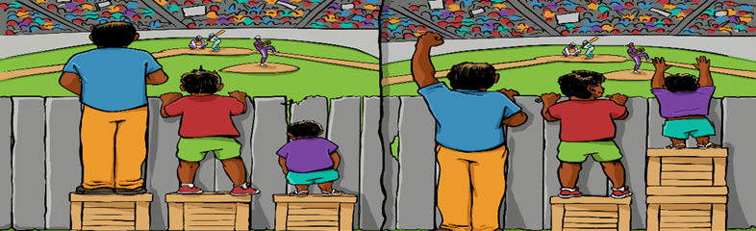
Equity: refers to fairness and justice and is distinguished from equality: Whereas equality means providing the same to all, equity means recognizing that we do not all start from the same place and must acknowledge and adjust imbalances.

Slide 60
Inclusion: means that the members of an environment feel that they are valued, respected, and included regardless of their background or identity. They have the same opportunities as others, and they are not overlooked or excluded.

Slide 61
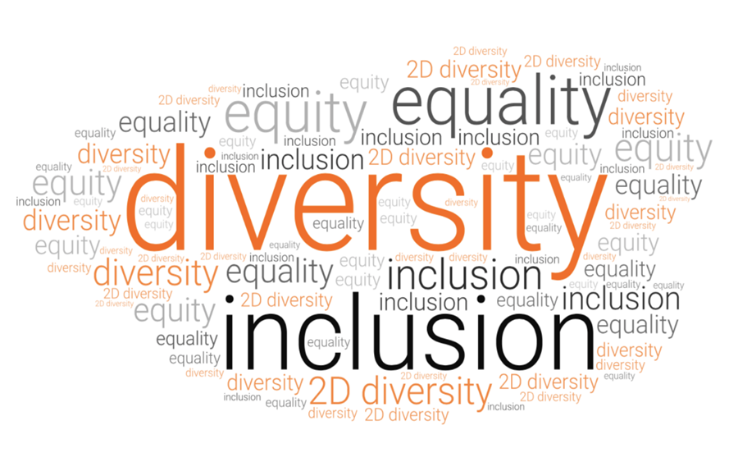
Questions
How has your community responded to the invitation to promote equity and inclusion over the past several years?
What opportunities are there for your community to deepen your collective responses to the call for equity and inclusion today?

Slide 62
Group Activity
Work in groups of four – image society as a place where all people are welcome to live, breathe, and pursue happiness equitably. This is what the Kin-dom of God represents.
Read Matthew 13:31-33, 44-46 - We want you to write a three to six sentence parable describing how you understand the Kin-dom of God.
Questions - If someone were to ask you to show them what the kin-dom of God is like:
What illustration would you use to convey it?
What illustration would convey to someone who lives under constant oppression and discrimination that God is facilitating an alternative experience right here and now that overpowers the social limitations imposed by local leaders?
Group share their parable aloud and add their parable to the Community Highlights section of the room.

Slide 63
Scripture Exploration
Ephesians 2: 14-19
What demographic separations are upheld in our current society that are like those in Paul’s letter to the Ephesians between Jews and Gentiles?
What would it mean for those demographic separations to be reconciled?
What attitudes, beliefs, and values do you see as helping us achieve oneness across these divisions?
What steps can we take to move beyond diversity to model of full inclusion?
Matthew 22: 1-12
When have you found yourself having similar thoughts as the king in verse 12?
How have you found your church community fostering concepts of othering regarding who belongs in the worship space and who is an outsider?
What harm do the practices explored in questions 1 and 2 cause to the invitation to know each other as kin?

Slide 64
Matthew 22: 1-12 Parable of the wedding party
22 Jesus responded by speaking again in parables: ² “The kingdom of heaven is like a king who prepared a wedding party for his son. ³ He sent his servants to call those invited to the wedding party. But they didn’t want to come. ⁴ Again he sent other servants and said to them, ‘Tell those who have been invited, “Look, the meal is all prepared. I’ve butchered the oxen and the fattened cattle. Now everything’s ready. Come to the wedding party!”’ ⁵ But they paid no attention and went away—some to their fields, others to their businesses. ⁶ The rest of them grabbed his servants, abused them, and killed them.
⁷ “The king was angry. He sent his soldiers to destroy those murderers and set their city on fire. ⁸ Then he said to his servants, ‘The wedding party is prepared, but those who were invited weren’t worthy. ⁹ Therefore, go to the roads on the edge of town and invite everyone you find to the wedding party.’
¹⁰ “Then those servants went to the roads and gathered everyone they found, both evil and good. The wedding party was full of guests. ¹¹ Now when the king came in and saw the guests, he spotted a man who wasn’t wearing wedding clothes. ¹² He said to him, ‘Friend, how did you get in here without wedding clothes?’ But he was speechless.

Slide 65
Ephesians 2: 14-19
¹⁴ Christ is our peace. He made both Jews and Gentiles into one group. With his body, he broke down the barrier of hatred that divided us. ¹⁵ He canceled the detailed rules of the Law so that he could create one new person out of the two groups, making peace. ¹⁶ He reconciled them both as one body to God by the cross, which ended the hostility to God.
¹⁷ When he came, he announced the good news of peace to you who were far away from God and to those who were near. ¹⁸ We both have access to the Father through Christ by the one Spirit. ¹⁹ So now you are no longer strangers and aliens. Rather, you are fellow citizens with God’s people, and you belong to God’s household.

Slide 66
Scripture Exploration
Ephesians 2: 14-19
What demographic separations are upheld in our current society that are like those in Paul’s letter to the Ephesians between Jews and Gentiles?
What would it mean for those demographic separations to be reconciled?
What attitudes, beliefs, and values do you see as helping us achieve oneness across these divisions?
What steps can we take to move beyond diversity to model of full inclusion?
Matthew 22: 1-12
When have you found yourself having similar thoughts as the king in verse 12?
How have you found your church community fostering concepts of othering regarding who belongs in the worship space and who is an outsider?
What harm do the practices explored in questions 1 and 2 cause to the invitation to know each other as kin?

Slide 67
Matthew 13:31-33 Parable of the mustard seed
³¹ He told another parable to them: “The kingdom of heaven is like a mustard seed that someone took and planted in his field. ³² It’s the smallest of all seeds. But when it’s grown, it’s the largest of all vegetable plants. It becomes a tree so that the birds in the sky come and nest in its branches.”
Matthew 13:44-46 Parable of the yeast
³³ He told them another parable: “The kingdom of heaven is like yeast, which a woman took and hid in a bushel of wheat flour until the yeast had worked its way through all the dough.”

Slide 68
Welcome Home
Exploration 8:
Martha Efird,
Michelene Matthews
Sylvia M Sekle-Dueh

Slide 69
John 17:15-17
¹⁵ I’m not asking that you take them out of this world but that you keep them safe from the evil one. ¹⁶ They don’t belong to this world, just as I don’t belong to this world. ¹⁷ Make them holy in the truth; your word is truth.

Slide 70
Luke 15:11-20
¹¹ Jesus said, “A certain man had two sons. ¹² The younger son said to his father, ‘Father, give me my share of the inheritance.’ Then the father divided his estate between them. ¹³ Soon afterward, the younger son gathered everything together and took a trip to a land far away. There, he wasted his wealth through extravagant living.
¹⁴ “When he had used up his resources, a severe food shortage arose in that country and he began to be in need. ¹⁵ He hired himself out to one of the citizens of that country, who sent him into his fields to feed pigs. ¹⁶ He longed to eat his fill from what the pigs ate, but no one gave him anything. ¹⁷ When he came to his senses, he said, ‘How many of my father’s hired hands have more than enough food, but I’m starving to death! ¹⁸ I will get up and go to my father, and say to him, “Father, I have sinned against heaven and against you. ¹⁹ I no longer deserve to be called your son. Take me on as one of your hired hands.” ’ ²⁰ So he got up and went to his father. “While he was still a long way off, his father saw him and was moved with compassion. His father ran to him, hugged him, and kissed him.

Slide 71
‘We are Called’, In Faith We Sing, 2172
Come! Live in the light! Since with the light for the kingdom to live in the freedom of the city of God!
We are called to act with justice – we are called to love tenderly – we are called to serve one another to walk humbly with God. (Refrain)
Come! Open your heart! Show your mercy to all those in fear! We are called – to be hope for the hopeless so all hatred and blindness will be no more!
(Refrain)
Sing! Sing a new song! Sing of that great day when all will be one! God will reign, and we’ll walk with each other as sisters and brothers united in love!
(Refrain)

Slide 72
THANK YOU for joining us!
Save travels home &
See you in 2025!

Slide 73
Romans 12
Living sacrifice and transformed lives
12 So, brothers and sisters, because of God’s mercies, I encourage you to present your bodies as a living sacrifice that is holy and pleasing to God. This is your appropriate priestly service. ² Don’t be conformed to the patterns of this world, but be transformed by the renewing of your minds so that you can figure out what God’s will is—what is good and pleasing and mature.
Transformed relationships
³ Because of the grace that God gave me, I can say to each one of you: don’t think of yourself more highly than you ought to think. Instead, be reasonable since God has measured out a portion of faith to each one of you. ⁴ We have many parts in one body, but the parts don’t all have the same function. ⁵ In the same way, though there are many of us, we are one body in Christ, and individually we belong to each other. ⁶ We have different gifts that are consistent with God’s grace that has been given to us. If your gift is prophecy, you should prophesy in proportion to your faith. ⁷ If your gift is service, devote yourself to serving. If your gift is teaching, devote yourself to teaching. ⁸ If your gift is encouragement, devote yourself to encouraging. The one giving should do it with no strings attached. The leader should lead with passion. The one showing mercy should be cheerful.
⁹ Love should be shown without pretending. Hate evil, and hold on to what is good. ¹⁰ Love each other like the members of your family. Be the best at showing honor to each other. ¹¹ Don’t hesitate to be enthusiastic—be on fire in the Spirit as you serve the Lord! ¹² Be happy in your hope, stand your ground when you’re in trouble, and devote yourselves to prayer. ¹³ Contribute to the needs of God’s people, and welcome strangers into your home. ¹⁴ Bless people who harass you—bless and don’t curse them. ¹⁵ Be happy with those who are happy, and cry with those who are crying. ¹⁶ Consider everyone as equal, and don’t think that you’re better than anyone else. Instead, associate with people who have no status. Don’t think that you’re so smart. ¹⁷ Don’t pay back anyone for their evil actions with evil actions, but show respect for what everyone else believes is good.
¹⁸ If possible, to the best of your ability, live at peace with all people. ¹⁹ Don’t try to get revenge for yourselves, my dear friends, but leave room for God’s wrath. It is written, Revenge belongs to me; I will pay it back, says the Lord.^{[a]} ²⁰ Instead, If your enemy is hungry, feed him; if he is thirsty, give him a drink. By doing this, you will pile burning coals of fire upon his head.^{[b]} ²¹ Don’t be defeated by evil, but defeat evil with good.

Slide 74
Ephesians 4
Unity of the body of Christ
4 Therefore, as a prisoner for the Lord, I encourage you to live as people worthy of the call you received from God. ² Conduct yourselves with all humility, gentleness, and patience. Accept each other with love, ³ and make an effort to preserve the unity of the Spirit with the peace that ties you together. ⁴ You are one body and one spirit, just as God also called you in one hope. ⁵ There is one Lord, one faith, one baptism, ⁶ and one God and Father of all, who is over all, through all, and in all.
⁷ God has given his grace to each one of us measured out by the gift that is given by Christ. ⁸ That’s why scripture says, When he climbed up to the heights, he captured prisoners, and he gave gifts to people.^{[a]}
⁹ What does the phrase “he climbed up” mean if it doesn’t mean that he had first gone down into the lower regions, the earth? ¹⁰ The one who went down is the same one who climbed up above all the heavens so that he might fill everything.
¹¹ He gave some apostles, some prophets, some evangelists, and some pastors and teachers. ¹² His purpose was to equip God’s people for the work of serving and building up the body of Christ ¹³ until we all reach the unity of faith and knowledge of God’s Son. God’s goal is for us to become mature adults—to be fully grown, measured by the standard of the fullness of Christ. ¹⁴ As a result, we aren’t supposed to be infants any longer who can be tossed and blown around by every wind that comes from teaching with deceitful scheming and the tricks people play to deliberately mislead others. ¹⁵ Instead, by speaking the truth with love, let’s grow in every way into Christ, ¹⁶ who is the head. The whole body grows from him, as it is joined and held together by all the supporting ligaments. The body makes itself grow in that it builds itself up with love as each one does its part.
The old and new life
¹⁷ So I’m telling you this, and I insist on it in the Lord: you shouldn’t live your life like the Gentiles anymore. They base their lives on pointless thinking, ¹⁸ and they are in the dark in their reasoning. They are disconnected from God’s life because of their ignorance and their closed hearts. ¹⁹ They are people who lack all sense of right and wrong, and who have turned themselves over to doing whatever feels good and to practicing every sort of corruption along with greed.
²⁰ But you didn’t learn that sort of thing from Christ. ²¹ Since you really listened to him and you were taught how the truth is in Jesus, ²² change the former way of life that was part of the person you once were, corrupted by deceitful desires. ²³ Instead, renew the thinking in your mind by the Spirit ²⁴ and clothe yourself with the new person created according to God’s image in justice and true holiness.
²⁵ Therefore, after you have gotten rid of lying, Each of you must tell the truth to your neighbor^{[b]} because we are parts of each other in the same body. ²⁶ Be angry without sinning.^{[c]} Don’t let the sun set on your anger. ²⁷ Don’t provide an opportunity for the devil. ²⁸ Thieves should no longer steal. Instead, they should go to work, using their hands to do good so that they will have something to share with whoever is in need.
²⁹ Don’t let any foul words come out of your mouth. Only say what is helpful when it is needed for building up the community so that it benefits those who hear what you say. ³⁰ Don’t make the Holy Spirit of God unhappy—you were sealed by him for the day of redemption. ³¹ Put aside all bitterness, losing your temper, anger, shouting, and slander, along with every other evil. ³² Be kind, compassionate, and forgiving to each other, in the same way God forgave you in Christ.

Slide 75
Colossians 3
Your life hidden in Christ
3 Therefore, if you were raised with Christ, look for the things that are above where Christ is sitting at God’s right side. ² Think about the things above and not things on earth. ³ You died, and your life is hidden with Christ in God. ⁴ When Christ, who is your life, is revealed, then you also will be revealed with him in glory.
⁵ So put to death the parts of your life that belong to the earth, such as sexual immorality, moral corruption, lust, evil desire, and greed (which is idolatry). ⁶ The wrath of God is coming upon disobedient people because of these things. ⁷ You used to live this way, when you were alive to these things. ⁸ But now set aside these things, such as anger, rage, malice, slander, and obscene language. ⁹ Don’t lie to each other. Take off the old human nature with its practices ¹⁰ and put on the new nature, which is renewed in knowledge by conforming to the image of the one who created it. ¹¹ In this image there is neither Greek nor Jew, circumcised nor uncircumcised, barbarian, Scythian, slave nor free, but Christ is all things and in all people.
¹² Therefore, as God’s choice, holy and loved, put on compassion, kindness, humility, gentleness, and patience. ¹³ Be tolerant with each other and, if someone has a complaint against anyone, forgive each other. As the Lord forgave you, so also forgive each other. ¹⁴ And over all these things put on love, which is the perfect bond of unity. ¹⁵ The peace of Christ must control your hearts—a peace into which you were called in one body. And be thankful people. ¹⁶ The word of Christ must live in you richly. Teach and warn each other with all wisdom by singing psalms, hymns, and spiritual songs. Sing to God with gratitude in your hearts. ¹⁷ Whatever you do, whether in speech or action, do it all in the name of the Lord Jesus and give thanks to God the Father through him.
¹⁸ Wives, submit to your husbands in a way that is appropriate in the Lord. ¹⁹ Husbands, love your wives and don’t be harsh with them. ²⁰ Children, obey your parents in everything, because this pleases the Lord. ²¹ Parents, don’t provoke your children in a way that ends up discouraging them.
²² Slaves, obey your masters on earth in everything. Don’t just obey like people pleasers when they are watching. Instead, obey with the single motivation of fearing the Lord. ²³ Whatever you do, do it from the heart for the Lord and not for people. ²⁴ You know that you will receive an inheritance as a reward. You serve the Lord Christ. ²⁵ But evildoers will receive their reward for their evil actions. There is no discrimination.

