Slide 2
Let’s Talk About Change

Slide 3
The Pessimist Complains About the Wind.
The Optimist Expects it to Change.
The Realist Adjusts the Sails
—William Ward
Notes:
READ SLIDE
Big Changes Are On The Way as the landscape of The United Methodist Church and other denominations continues to change.

Slide 4
Key Questions:
What are women looking for in a faith-based organization?
What do women think about United Methodist Women and the work we do?
How do women want to give?
What is most important to the women?
How do women want to gather?
Notes:
For at least 5 years, members of our board, program advisory board and staff have proactively engaged in conversations, conducted surveys and other research with over 24,000 women in the UMC, UMW and larger Christian women's community to investigate the answers to key questions:
READ SLIDE

Slide 5
Inspirations:
Inspiration for new programs
Inspiration for new ways to gather
Inspiration for new ways to give
Inspiration for new ways to join
Inspiration for new ways to influence and impact the world
Notes:
Some of the answers led to more questions. The most important thing that came from this process was Inspiration.
READ SLIDE

Slide 6
Goals:
Review the key research findings and data that are informing United Methodist Women’s upcoming programmatic and brand changes.
Explore our personal responses to change and positive ways to navigate change.
Compare the changes at United Methodist Women to Jesus’ new wineskins metaphor about change in Mark 2:21-22.
Talk about how we can become an influencer inviting new women to our great movement and sisterhood.
Notes:
In this workshop we will:
Review the key research findings and data that are informing UMW’s upcoming programmatic and brand changes
Explore our personal responses to change and positive ways to navigate change
Compare the need for UMW’s upcoming changes to Jesus’ new wineskins metaphor about change in Mark 2:21-22
Talk about how we can become influencers, exciting current members to participate in the new and innovated programs and inviting new women get to know us anew.

Slide 7
Key Research Findings
Notes:
Let’s look at what we’ve learned from five years of research.

Slide 8
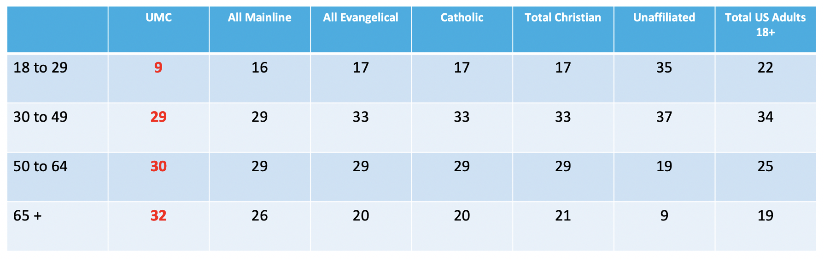
Demographic Comparisons
Source: Pew Research Centers, General Commission on Finance Administration, US Census 2014
Percentages of US Population
Notes:
Some of the research we’ve accessed was provided by United Methodist Communications, which is engaged in similar work on behalf of the denomination. Using data from the Pew Research Center and the US Census, UMCOM created this graph to show that:
The United Methodist Church has an older membership than the other churches represented on this graph.
The nation’s population--represented in the last column-- is younger than The United Methodist Church membership overall, represented in the red numbers UMW column on the left.
READ THE UMC COLUMN AND THE LAST COLUMN, WHICH SHOWS THE NATION’S AGE DEMOGRAPHICS, TO COMPARE THEM.

Slide 9
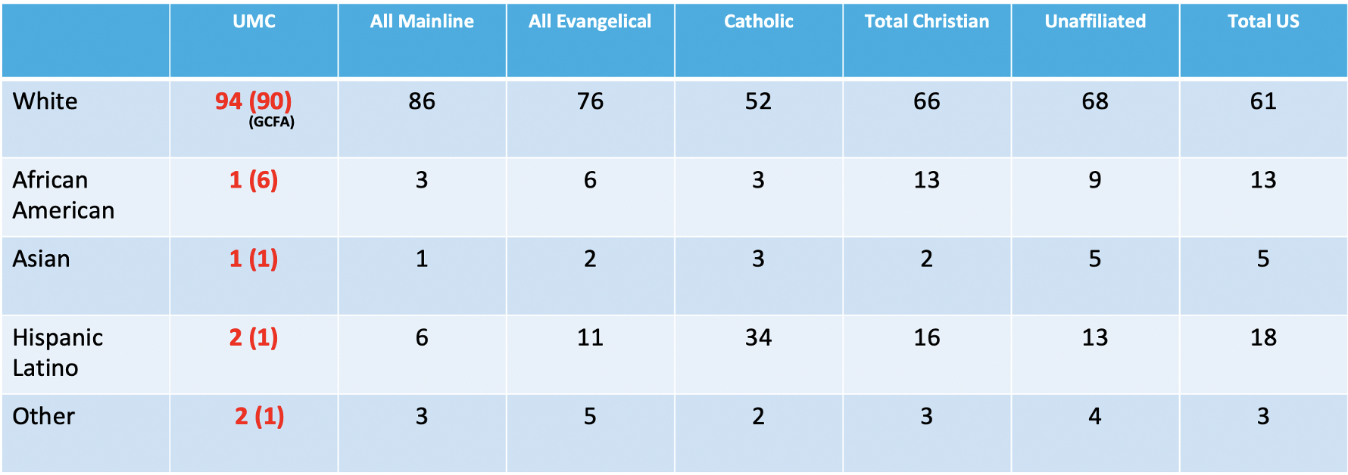
Racial/Ethnic Comparisons
Source: Pew Research Centers, General Commission on Finance Administration, US Census 2014
Notes:
UMCOM also created this graph comparing the racial/ethnic demographics of The United Methodist Church with that of of various other Christian denominations and with that of the United States.
The United Methodist Church demographics are in red in the column to the left. The numbers inside the parentheses are from the UMC’s General Council on Finance and Administration and differs a bit from the Pew Centers, as you see, but the overall information is much the same.
Notice, The United Methodist Church has more White members than every other church represented in the graph.
Most importantly, notice the last column, which represents the demographics of the total population of the United States. While the nation is 61 percent White, The United Methodist Church is 90-94 percent White.

Slide 10
Great News!
Our work is valued and familiar to 97% of the 9,400 The United Methodist Church women who took our first survey.
Notes:
READ SLIDE
When we asked women in The United Methodist Church if they were familiar with United Methodist Women, an overwhelming percent were, and described us with words like mission, service, and faith.
So, WHAT we do is valued and appreciated.

Slide 11
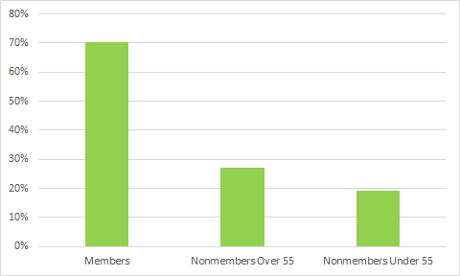
Disconnect Between Members & Nonmembers
The way United Methodist Women meets or gathers is inviting to me.
Level of agreement
(Combining Strongly Agree and Agree)
Notes:
This slide shows that while members like the way we meet and gather, non-members and younger women don’t particularly care for the way we do things. And in truth, this data just confirms what we know from our own local units and districts and conference meetings.

Slide 12
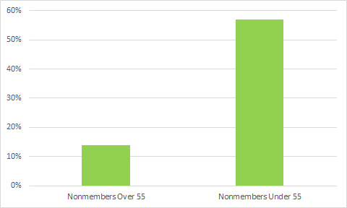
The Hurdle with UMC Nonmembers Under 55
The average age of the members is too different than mine.
Level of agreement
(Combining Strongly Agree and Agree)
Notes:
This slide shows that many nonmembers under 55 find the average age of our membership too different from their own.

Slide 13
Current Giving Models Are Not Appealing
United Methodist Women’s pledge model is appealing to me.
Level of agreement
(Combining Strongly Agree and Agree)
Notes:
This slide shows that while current members like our Pledge to Mission as a primary way to give, nonmembers don’t find it appealing.

Slide 14
Spirituality Dimension
(In percentages)
Do you consider yourself to be a spiritual person?
Total
Notes:
This slide, put together by UMCOM, reflects a growing trend in the United States.
According to Pew Research Center studies, about a quarter of U.S. adults (27%) now say they think of themselves as “spiritual” but not “religious,” up 8 percentage points in five years, according to a Pew Research Center survey conducted in 2017.
The growth in people who self identify as “spiritual” is consistent across all demographics—men and women; Whites, Blacks, Hispanics, and Asian; different ages and education levels; Republicans and Democrats.
The Pew survey did not directly ask respondents whether the label “spiritual but not religious” describes them. Instead, it asked two separate questions: “Do you think of yourself as a religious person, or not?” and “Do you think of yourself as a spiritual person, or not?” The results presented here are the product of combining responses to those two questions

Slide 15
Key Takeaways
Provide additional options for younger/nonmembers to participate.
Nurture current members through traditional structures and enhanced programs.
Update our image and the way we share our mission story to welcome younger/nonmembers.
Increase the racial/ethnic diversity of United Methodist Women, aligning with our core values and tapping a great opportunity for growth in a more diverse United States.
Women are seeking meaningful opportunities to engage with other faith-based women.
Women see themselves as modern, fun and bold and want women’s groups that are personal, carefully planned and bold.
Women are looking for unique combinations of spiritual growth and self-care, which we have come to know as soul care.
Women are ready and willing to invest their time and money into faith-based experiences, especially when they see these as soul care experiences.
Notes:
We need to provide additional options for younger and non-members to participate in our organization
We need to continue to nurture current members through the structures and programs that serve their needs.
We need to update our image and the way we share our mission story so younger and other nonmembers who’ve indicated like our work know that they are welcome and United Methodist Women is a place for them too.
Increasing the racial/ethnic diversity of United Methodist Women is not only a good thing that aligns with our core values, doing so is also a great opportunity for growth as the United States become a more racial/ethnically diverse nation
(below references right-hand text column)
READ SLIDE
Upcoming changes for United Methodist Women are informed by these key findings.

Slide 16
Navigating Change
Notes:
Change happens. Living through the COVID pandemic over the past two is an excellent example.
COVID-19 created a situation where we faced changes that were both within and out of our control.
When change happens, it can be harder to manage, but not impossible. When change happens, we can control our reactions and our perspective—and in doing so, we can even find and seize new opportunities.

Slide 17
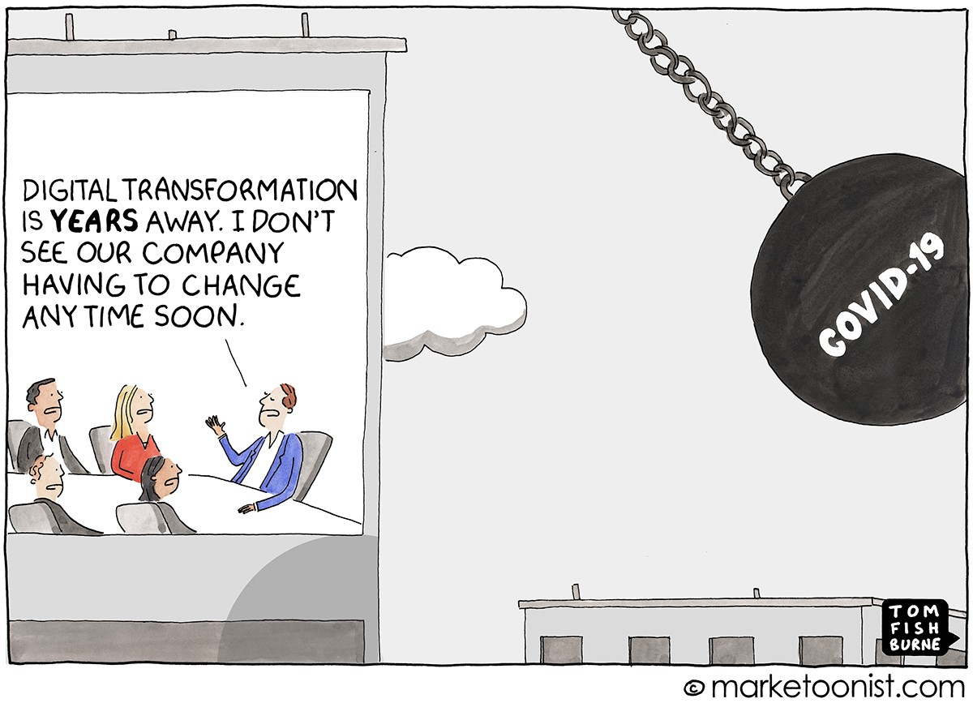
Notes:
Imagine you are the leader of the company making the statement in the cartoon. Focus on the things you can control.
Is there anything you could have done that would have better prepared the company for COVID-19?
Imagine you are one of the employees of the company. When COVID-19 hit and they had to change how they worked, what could they do to focus on the things they can control and not get too overwhelmed?

Slide 18
Change is hard at the beginning, messy in the middle and gorgeous at the end.
Change can be exhilarating, giving freedom and new opportunities.
Change can be difficult or negative.
Either way, managing change is a process.
Notes:
The Magic of New Beginnings
As a child, you learned to walk and talk. Later, you learned to read and write. Many of us learned to drive. These changes were exhilarating! They gave us freedom and presented us with new opportunities.
At other times, change can be difficult, like when we end relationships or experience negative changes in our health.
Either way, managing change is a process.

Slide 19
Think about a time you went through a significant change.

Slide 20
Write your answers to each question then discuss in small groups.
What were you thinking?
How did you feel?
What did you believe?
What did you say then and now?
What did you show?
What advice would you give someone who is having difficulty facing a change?
Notes:
GIVE GROUP 5 MINUTES TO WRITE AND 5 MINUTES TALK IN SMALL GROUPS FOR THIS EXERCISE.
Think about a time you went through a significant change, whether it was your choice or not, and respond to these questions in your journal, a sheet of paper or wherever you feel comfortable.
What were you thinking? Think about your narrative of the change. Did you agreed or disagree with the change? Were thoughts grounded in objective evidence or assumptions?
How did you feel? What emotions did you experience? Did you have any physical responses to the change?
What did you believe? If you experienced a strong emotional reaction, did the change conflict with your values or beliefs? How did your beliefs, values and assumptions change as a result?
What did you say then and now? What did you say then and now? What words did you use to convey how you felt? How would you change your words to better convey your thoughts and feelings about the change?
What did you show? How did your tone and body language help convey your thoughts about the change? What changes would you make to your tone, body language and other nonverbals to better convey your thoughts and feelings about the change.
What advice would you give someone who is having difficulty facing a change?

Slide 21
Keeping a Positive Mindset
Things change, people change, but GOD remains.
Allow yourself to acknowledge and experience feelings of loss— and allow yourself to let them go.
Focus on what is being gained rather than perceived losses.
Look for the lesson and/or opportunity.
Notes:
Keeping a Positive Mindset
READ SLIDE

Slide 22
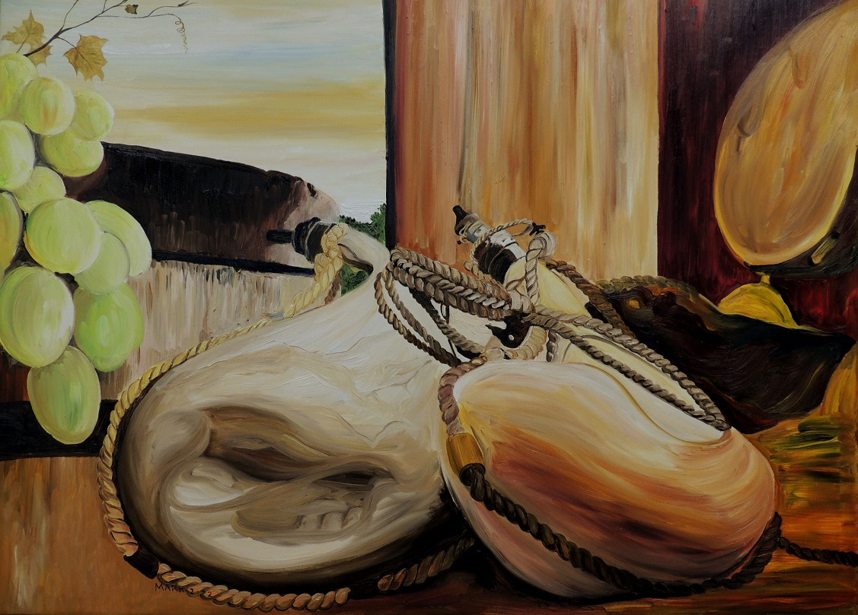
Jesus on Wineskins
Notes:
Jesus used a metaphor about wineskins to talk to his disciples about changes and why change was necessary. This metaphor describes the what’s happening in United Methodist Women is today

Slide 23
21 No one sews a piece of new unshrunk cloth on old clothes; otherwise, the patch tears away from it, the new from the old, and makes a worse tear.
22 No one pours new wine into old leather wineskins otherwise, the wine would burst the wineskins and the wine would be lost and the wineskins destroyed. But new wine is for new wineskins.
Mark 2:21-22 (CEB)
Notes:
READ SLIDE
We chose this Scripture as our guide not thinking about or implying that long-time members are old wine to be replaced by new members as new wine, rather that it exemplifies that change is necessary for growth and transformation. We have been hearing from members for years that we need to grow our membership.

Slide 24
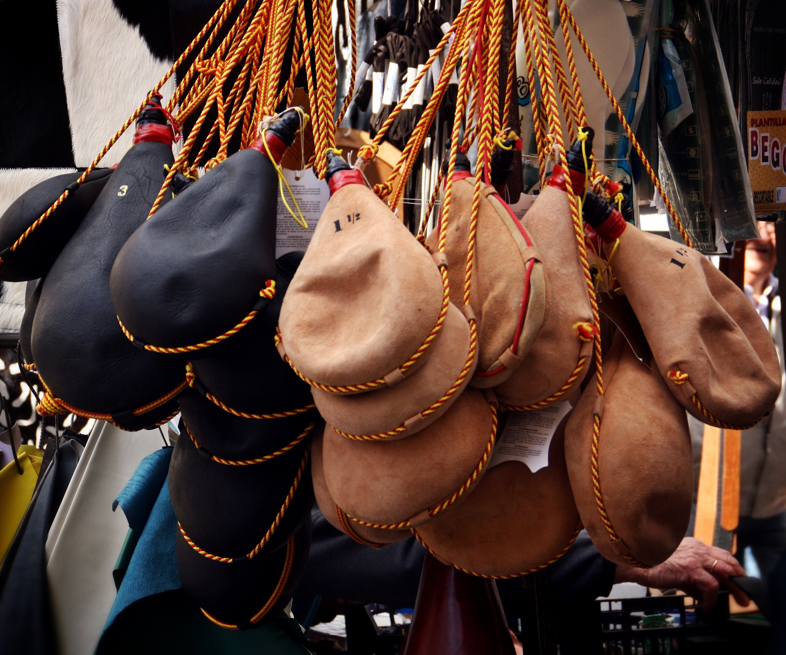
Why Do We Need New Wineskins?
To provide additional options for younger/nonmembers to participate.
To nurture current members through traditional structures and with new and/or enhanced programs.
To update our image and the way we share our mission story to welcome younger/nonmembers.
To increase the racial/ethnic diversity of our organization, aligning with our core values and tapping a great opportunity for growth in a more diverse United States.
Notes:
Why Do We Need New Wineskins?
Our organization has come to a point where we are ready to make new wine in a new wineskin to continue fulfilling our mission of addressing the needs of women, children. We have been served well by the structure and programs contained within the old wineskin.
READ SLIDE

Slide 25
Why Do We Need New Wineskins?
Together, new opportunities and programs coupled with the longstanding programs that embody our core values, we will create new wine as we grow and expand in new wineskins.
Changes will be implemented throughout 2022 and 2023.
Notes:
READ SLIDE
We remain committed to spiritual growth, leadership development, transformative education, social justice and improving the lives of women, children and youth around the world.
Many of the things that love our organization are part of the grapes that have been used to make the wine in the old wineskins and will be part of the grapes that will make the wine in the new wineskins. Other things will be new or innovated to reflect the life stages and needs of a wider segment of women today.
You spoke. We listened. And together we are creating change that brings more opportunities for engagement and interaction for everyone.
We are excited about the new wineskins, and we are confident you will be too.

Slide 26
Get Ready!
New programs
New options for gathering
New options for giving
New options for joining
New options for influencing and impacting the world
Notes:
Get Ready!
Current programs and new initiatives will reinvigorate current members, attract new members and expand our impact.

Slide 27
United Methodist Women is now United Women in Faith
We’ve taken a new name to better reflect how we answer our calling today. It’s an exhilarating time, as we commit to even greater inclusivity, action and impact. We remain women of passion and power, united by God’s love in our mission to support women, children and youth.
Notes:
The name United Women in Faith is part of this process of refreshing our organization with new programs and innovations. We remain a part of The United Methodist Church and incorporated as United Methodist Women now doing business as United Women in Faith.
READ SLIDE
Also, membership in the United Methodist Church has never been a requirement for membership in our organization. The name United Women in Faith reflects the open doors to membership that our organization has always had. This is especially important to convey today as some members may belong to local churches that may choose to disaffiliate with the denomination.

Slide 28
Notes:
So now we are United Women in Faith! Our new logo features our new name next to a Christian cross in muted colors of yellow, blue, orange and green. The logo is symbolic of our forward-looking faith, and the diversity of our organization and the world God so loves.

Slide 29
Be Flexible in the Midst of Change!
Read and share updates, FAQs and other information from issues of response and
Help others navigate the change with your energy, enthusiasm and excitement about the changes.
Give yourself time to reflect on the changes.
Maintain a positive mindset.
Show that United Women in Faith is still an organization of BOLD women who act for justice and transform communities.
As time passes and new programs are rolled out, try it! Make an effort to experience the programs, see how others received them (especially new members you may invite), and give your best effort to support!
Notes:
As we prepare move forward, we need leaders like you to guide the way! Be a part of the change!
READ SLIDE

Slide 30
Tamara Clark
Tclark@UWFaith.org

