Slide 1
Notes:
I’ll say yes! Lord yes! To your will and to your way. I’ll say yes Lord, yes. I will trust you and obey. When your spirit speaks to me, in my whole heart I’ll agree. And my answer will be yes Lord yes.
Greetings on this day! I hope you all don’t mind if I share one of my three favorite scriptures today. Mathew 25:31 – 40 says:
³¹ “When the Son of Man comes in his glory, and all the angels with him, he will sit on his glorious throne. ³² All the nations will be gathered before him, and he will separate the people one from another as a shepherd separates the sheep from the goats. ³³ He will put the sheep on his right and the goats on his left.
³⁴ “Then the King will say to those on his right, ‘Come, you who are blessed by my Father; take your inheritance, the kingdom prepared for you since the creation of the world.
And then it goes on to say
{CLICK}

Slide 2
Matthew 25
³⁵ For I was hungry and you gave me something to eat, I was thirsty and you gave me something to drink, I was a stranger and you invited me in, ³⁶ I needed clothes and you clothed me, I was sick and you looked after me, I was in prison and you came to visit me.’
Notes:
³⁵ For I was hungry and you gave me something to eat, I was thirsty and you gave me something to drink, I was a stranger and you invited me in, ³⁶ I needed clothes and you clothed me, I was sick and you looked after me, I was in prison and you came to visit me.’
³⁷ “Then the righteous will answer him, ‘Lord, when did we see you hungry and feed you, or thirsty and give you something to drink? ³⁸ When did we see you a stranger and invite you in, or needing clothes and clothe you? ³⁹ When did we see you sick or in prison and go to visit you?’
{CLICK}

Slide 3
Matthew 25
⁴⁰ Truly I tell you, whatever you did for one of the least of these brothers and sisters of mine, you did for me.
Notes:
⁴⁰ “The King will reply, ‘Truly I tell you, whatever you did for one of the least of these brothers and sisters of mine, you did for me.’
I, like many of us, have been on both the receiving and giving end of good deeds. I’ve been hungry, given clothes, invited in as a stranger and even sick receiving visits from people going out of their way to share their time and presence with me. I would think that some of us have been in these situations at different times in our lives. We are all human, living separate and unique lives but having some of these situations in common. And many of us have also been givers, serving the needs of others in different ways. I know that is true because you we are United Women in Faith! We are mission-oriented, and it didn’t start with us. For United Women in Faith it began over 150 years ago.
{CLICK}

Slide 4
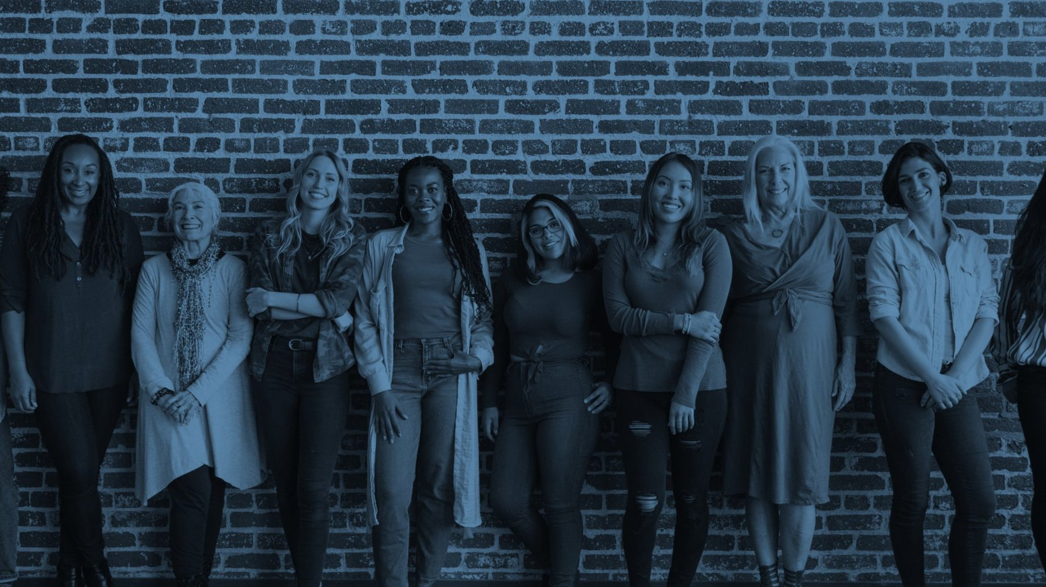
I was sick and you looked after me
Notes:
It started in 1869 when eight women gathered at a Methodist church in Boston to plan how to mobilize the women of their day. They then raised funds to send a woman doctor and a woman educator to India to serve women in that nation who could not be served by the male missionaries sent by their denomination.
“I was sick and you looked after me”
{CLICK}

Slide 5
I was hungry and you gave me something to eat, I was thirsty and you gave me something to drink
Notes:
By 1939 five denominations had become The Methodist Church, and the women of the new entity established Woman’s Society of Christian Service groups and the Wesleyan Service Guilds. Those groups then raised funds to support their own organization and its ministries serving women, children and youth around the world.
“For I was hungry and you gave me something to eat, I was thirsty and you gave me something to drink”
{CLICK}

Slide 6
I was a stranger and you invited me in. I needed clothes and you clothed me
Notes:
Then in 1972, after a new church merger in 1968 created The United Methodist Church, the women responded to the changing landscape by also banning together as one inclusive organization. Later UNITED Methodist Women, was chosen as a name to unite the women from the various denominations and service guilds. They focused their ministries on the needs of women, children and youth and justice for disenfranchised people and communities.
“I was a stranger and you invited me in. I needed clothes and you clothed me.”
{CLICK}

Slide 7
I was in prison and you came to visit me
Notes:
Today in 2022, we continue the work of our foremothers. In May UWFaith announced a grant of $250,000 to Girls Embracing Mothers (GEM), which supports women and girls impacted by the criminal justice system through empowerment-based programs that strengthen the relationship between young girls and incarcerate mothers. It offers reentry-based training for mothers who are incarcerated, with the goal of breaking the cycle of incarceration and supporting girls and women in their efforts to lead healthy, healed and whole lives.
“I was in prison and you came to visit me”
{CLICK}

Slide 8


Faith
Action
Sisterhood
Notes:
This year we are embarking on a new journey responding to a changed landscape in church and society including the way women are living into their faith. This new journey forward is inclusive of women of all ethnicities, social-strata and walks of life who have chosen to be followers of Jesus. This includes women of varying United Methodist, and other Christian denominations and traditions.
Just two weeks ago I was meeting with the president and vice president of my local UWFaith group, planning for our next gathering and the calendar for next year. We were meeting outside in a playground in North Philadelphia on a bench. Someone who knew us was walking by and asked what we were doing…our president said are a part of United Women in Faith and that we were planning things to do support the needs of the women and children in the community, as well as planning fundraisers. She was very interested and sat down and joined us for the rest of the planning. Contributing ideas and offering to help with whatever needed to be done.
There are faith-filled women out there who are called and would love to join us in this work.
FAITH, SISTERHOOD AND ACTION are the foundations of our journey
Everything we do, all of our ACTION—service, education, advocacy— and the nurturing of our SISTERHOOD starts with Faith! Faith is our oxygen. Faith is what the women of our organization live and breath. It is our way of connecting. Faith is how we tap into God’s abundant love while following the practices of Jesus to pray, heal, teach and confront the injustices of his time. In United Women in Faith, we follow Jesus’ example, by continuing to nurture that faith so that we are able to be witnesses in a constantly changing world.
{CLICK}

Slide 9
James 2
¹⁴ What good is it, my brothers and sisters, if someone claims to have faith but has no deeds? Can such faith save them? ¹⁵ Suppose a brother or a sister is without clothes and daily food. ¹⁶ If one of you says to them, “Go in peace; keep warm and well fed,”
Notes:
James 2:14-18 has a caption of Faith and Deeds. The verses read:
¹⁴ What good is it, my brothers and sisters, if someone claims to have faith but has no deeds? Can such faith save them? ¹⁵ Suppose a brother or a sister is without clothes and daily food. ¹⁶ If one of you says to them, “Go in peace; keep warm and well fed,”

Slide 10
James 2
but does nothing about their physical needs, what good is it? ¹⁷ In the same way, faith by itself, if it is not accompanied by action, is dead. ¹⁸ But someone will say, “You have faith; I have deeds.” Show me your faith without deeds, and I will show you my faith by my deeds.
Notes:
. but does nothing about their physical needs, what good is it? ¹⁷ In the same way, faith by itself, if it is not accompanied by action, is dead.
¹⁸ But someone will say, “You have faith; I have deeds.”
Show me your faith without deeds, and I will show you my faith by my deeds.
I dare say that United Women in Faith is unique. There are women organizations centered around faith, growing their spiritual lives, but they don’t live and breathe the deeds, the action. There are organizations who are social-action driven, but don’t have faith at their core. And there is not another women’s organization that brings together faith and deeds, within a sisterhood reaching worldwide.
{CLICK}

Slide 11
“I have learned the importance of prayer is crucial through the years of my degree program. I also learned the importance of staying focused and being part of a team”
~ Patience Chapata
2021
358 Grants &
Scholarships
33
Countries
$4,084,488
Awarded
Patience Chapata, BS Degree Women’s University in Africa
Notes:
I am proud to be a part of United Women in Faith, because we effect insurmountable change in our local communities and spheres of influence, as well as around the world through our connections. And we truly fulfill what our new mission says:
{CLICK}

Slide 12

Our international work empowers women and youth to find local solutions and make positive, measurable change in their communities.
2021
7 Regional Missionaries
$1.2 Million
Spent
Sub-Saharan Africa ~ Asia ~ Latin America ~ Carribean
Notes:
We seek to connect and nurture women through Christian spiritual formation, leadership development, creative fellowship and education so that they can inspire, influence and impact local and global communities.
So we’ve taken this new name to better reflect how we answer our calling today. And it’s an exhilarating time! With this new name, we commit to deeper ways to inspire, influence and impact. We commit to turning it up! For Justice for women, children and youth. We commit to continuing the tradition of showing our faith by our deeds.
{CLICK}

Slide 13

Notes:
Final Slide

