Slide 1
This session is being recorded.
United Methodist Women Western North Carolina Conference
Bearing Witness in the Kin-dom
Study Leader: Rev. Amy Coles
Schedule:
Thursday, July 15th – 6:00pm to 8:00pm
Friday, July 16th – 6:00pm to 8:00pm
Saturday, July 17th – 10:00am to 1:00pm
Sunday, July 18th – 3:00pm to 5:00pm

Slide 2
Bearing Witness in the Kin-dom
Session 4: Meaningful Participation

Slide 3
CENTERING QUOTE Faith always includes a social dimension. To nurture the potential of Christ-likeness in ourselves and our neighbors is the communal task of being church together (p. 86).

Slide 4
CENTERING QUOTE Growth in Christ-likeness allows us to love each other, to encourage development of each person’s full human potential. Flourishing is for everyone, not just for the select few or the demonstrably pious. As children of God bearing God’s full image, all of humanity is
redeemed through Christ. Each person is
invited to flourish (p. 84)

Slide 5
Imagining a New Heaven and Earth Without a foundation of dignity and love, attempts at repentance falter. When I asked her about the “Act of Repentance and Healing for Indigenous Persons” at General Conference 2012, [Tweedy] told me she was against it. Her congregations were not ready for repentance. She explained, “I was serving an Anglo church at the time. The people were asking, ‘Why are we apologizing? Why do we have to do that?’ So, we hadn’t done our job. If those are the kinds of questions you’re asking, we
need to do some teaching” (p. 71).

Slide 6
Glorious New Creation:
Isaiah 65: 17-25 (CEB)
¹⁷ Look! I’m creating a new heaven and a new earth: past events won’t be remembered; they won’t come to mind. ¹⁸ Be glad and rejoice forever in what I’m creating, because I’m creating Jerusalem as a joy and her people as a source of gladness. ¹⁹ I will rejoice in Jerusalem and be glad about my people. No one will ever hear the sound of weeping or crying in it again.

Slide 7
²⁰ No more will babies live only a few days, or the old fail to live out their days. The one who dies at a hundred will be like a young person, and the one falling short of a hundred will seem cursed. ²¹ They will build houses and live in them; they will plant vineyards and eat their fruit. ²² They won’t build for others to live in, nor plant for others to eat. Like the days of a tree will be the days of my people; my chosen will make full use of their handiwork. ²³ They won’t labor in vain, nor bear children to a world of horrors, because they will be people blessed by the Lord, they along with their descendants.

Slide 8
²⁴ Before they call, I will answer; while they are still speaking, I will hear. ²⁵ Wolf and lamb will graze together, and the lion will eat straw like the ox, but the snake—its food will be dust. They won’t hurt or destroy at any place on my holy mountain, says the Lord.

Slide 9
What is the Kin-dom of God Like?
The kingdom of God is like a mustard seed (Luke 13:17-19)
The kingdom of heaven is like yeast (Matthew 13:33)
The kingdom of heaven is like a new (Matthew 13:47)
These parables used common imagery from the
historical context to explain the nature of a world
made right. What imagery would Jesus use if he
spoke in parables today? Would he allude to the Avengers? A protest? Wall Street?

Slide 10
Meaningful Participation
Historical Clarity
Attentive Presence
Grounded Being
Notes:
9
Bearing witness as a process
How do we bear witness as individuals within the church, calling the church to count,

Slide 11
Solidarity
Justice
Love
Dignity
Notes:
10
Bearing witness as a process
How do we bear witness as individuals within the church, calling the church to count,

Slide 12
God’s Initiative
Our Response
Module | Perspectival Moment | God’s Grace and Activity | Our Moral Activity | Relational Context | Moral Emphasis
Grounded Being | created existence | prevenient grace; bestowed worth | recognition | dignity | equality and human rights
Attentive Presence | present | justifying grace; conviction of sin | empathy | love | basic goods for the most vulnerable
Historical Clarity | past | justifying grace; forgiveness | memory and repentance | justice | righting relationships; restitution for victims
Meaningful Participation | future | sanctifying grace; reconciliation and shalom | imagination | solidarity | full flourishing of all creation

Slide 13
Worship

Slide 14
Call to Worship
Have you looked for butterflies or fruit on the trees? Look around and see the newness!
Did you hear this weekend about love in action? Look around and see the newness!
Did someone who was lost find her way home? Look around and see the newness! In Jesus Christ, God is busy making all things new! Be glad in God and rejoice!

Slide 15
“Be Thou My Vision” - ELENYI

Slide 16
2 Corinthians 5:16-19
¹⁶ From now on, therefore, we regard no one from a human point of view; even though we once knew Christ from a human point of view, we know him no longer in that way. ¹⁷ So if anyone is in Christ, there is a new creation: everything old has passed away; see, everything has become new! ¹⁸ All this is from God, who reconciled us to himself through Christ, and has given us the ministry of reconciliation; ¹⁹ that is, in Christ God was reconciling the world to himself, not counting their trespasses against them, and entrusting the message of reconciliation to us.

Slide 17
6 Word Stories
https://open.spotify.com/playlist/0lGH6niUQvLgYu4uT4pBTa?si=284af4c9384c4787

Slide 18
Prayer of Intercession
Reconciling Christ, bless our efforts to bring about reconciliation.
Give us the strength to persevere without counting the hurts,
and to find within ourselves the capacity to keep on loving.
Give us the grace to be able to stand in the middle of situations,
and to be a conduit for the deep listening
which can lead to healing and forgiveness.
Help us to conduct ourselves with dignity,
giving and expecting respect, moving from prayer to action,
and from action back again into prayer.

Slide 19
Grant that we may be so grounded in your love,
that our security is not threatened if we change our minds,
or begin to see a better way to act.
Bless those who are called to reconcile on a large-scale –
politicians, world leaders, leaders of business,
and those who stand in the midst of bitter conflict.
Reconciling Christ, bless us and bless all who engage
in the sacred work of envisioning new wholeness,
and bringing people and nations together.
We offer these prayers in your name and now pray together the prayer you taught all of your disciples.

Slide 20
Our Father, who art in heaven, hallowed be thy name. Thy Kingdom come, thy will be done, on earth as it is in heaven Give us this day our daily bread. And forgive us our trespasses, as we forgive those who trespass against us. And lead us not into temptation, but deliver us from evil. For thine is the kingdom, the power and the glory, forever. Amen.

Slide 21
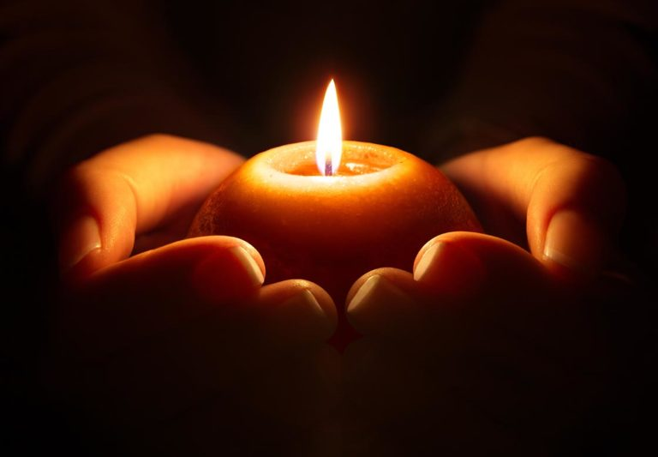
Christ’s Commission and Blessing
A lighted candle is a deeply human symbol: it enlightens the darkness, creates warmth, security and community. It symbolizes Christ, the light of the world. As ambassadors for Christ, we will carry this light into the world, into the dark places where fighting, discord and division impede our moral witness. May Christ's light effect reconciliation in our thoughts, words and deeds. Receive the Light of Christ and carry it into the dark places of our world! Be ministers of reconciliation! Be ambassadors for Christ!

Slide 22
Post-Session Journaling Prompt
Dear Church,
Write a letter to the church as if you are an apostle, calling your church community into greater engagement as a moral witness. Address the barriers that might prevent your church from engaging, as well as the strengths within yourself and your community that you may draw upon as you do this work of active, intentional participation. Invite your siblings in Christ to the specific work of repentance and reorientation. Cast a vision for what might be possible and/or result from the hard-but-necessary work you are calling them into.

Slide 23
Mission u 2021
United Methodist Women Western North Carolina Conference
July 15-18 – Bearing Witness in the Kin-dom
July 19-22 – Pushout (Full study)
July 23-25 – Pushout (Full study)
July 31 – Pushout (Overview)
August 1 – Pushout (Overview)

