Slide 1
This session is being recorded.
United Methodist Women Western North Carolina Conference
Bearing Witness in the Kin-dom
Study Leader: Rev. Amy Coles
Schedule:
Thursday, July 15th – 6:00pm to 8:00pm
Friday, July 16th – 6:00pm to 8:00pm
Saturday, July 17th – 10:00am to 1:00pm
Sunday, July 18th – 3:00pm to 5:00pm

Slide 2
Bearing Witness in the Kin-dom
Session 3: Historical Clarity

Slide 3
CENTERING QUOTE Love has a way of creating within us a righteous discontent, causing us to seek causes and explanation, prompting us to see patterns and connections. Bearing witness through historical clarity gives us opportunity to realize personal and social responsibility for the world around us (page 53).

Slide 4
GATHERING LITANY (Based upon Isaiah 61) One: The spirit of the Lord God is upon me, because the Lord has anointed me; God has sent me to bring good news to the oppressed, All: God has sent me to bind up the brokenhearted, to proclaim liberty for the captives, and release to the prisoners;

Slide 5
One: to proclaim the year of the Lord’s favor, and the day of vengeance of our God; to comfort all who mourn; and to provide for those who mourn in Zion— All: to give them a garland instead of ashes, the oil of gladness instead of mourning, and the mantle of praise instead of a faint spirit.

Slide 6
One: They will be called oaks of righteousness, the planting of the Lord to display God’s glory. All: They shall build up the ancient ruins, and they shall raise up the former devastations; they shall repair the ruined cities, the devastations of many generations.

Slide 7
Perspective—Reflection on our Past
Seeking historical clarity allows us to recognize patterns of oppression. How we got there.
Considering the ongoing impact of historic traumas and confessing our own participation in continuing the effects of that trauma.
Reassessing our past in light of present ills helps us to name injustices and recognize systemic oppression and working towards God’s good future.

Slide 8
God’s Grace and Activity—Justifying Grace, Forgiveness
God enabled moment of justification happens when we are convicted of the need of God in our lives as we enter into a renewed relationship with God.
While God has already promised forgiveness, seeking forgiveness takes preparation.
Forgiveness does not mean forgetting the past.
When we cry from the depths, we experience God’s hand lifting us up. It is God’s justifying grace that lifts us up and offers hope. God has already promised us forgiveness.

Slide 9
Our Moral Activity – Memory and Repentance
Repentance is an act of memory.
Repentance helps me turn from past ways of thinking. But I also need to consider my need to repent of actions that caused harm and injustice.
Bearing witness through historical clarity requires an exercise of memory leading to repentance. Exercise of memory enables renamed perspective and understanding.
It is only by reckoning with our past that we can prepare ourselves for meaningful participation in God’s preferred future.

Slide 10
Repentance calls for turning from the ways of the past and preventing future wrongs. The first step is admitting wrong and feeling remorse.
The second step is to cease our wrong-doing. Historical clarity helps reveal that we had a hand in the suffering. I can ask and seek God’s forgiveness and mindfully turn away from wrongful actions.
The third step is through grace, use the power to repair harm and dismantle systems of injustice.

Slide 11
Relational Context—Justice
Bearing witness to the suffering of this world is a way of proclaiming that, in the name of God, we will not stand by idly.
Reckoning with our past can enable right relationships: “By your spirit make us one with Christ, one with each other, and one in ministry to all the world.” (Holy Communion liturgy) This is about our life together. Through the nourishment of the Holy Communion, we are equipped to bear witness to God’s will for a more just future. This prepares us for right relationships—justice.

Slide 12
We are called to resist injustice. How do we use historical clarity to act for injustice.
Justice is what God does—for us, through us, despite us—to restore and make all things new.
Repentance can be an act of justice. Fruit of repentance is the relationships that sprout from it.

Slide 13
Moral Emphasis—Righting Relationships, Restitution for Victims
We focus on communal restitution to whom it is due.
Repentance is not only feeling remorse and asking for forgiveness, but it also requires personal and communal restitution creating healthy attitudes, more equitable power structures and new ways of accountability within the church and other institutions.

Slide 14
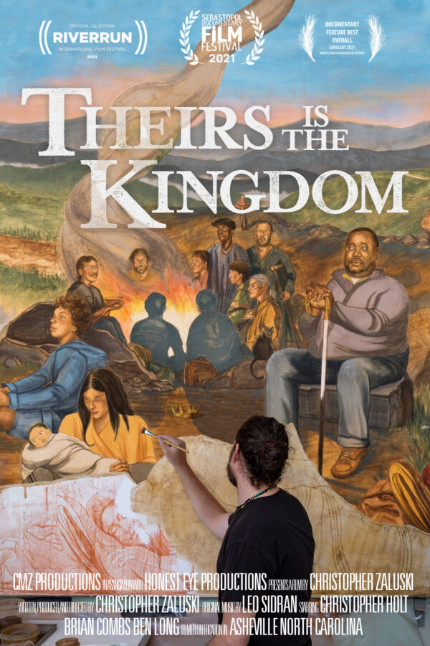
Theirs Is The Kingdom
At the intersection of poverty and portraiture, Theirs is the Kingdom follows the rare creation of a contemporary fresco mural inside the sanctuary of Haywood Street United Methodist church in Asheville, North Carolina.
A Documentary by Christopher Zaluski
Learn more about the film, and how you can host a screening at:
theirsisthekingdomfilm.com
and
haywoodstreetfresco.org
haywoodstreet.org

Slide 15
Denial Refusal to accept even in the face of scientific data

Slide 16
Anger Pointing fingers at others; at God—if God is in control why is this happening?

Slide 17
Bargaining If I do this…drive a hybrid car; use cloth bags…am I practicing climate justice?

Slide 18
Depression A sense of hopelessness in the face of systemic change

Slide 19
Acceptance Asking what change is required

Slide 20
Recognizing that we all have dirty hands when it comes to systemic injustices, such as climate change, could cause us to despair if it were not for the promise of forgiveness. And even if we are not paralyzed with inaction through despair, we can easily become overwhelmed trying to save the world. Yet it is not through our own power but through the power of the Holy Spirit that we join in the work of justice. The good news is: God has already forgiven us and is already making all thing new.
Darryl W. Stephens
Bearing Witness in the Kin-dom, p. 59

Slide 21
Consider your personal journey through the stages of grief on issues facing your community.
What are you in denial about?
What are you angry about?
What are you bargaining about?
What are you depressed about?
How has a measure of acceptance of the reality of a problem prepared and enabled you to being working towards justice?

Slide 22
JOURNALING PROMPTS
When have you witnessed injustice? What did that feel like in your body? What emotions did you experience?
In what areas of injustice have you struggled to bear witness? What would it look like for you to choose to lean in and bear witness?
Recall a time when someone witnessed a pain, struggle, or injustice you experienced. What was that experience like?
Did someone bearing witness to you and your situation
help you? How did it feel?

Slide 23
United Methodist Women Western North Carolina Conference
Bearing Witness in the Kin-dom
Study Leader: Rev. Amy Coles
Schedule:
Thursday, July 15th – 6:00pm to 8:00pm
Friday, July 16th – 6:00pm to 8:00pm
Saturday, July 17th – 10:00am to 1:00pm
Sunday, July 18th – 3:00pm to 5:00pm

