Slide 1
This session is being recorded.
United Methodist Women Western North Carolina Conference
Bearing Witness in the Kin-dom
Study Leader: Rev. Amy Coles
Schedule:
Thursday, July 15th – 6:00pm to 8:00pm
Friday, July 16th – 6:00pm to 8:00pm
Saturday, July 17th – 10:00am to 1:00pm
Sunday, July 18th – 3:00pm to 5:00pm

Slide 2
Bearing Witness in the Kin-dom
Session 2: Attentive Presence

Slide 3
Bearing witness is about my willingness to participate in what God is doing with my neighbor.
(p. 34)

Slide 4
To bear witness is to unburden our neighbors from the agony of an untold story. We are called to be present and attentive, to hear one another’s stories. And then, to care for that story as if it were our own (p. 35).

Slide 5
Philippians 2:1–4
If then there is any encouragement in Christ, any consolation from love, any sharing in the Spirit, any compassion and sympathy, make my joy complete: be of the same mind, having the same love, being in full accord and of one mind. Do nothing from selfish ambition or conceit, but in humility regard others as
better than yourselves. Let each of you look not to your own interests, but to the interests of others.

Slide 6
OMG IDK
@keegzzz
Nothing but the blood of Jesus.
@PensivePoet97
6 Word Faith Stories
Held by Love, I unlearn fear.
@revsean
I love Jesus, not his fans.
@skafuller
https://open.spotify.com/playlist/3HAQRGmc8DuL6GHEzn5T2a?si=6e1b38e8f0754605

Slide 7
ZOOM LISTENING STRATEGIES
Mute yourself when you are not speaking.
Face your screen and watch the person speaking.
Be aware of your facial expressions and the feedback that you are giving silently.
Use the digital hand-raising function and be proactive about speaking if you have something to say.
Sometimes we all freeze up when we are using
digital platforms.

Slide 8
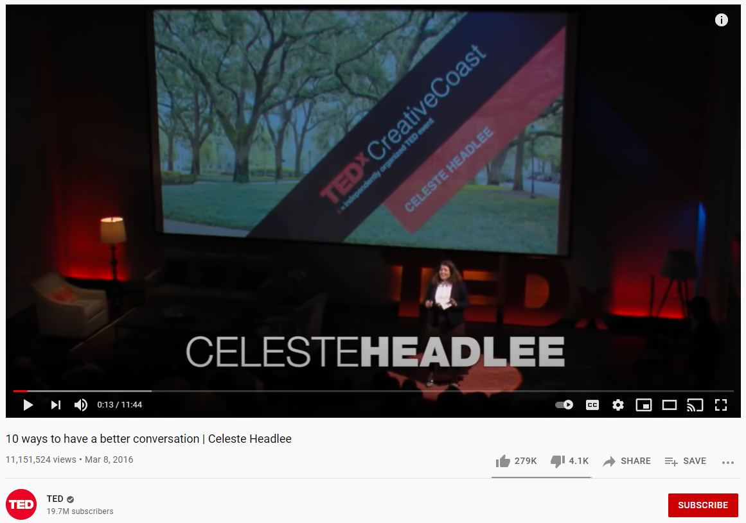
https://youtu.be/R1vskiVDwl4

Slide 9
~How did active, attentive listening affect your experience? ~What did you hear that you might have missed otherwise? ~In what ways could you incorporate attentive listening into your daily life? ~What changes might that bring about? ~What is the relationship between active
listening and empathy?

Slide 10
Perspective—Present
The perspectival moment or conscious moment for this module is the lived present. Attentive presence breaks forth from the present and helps us share past and future.

Slide 11
God’s Grace and Activity (or action or initiative)—
Justifying Grace and Our Conviction of Sin
While the Holy Spirit acts through prevenient grace before we even become aware of it, the spirit also enables us to respond. God first bestows worth by loving us and we respond through repentance and a desire to love back in return.
A parallel event happens in the church. When we are convicted of our need to love our neighbor, we then enter into a renewed
relationship with those around us.

Slide 12
Our Moral Activity—Empathy
When we practice attentive presence, we enter into relationship.
Deep connection = empathy.
Empathy is a moral activity—where we truly care for another person’s perspective, “story” and care for it as if it is our own.

Slide 13
Relational Context—Love
We cannot separate the love of God and love of neighbor—Love the Lord…. Love your neighbor. The two laws are interconnected. Jesus makes it clear that there is no way to love God without also loving those who are created in God’s
image.

Slide 14
Moral Emphasis--Basic Goods for the Most Vulnerable
To bear witness is to speak out on behalf of the neighbor for their full flourishing. We cannot stop at mercy but to do something about their suffering. To speak out against all forms of injustice.
For us to love God and neighbor, we need to consider
our neighbors need for basic goods.

Slide 15
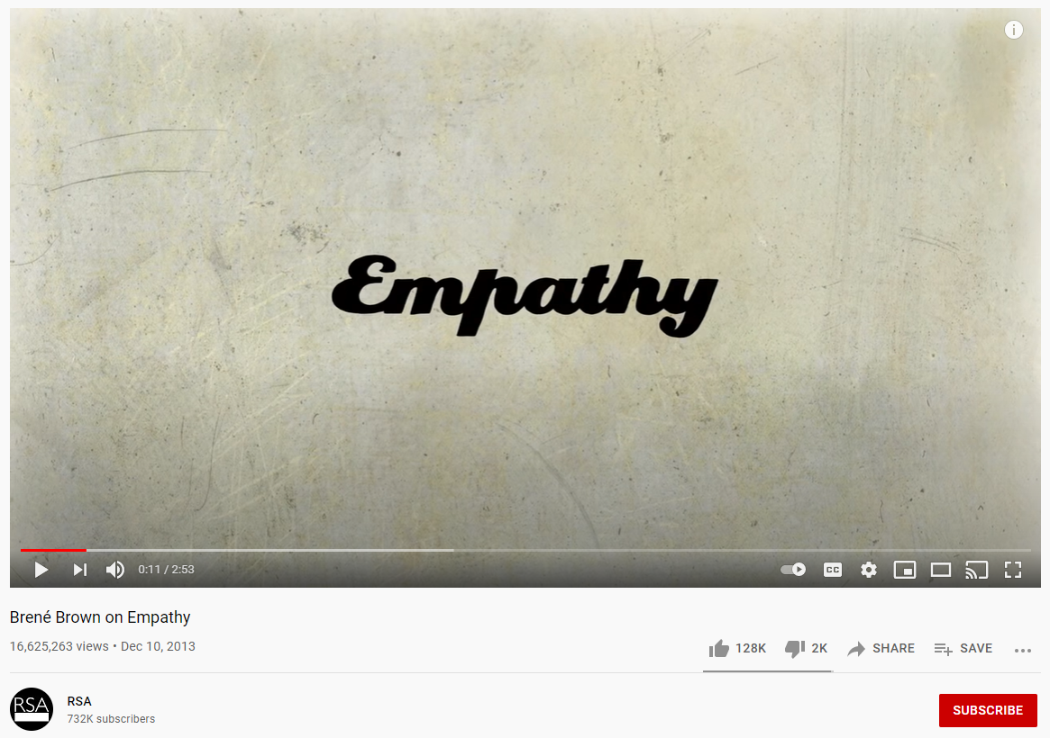
https://youtu.be/1Evwgu369Jw

Slide 16
Think/Feel
See
Hear
Say & Do

Slide 17
Pain
Gain

Slide 18
Story or Event | Actions | Witness
Exodus of the Hebrew people from Egypt (Exodus 1-15) | Plagues, escape | God bears witness to the suffering. “Let my people go” Miriam’s song
Civil Rights Struggles, 1960s
Civil Rights Struggles, 2020
Jesus Blesses Little Children (Matthew 19:13-15)
#MeToo
Struggle for Marriage Equality (2015) and LGBTQ Protections (2020)
Story or Event
Actions
Witness
God bears witness to the suffering.
Exodus of the Hebrew people
Plagues, escape
“Let my people go”
from Egypt (Exodus 1
-
15)
Miriam’s song
Civil Rights Struggles, 1960s
Civil Rights Struggles, 2020
Jesus Blesses Little Children
(Matthew 19:13
-
15)
#MeToo
Struggle for Marriage Equality
(2015) and LGBTQ Protections
(2020)

Slide 19
Empathy is not pity.
Empathy is not saviorism.
Empathy is compassion for self and others.
Empathy is the ability to share and understand feelings with others.
Empathy does not mean you understand exactly what a person is feeling.

Slide 20
JOURNALING PROMPTS
What are your obstacles to empathy?
What anxious thoughts prevent you from being fully present with others?
Why is it important to take time to be present with your neighbor before rushing to provide
answers, goods, or services?

Slide 21
United Methodist Women Western North Carolina Conference
Bearing Witness in the Kin-dom
Study Leader: Rev. Amy Coles
Schedule:
Thursday, July 15th – 6:00pm to 8:00pm
Friday, July 16th – 6:00pm to 8:00pm
Saturday, July 17th – 10:00am to 1:00pm
Sunday, July 18th – 3:00pm to 5:00pm

