Slide 1
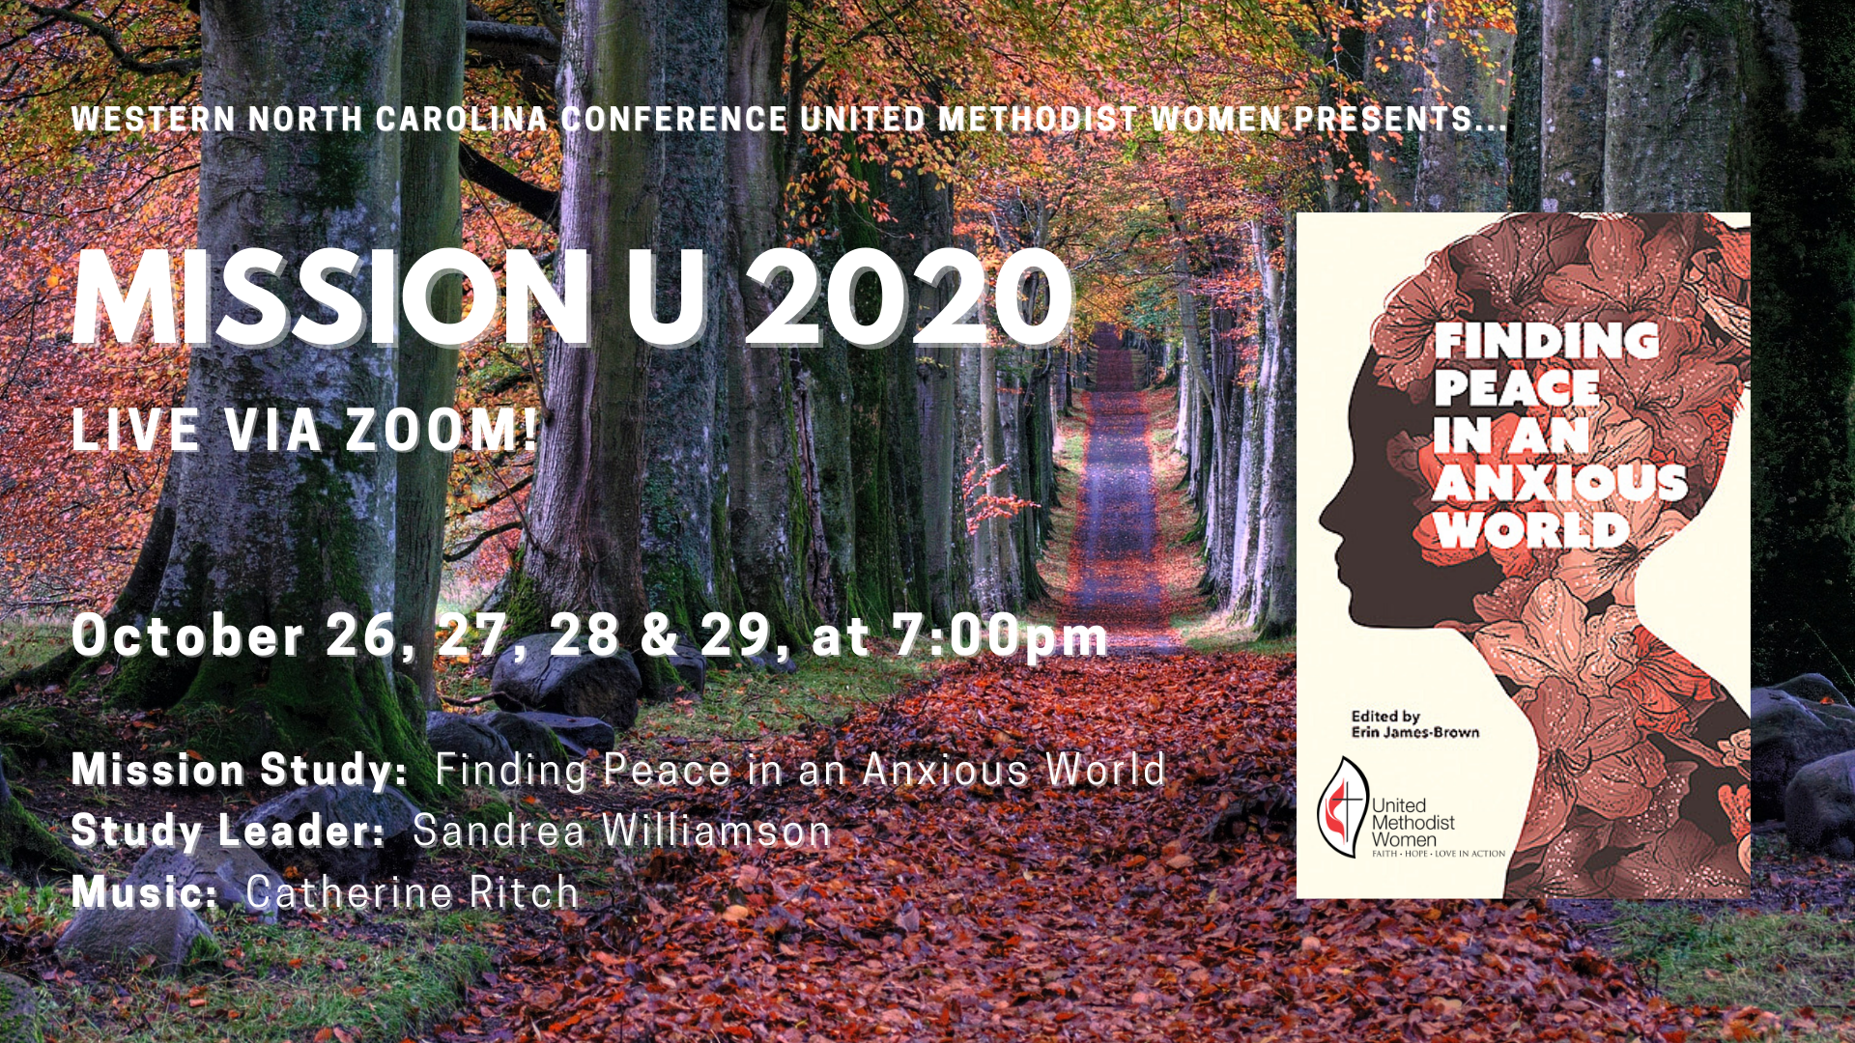

Slide 2


SESSION 3:
COURAGE
Credit: “I’m Gonna Live So God Can Use Me,” Words: African American Spiritual. arr. Wendell P. Whalum. (1932-1987) ©The Estate of Wendell Whalum. All rights reserved. Used with permission. TFWS 2153
Musician: Catherine Ritch

Slide 3

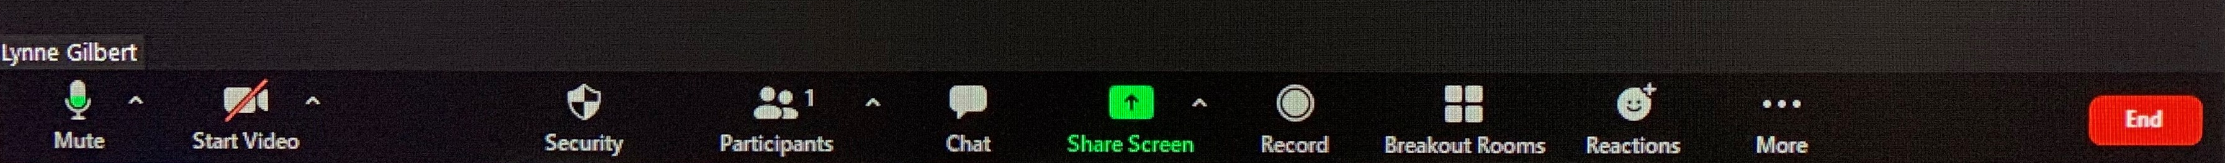

Slide 4
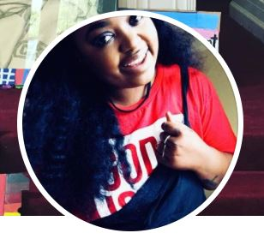

Wednesday, October 28
Natalia C. Daies
Senior Program Associate
Missionary Service
ndaies@umcmission.org

Slide 5
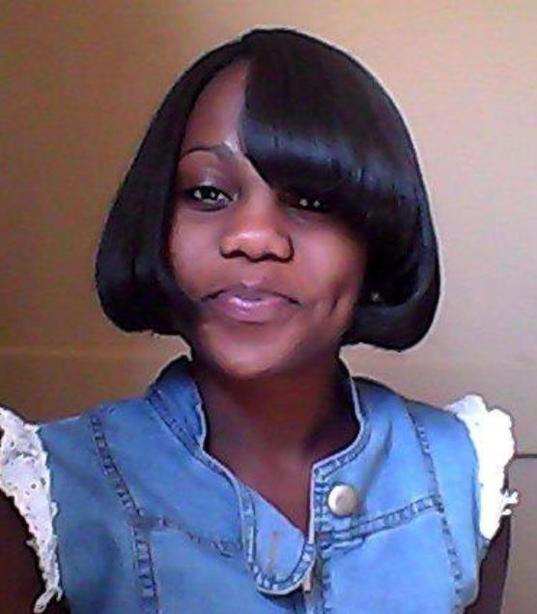
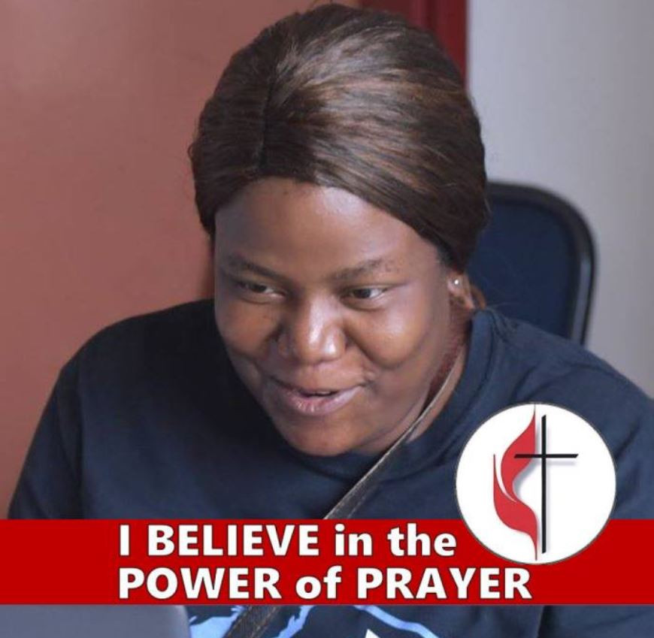
Zimbabwe UMW Scholarship Recipients
Africa University:
Moses Fisho
(Photo Unavailable)
University of Namibia
In Namibia:
Natasja Magarokosho
Women’s University
in Africa:
Patience Chapata

Slide 6
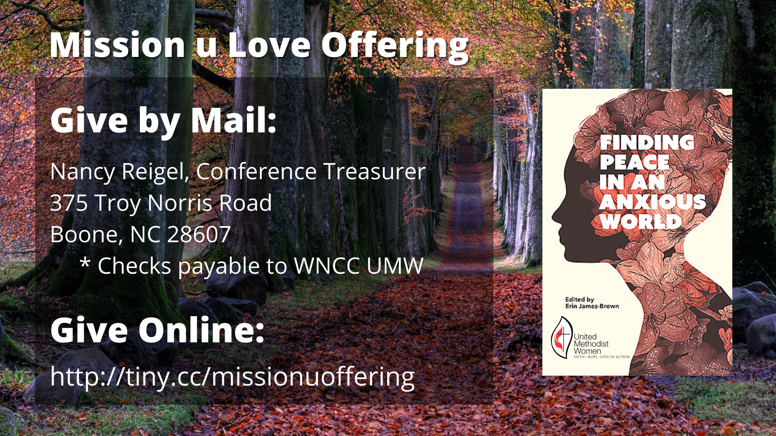
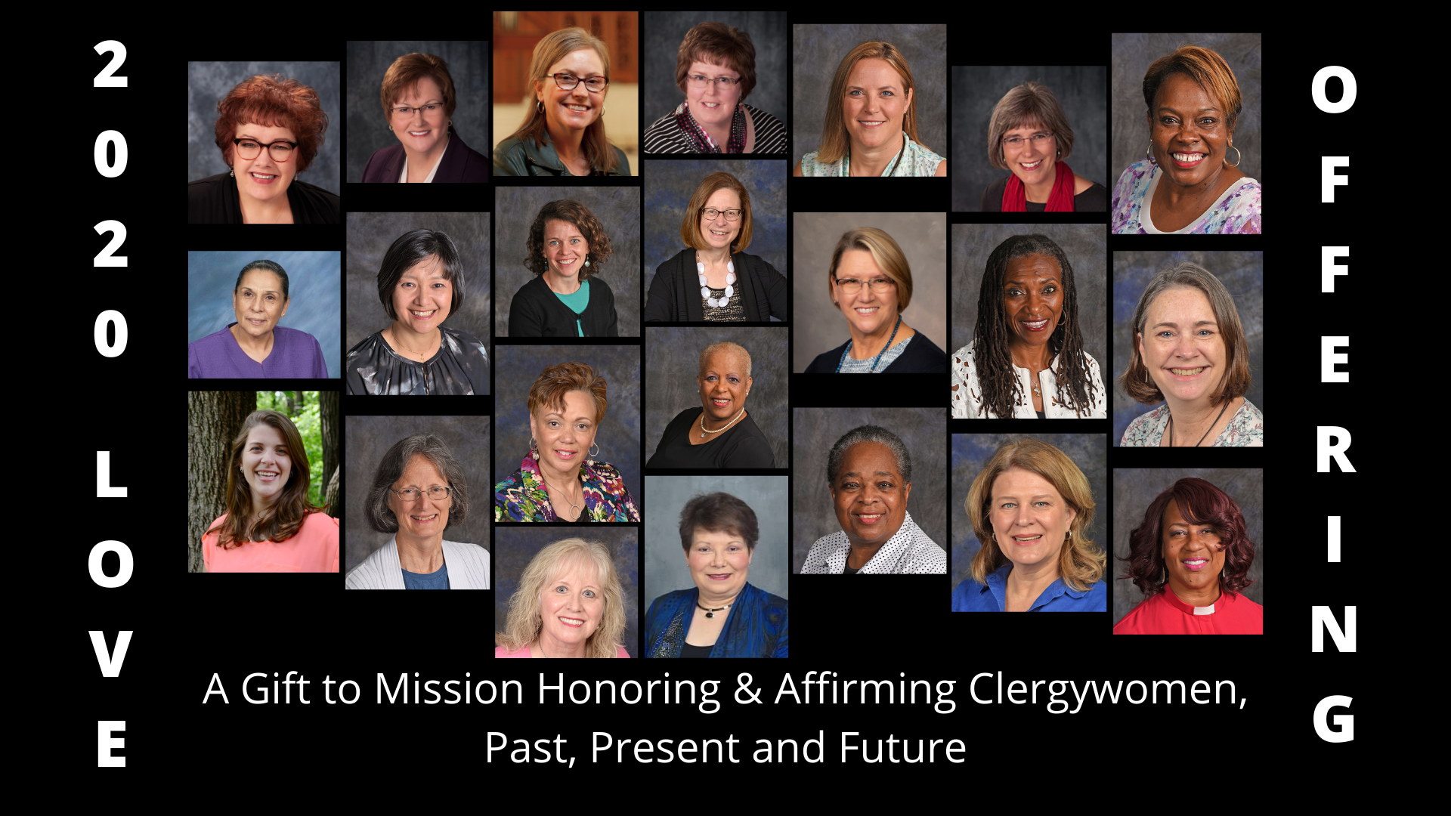
A Gift to Mission through United Methodist Women

Slide 7

Sandrea Williamson, Facilitator
Credit: This presentation was developed in close collaboration with
GLORY DHARMARAJ, Ph.D.
President, World Association For Christian Communication,
North-America
Director of Spiritual Formation & Mission Theology, (Retired) United Methodist Women
Sandrea Williamson, Facilitator

Slide 8
The Serenity Prayer
God, grant me the Serenity
To Accept the things I cannot change...
Courage to change the things I can,
And Wisdom to know the difference.

Slide 9
Session 3: COURAGE
Explore and define the idea of courage in a Christian framework
Consider what it is we need to face and where courage can be found
Reaffirm that trusting God’s power supports our incremental progress to everyday courage
Introduce calming practices
  Kataphatic Prayer
  Emotional Freedom Technique (Tapping)

Slide 10
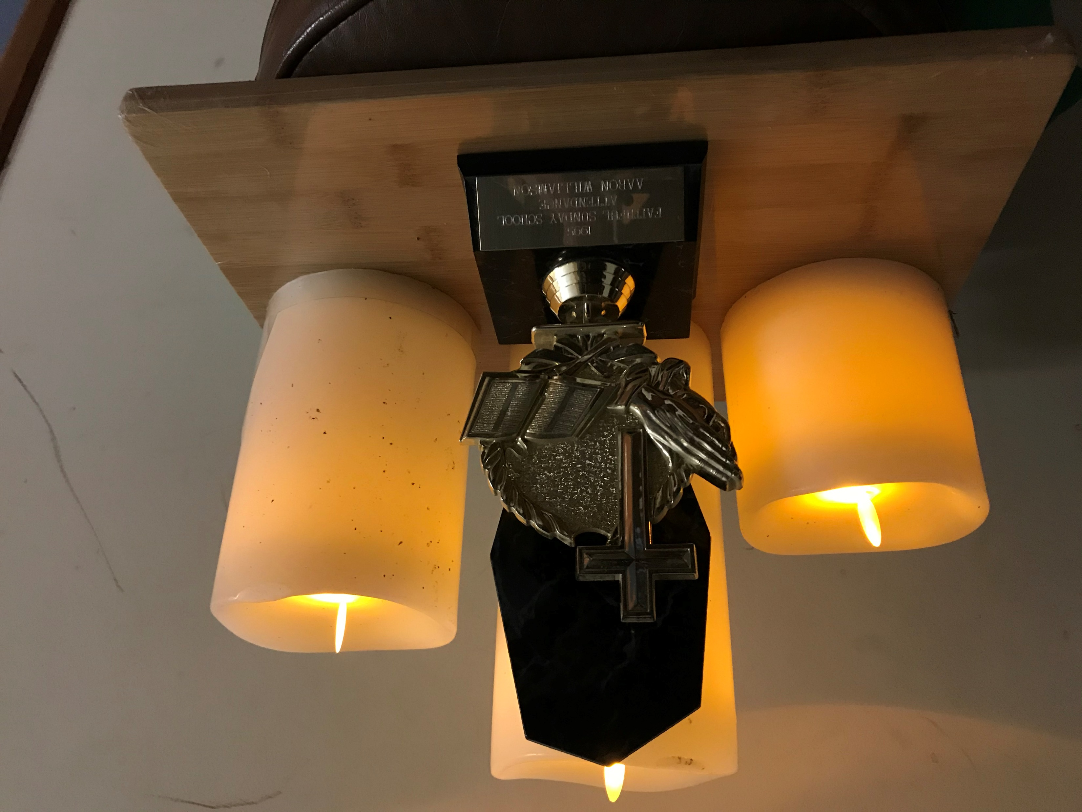

Slide 11
SESSION 3:
COURAGE
God who gives life to all, be with us today as we continue to study your wisdom. Prepare our hearts and minds to work together with each other. Give us courage as we continue to do the holy work of learning. How good it is to center down, and to spend time with you! Amen.

Slide 12
I‘m Gonna Live So God Can Use Me
1. I’m gonna live so God can use me
Anywhere, Lord, anytime.
I’m gonna live so God can use me
Anywhere, Lord, anytime!
2. I’m gonna work so God can use me…
3. I’m gonna pray so…
4. I’m gonna sing so…
Credit: “I’m Gonna Live So God Can Use Me,” Words: African American Spiritual. arr. Wendell P. Whalum. (1932-1987) ©The Estate of Wendell Whalum. All rights reserved. Used with permission. TFWS 2153
Musician: Catherine Ritch

Slide 13

JESUS IN GERASENE:
MARK 5
COURAGE
PROVERBS 4: 20-27
Image: commons.wikimedia.org/wiki/File:Möbius_strip.jpg; Content: Glory Dharmaraj

Slide 14
PROVERBS 4:20-22
²⁰ My child, be attentive to my words;
incline your ear to my sayings.
²¹ Do not let them escape from your sight;
keep them within your heart.
²² For they are life to those who find them,
and healing to all their flesh.

Slide 15
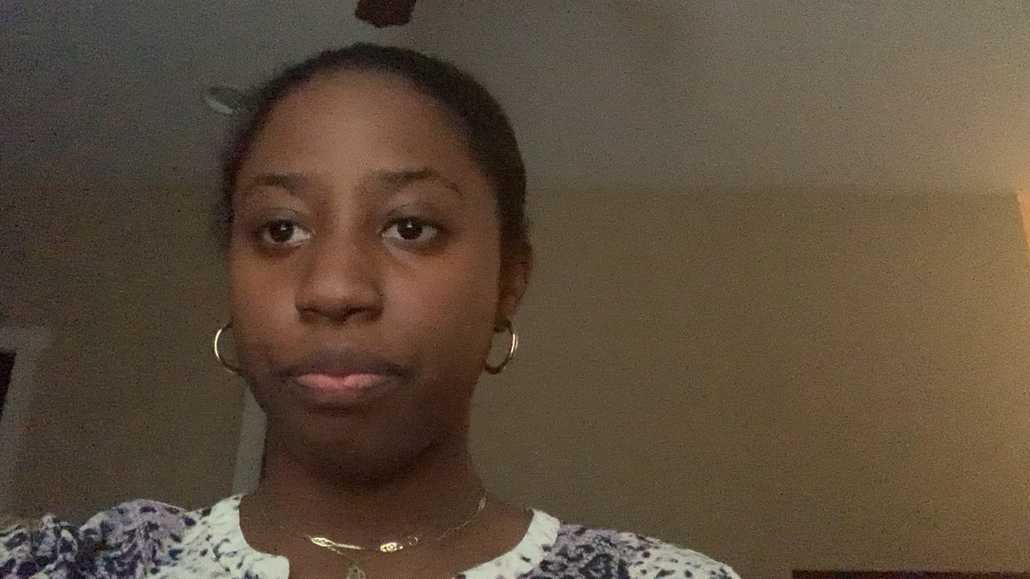
Scripture Reading: Proverbs 4:20-22
Reader: Erin Dickey

Slide 16
Explore and Define Courage
Consider the movie Inside Out. What would an anxiety cartoon character look like? What would a courage character look like? Are they opposites?
What is Courage to you?
When have you seen courage in action?

Slide 17
Matthew 14:22-29
²² Immediately he made the disciples get into the boat and go on ahead to the other side, while he dismissed the crowds. ²³ And after he had dismissed the crowds, he went up the mountain by himself to pray. When evening came, he was there alone, ²⁴ but by this time the boat, battered by the waves, was far from the land,^{[a]} for the wind was against them. ²⁵ And early in the morning he came walking toward them on the sea. ²⁶ But when the disciples saw him walking on the sea, they were terrified, saying, “It is a ghost!” And they cried out in fear. ²⁷ But immediately Jesus spoke to them and said, “Take heart, it is I; do not be afraid.”
²⁸ Peter answered him, “Lord, if it is you, command me to come to you on the water.” ²⁹ He said, “Come.” So Peter got out of the boat, started walking on the water, and came toward Jesus.

Slide 18
Courage in the Bible
Matthew 14:22-29 gives us a view of courage.
What does this story tell us about courage?
How does this story in Matthew 14 connect with the instruction of Proverbs 4:20-22?
Other examples of courage in the Bible?
Discuss your answers in your breakout groups for about 10 minutes.

Slide 19
Vulnerability and Courage
The Dance of Connections by Harriett Lerner
    Overfunctioners
    Underfunctioners
Courage as a necessary part of growth
    Brene Brown’s TED Talk, “The Power of Vulnerability”
    Brene Brown’s book, The Gift of Imperfection
    Consider the concepts of everyday heroism and ordinary courage (p. 52)

Slide 20
Exploring Christian Courage
“Ordinary courage takes daily practicing of trust, discernment, and resting in God.” (p. 54)
  Embed God’s words in your soul: Proverbs 4:20-21
  Find a scriptural phrase that can clear your mind and listen to God’s guidance: Proverbs 4:22
  Use a Proverb or other scripture to replace your anxiety: Proverb 4:23
  Guard our hearts and mouths: Proverbs 4:24

Slide 21
Exploring Christian Courage (continued)
“Ordinary courage takes daily practicing of trust, discernment, and resting in God.” (p. 54)
  Keep your eyes focused on the cross (Jesus): Proverbs 4:25
  Keep things straight and right in front of you: Proverbs 4:26-27
  Keep things simple: simply have the courage to move ahead, perhaps taking small steps at a time
  Remember the courage of Jesus: Mark 5

Slide 22
Transformative
Spirituality:
Accruing Christian Praxis as a resource for daily walk
Being present to our experiences
Acting on our newly gained insights from reflection
In conversation with the Jesus of the Gospel & wisdom of the Proverbs
Asking questions that apply to our situation
Concept: “A Theological Spiral of Action/Reflection” originated from National Assembly of Women Religious, USA, 1984. Updated by Letty M. Russell and J.S. Clarkson, Yale Divinity School, 1994. Image: Rashida Craddock; Content: Glory Dharmaraj

Slide 23
Christian Courage (continued)
Why do we need courage?
What is God calling us to have the courage to face?
How do we, like Peter, find the courage to “follow Jesus onto the water?”

Slide 24
Spiritual Practice: The Kataphatic Prayer
“This spiritual practice uses words, images, and songs to speak of God.” (p. 66)
It may be unfamiliar to most.
It focuses on positive association of what God is.
Challenge yourself to explore language as a tool.
“…ask questions, consider new possibilities, and rest in the image for a period of time ….” (p. 67)

Slide 25
Kataphatic Prayer (continued)
Name for God (i.e.: God, Lord, Mother, Creator)
  Silently picture God in relation to that word.
  Repeat that word silently in your head.
God is.. Take a minute to consider how God is like ….
God is not…: Take another minute to consider how God is not like…
God is NOT not…: Finish up by thinking of ways that God is NOT not like the image you have chosen. This double negative can help us connect with both the simplicity and complexity of our images of God.

Slide 26
Calming Practice: Emotional Freedom Technique (EFT or Tapping)
This is “a tool to help us overcome negative emotions and thought patterns and replace them with healing thoughts and healthy emotions.” (Managing Emotions: A Youth Study by Trudy Rankin and Faye Wilson, p. 28)
Taps on what are called acupressure or meridian points
Jessica Ortner’s Youtube video introduction to tapping:
Youtube.com/watch?v=pAclBdj20ZU

Slide 27
EFT or Tapping
(continued)
Use 9 tapping points for this exercise. (There are different variations of this practice.)
  side of the hand, forehead, side of the eye,
  under the eye, under the nose, top of chin,
  collarbone, under the arm, and on the top of the head.
Choose one affirming phrase to use throughout (“I’m a child of God,” “I am capable,” etc.).
Complete the tapping exercise.

Slide 28
Closing Prayer
God of many names, we are grateful for this time we spent together. Give us the courage of Peter, to follow where you say “come.” And grant us serenity, acceptance, and wisdom as we move through the world and act for justice. We pray in the name of Jesus Christ. Amen.

Slide 29
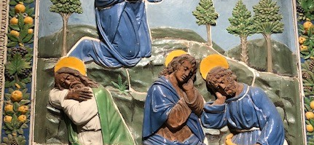
I‘m Gonna Live So God Can Use Me
1. I’m gonna live so God can use me
Anywhere, Lord, anytime.
I’m gonna live so God can use me
Anywhere, Lord, anytime!
2. I’m gonna work so God can use me…
3. I’m gonna pray so…
4. I’m gonna sing so…
Credit: “I’m Gonna Live So God Can Use Me,” Words: African American Spiritual. arr. Wendell P. Whalum. (1932-1987) ©The Estate of Wendell Whalum. All rights reserved. Used with permission. TFWS 2153
Musician: Catherine Ritch

