Slide 1


Slide 2


SESSION 2:
ACCEPTANCE
“It Is Well with My Soul,” The United Methodist Hymnal, no. 377
Credit: Words by Horatio G. Spafford, 1873. Music by Philip P. Bliss, 1876. Public domain.
Musician: Catherine Ritch

Slide 3

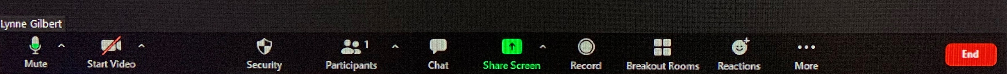

Slide 4
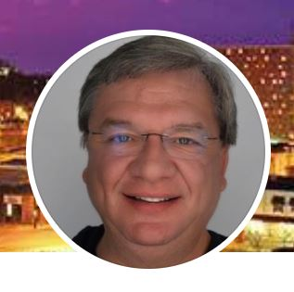

Tuesday, October 27
Rev. James Williams
Serving in
Wilmore, Kentucky
revjamiew@gmail.com

Slide 5
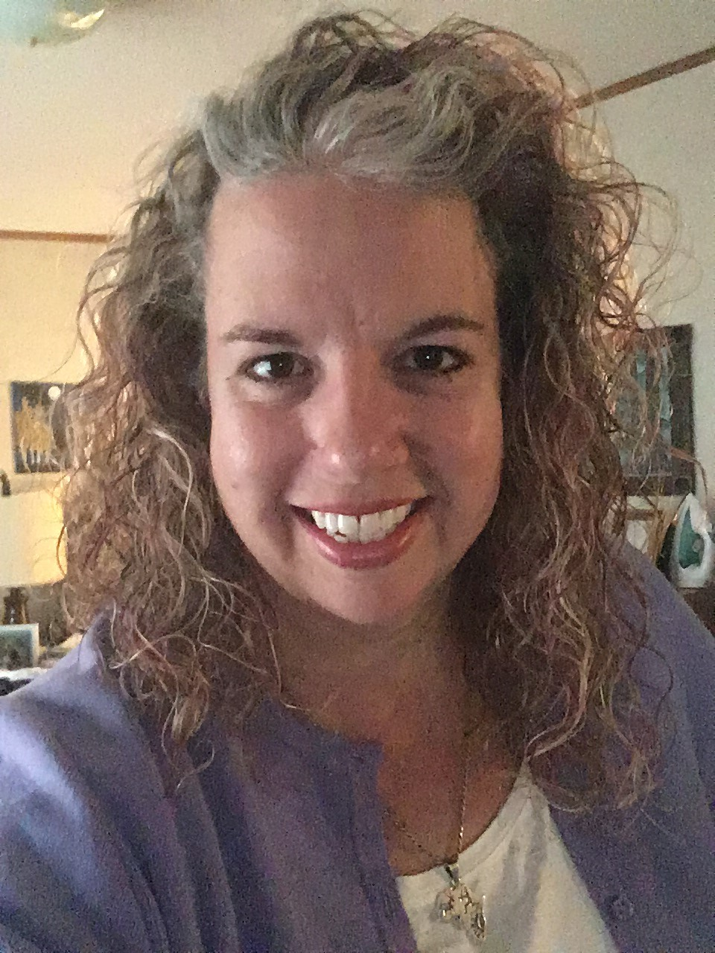
Tuesday, October 27
Tammie Boykin
Volunteer Service Manager
UMCOR- Sager Brown
tboykin@umcmission.org
“I have worked as Volunteer Services Manager at UMCOR Sager Brown in Baldwin Louisiana
since July 2016. I am responsible for booking teams who volunteer at our site as well as
making sure that all of their accommodations are ready for their arrival I also make sure during
their volunteer week that they receive all the announcements that they need and assist them in their stay.”

Slide 6
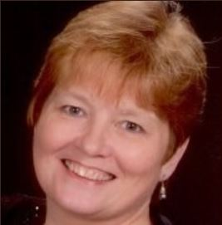
Tuesday, October 27
Elaine S. Swartz
Senior Program Associate
Fund Development
Mission Engagement
eswartz@umcmission.org
“My job is to interact with donors to Global Ministries and UMCOR to answer
any questions and assist with donations”.

Slide 7
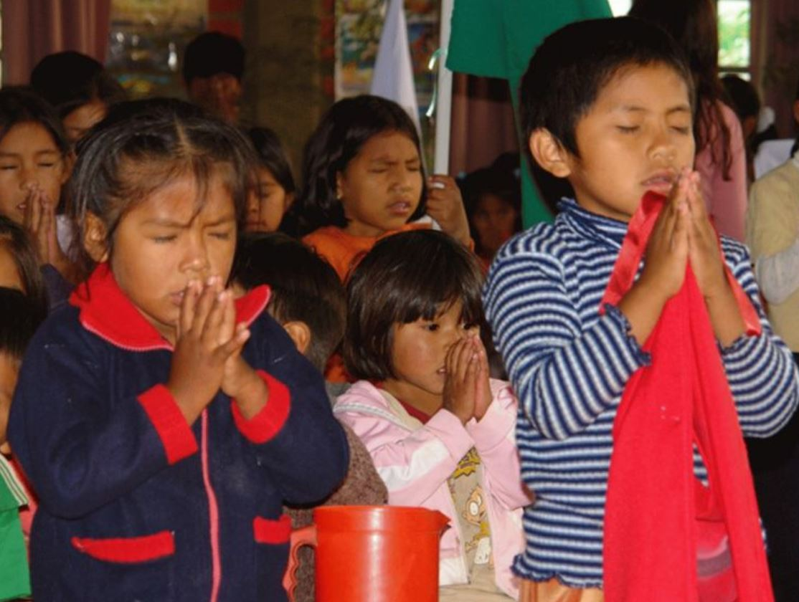
Bolivia
National Christian
Formation
and Children’s Ministry
Creating and Publishing contextualized
Bolivian Methodist children’s Sunday School curriculum

Slide 8
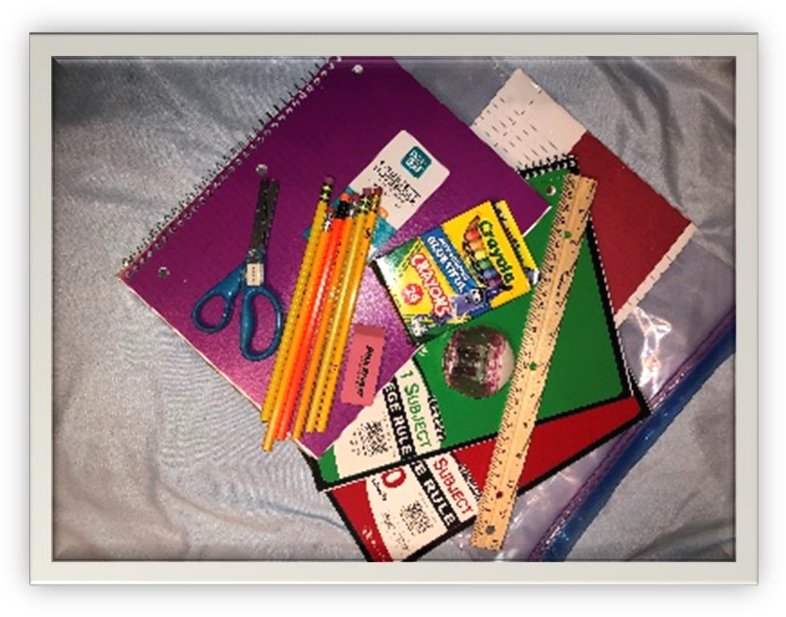
UMCOR School Kits Are Still Needed
For more information contact Linda Greer jacklindagreer@bellsouth.net

Slide 9

Sandrea Williamson, Facilitator
Credit: This presentation was developed in close collaboration with
GLORY DHARMARAJ, Ph.D.
President, World Association For Christian Communication,
North-America
Director of Spiritual Formation & Mission Theology, (Retired) United Methodist Women
Sandrea Williamson, Facilitator

Slide 10
The Serenity Prayer
God, grant me the Serenity
To Accept the things I cannot change...
Courage to change the things I can,
And Wisdom to know the difference.

Slide 11
Session 2: ACCEPTANCE
Explore acceptance as a way to peace
Consider that acceptance comes from a profound sense of trust in God’s ability to work for good
Reaffirm that trusting God’s power prevents anxiety from wielding control over your life
Introduce calming practices
  The Welcoming Prayer
  Corporate singing as a form of spiritual discipline

Slide 12
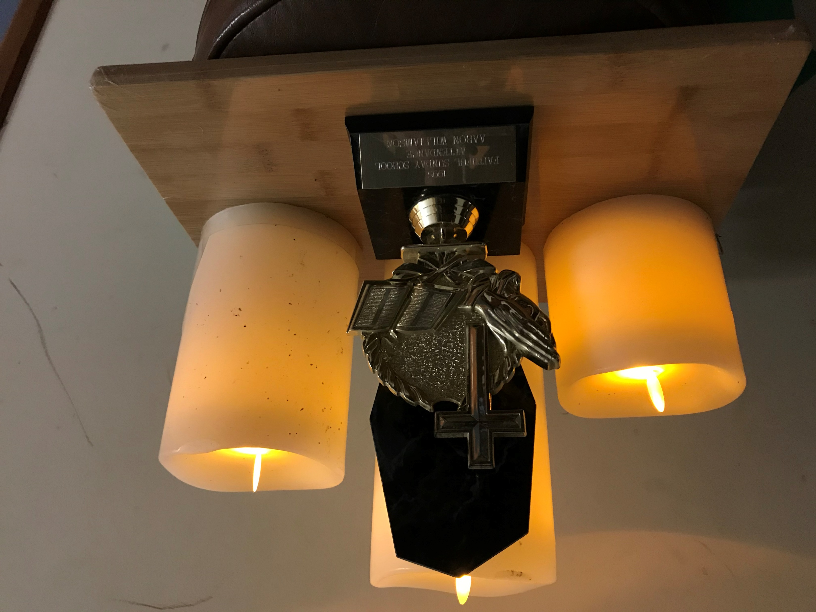

Slide 13
SESSION 2:
ACCEPTANCE
Constant God, you who never change, morning through night, season upon season, from time before and after, help us who are always being called to be transformed and become more like you. Help us to be infused with your light so that we can be points of light in and for this this world. Amen.
(“Called to Be Transformed in God’s Likeness,” by Ruth Willis of the Rocky Mountain Conference UMW, United Methodist Women Bible, 18)

Slide 14
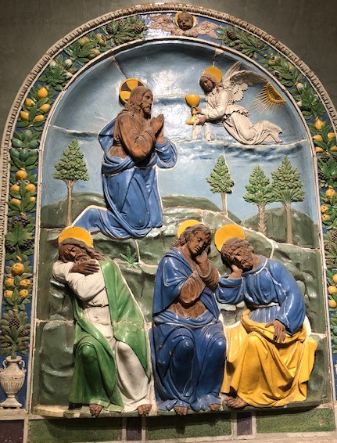
“It Is Well with My Soul,” The United Methodist Hymnal, no. 377
Credit: Words by Horatio G. Spafford, 1873. Music by Philip P. Bliss, 1876. Public domain
Musician: Catherine Ritch
It is Well With My Soul
1. When peace like a river
Attendeth my way
When sorrows like sea billows role,
Whatever my lot,
Thou has taught me to say
It is well, it is well with my soul.
Chorus:
It is well, (it is well)
With my soul (with my soul);
It is well, it is well with my soul!
2. Though Satan should buffet,
Though trials should come,
Let this blessed assurance control:
That Christ has regarded
My helpless estate
And hath shed his own blood
For my soul,
Chorus
3. My sin, o the bliss
Of this glorious thought!
My sin, not in part but the whole,
Is nailed to the cross
And I bear it no more,
Praise the Lord, Praise the Lord,
O My soul!
Chorus:
4. And Lord, haste the day
When my faith shall be sight,
The clouds be rolled back as a scroll;
The trump shall resound
And the Lord shall descend.
Even so, it is well with my soul.
Chorus
Image: Glory Dharmaraj

Slide 15

Mobius Strip Movement: Back-and-forth reading act
JESUS, GOD’S SHALOM
ACCEPTANCE
ABUNDANT WELFARE: PROVERBS 3: 3-8
Image: commons.wikimedia.org/wiki/File:Möbius_strip.jpg; Content: Glory Dharmaraj

Slide 16
PROVERBS 3:3-8
Do not let loyalty and faithfulness forsake you;
bind them around your neck,
write them on the tablet of your heart.
⁴ So you will find favor and good repute
in the sight of God and of people.
⁵ Trust in the Lord with all your heart,
and do not rely on your own insight.
⁶ In all your ways acknowledge him,
and he will make straight your paths.
⁷ Do not be wise in your own eyes;
fear the Lord, and turn away from evil.
⁸ It will be a healing for your flesh
and a refreshment for your body.

Slide 17
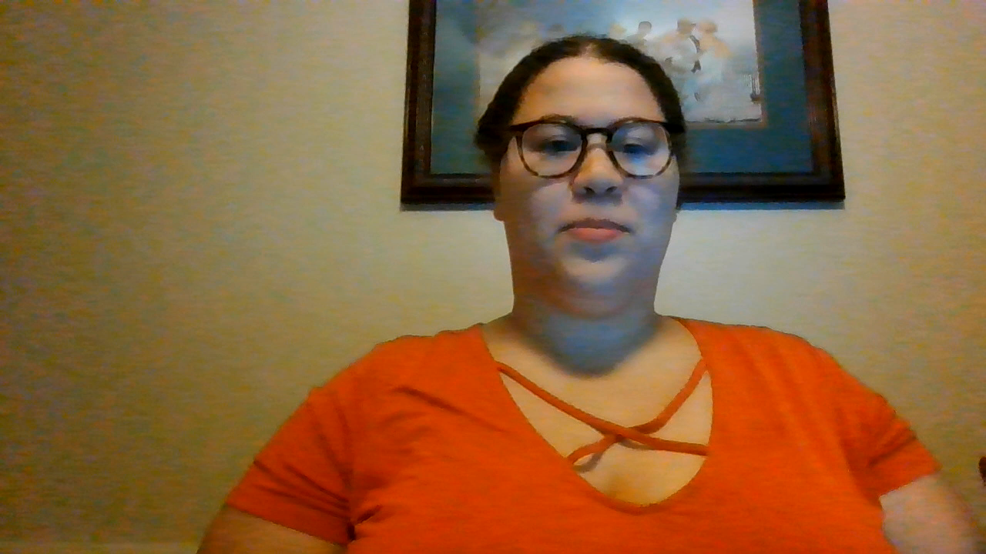
Scripture Reading: Proverbs 3:3-8
Reader: Sydney Alexander

Slide 18
“Written on the Tablet of Your Heart”
Reflect on what you just read or heard in Proverbs 3:3-8.
This verse reminds us of the Shema, Deuteronomy 6:4-9, where the Hebrews were told to “Keep these words…in your heart. Recite them to your children….”
Do you have any part of Proverbs 3:3-8 “written on your heart?” If so, what is it, and why? (Silent reflection)
Share your reflection with others in your breakout groups for about 8 minutes.

Slide 19
What is Acceptance?
Acknowledging that there are things we cannot change!
Allows us to see ourselves, others and the world as they really are, not as we wish they were
“The Gift of Imperfection” by Brené Brown
Accepting Our Limitations: Learning to Trust God

Slide 20
What is Acceptance?
Understanding some new concepts
  Social Location: The groups people belong to because of their place or position in history and society.
  Intersectional Vulnerabilities: different identities, needs, priorities and capacities we have, which are not always static, and which can shift and change over time
  Trauma-Informed Jesus: God Incarnate was fully divine and yet suffered human trauma

Slide 21
Class
Race
Gender
INTERSECTIONAL VULNERABILITIES
Age
INTERSECTIONALITY
Ethnicity
Ability
Sexuality
Image: Rashida Craddock; Content: Glory Dharmaraj

Slide 22
Acceptance
(continued)
Consider the following questions:
  Each breakout group will be given a quote to discuss about acceptance.
  What does this quote say to you?
  Do you agree or disagree with the premise? Why or why not?
Discuss your quote in your breakout groups for about 10 minutes.

Slide 23
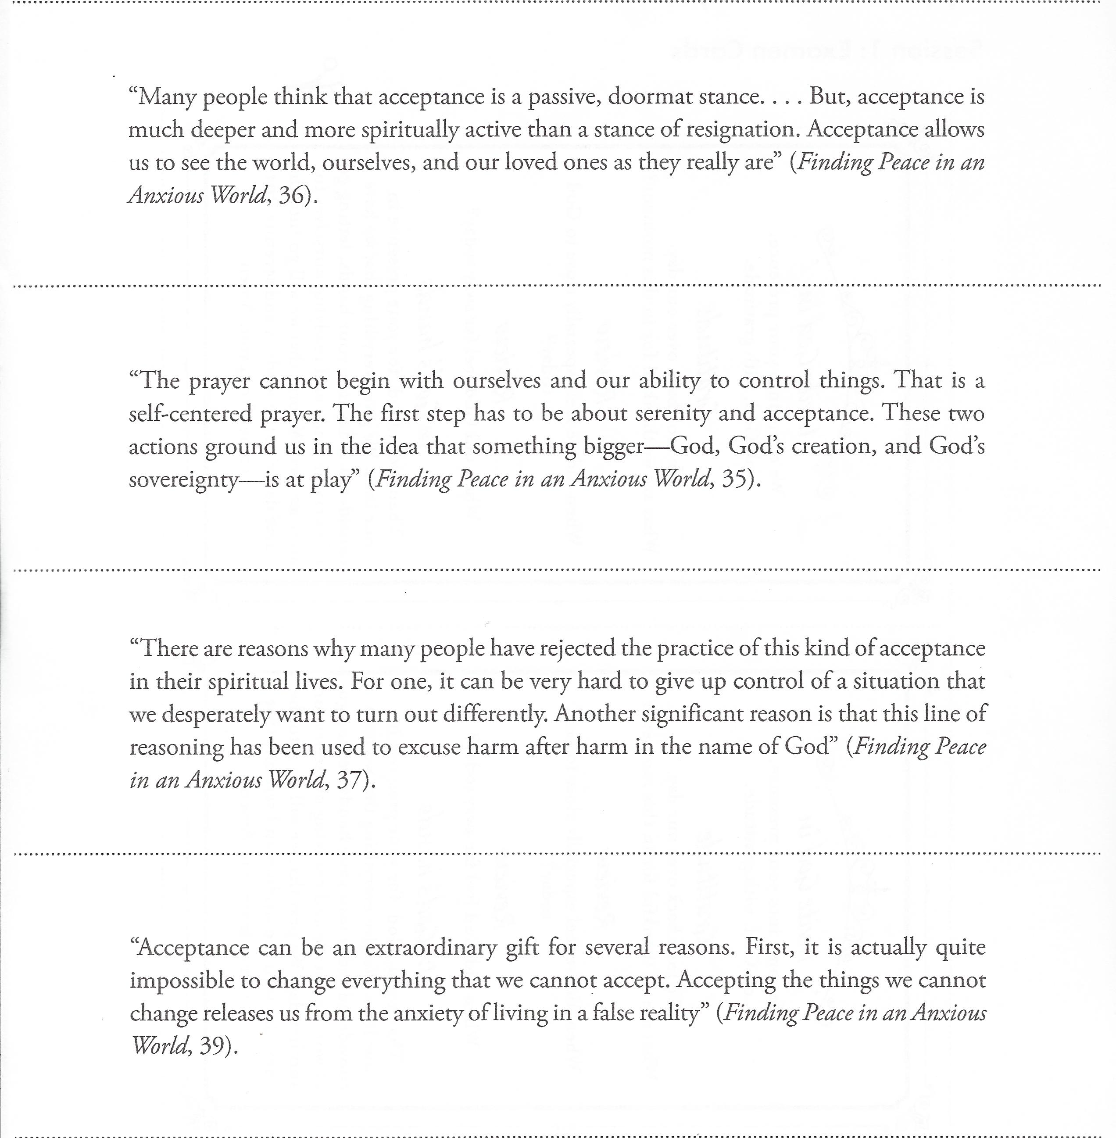

Slide 24
What is Christian acceptance?
Mark 14:32-36
³² They went to a place called Gethsemane, and Jesus said to his disciples, “Sit here while I pray.” ³³ He took Peter, James and John along with him, and he began to be deeply distressed and troubled. ³⁴ “My soul is overwhelmed with sorrow to the point of death,” he said to them. “Stay here and keep watch.”
³⁵ Going a little farther, he fell to the ground and prayed that if possible the hour might pass from him. ³⁶ “Abba,^{[f]} Father,” he said, “everything is possible for you. Take this cup from me. Yet not what I will, but what you will.”
Image: Glory Dharmaraj

Slide 25
The Christian Way of Acceptance
Takes the burden off us and frees us for new possibilities
Removes the opportunity for us to make things worse!
Is not easy!
  Can reveal tender (painful) places in our minds and souls
  Calls for us to turn to God, not rely on our own understanding
  Calls for really discerning things we can’t change, and things we should
Quote from Ajahn Chah
  “…If you let go completely, you will have complete peace.”

Slide 26
Accepting Our Limitations: Trusting God
We are not the center of the universe! Only God is the center.
Accepting our limits allows us to rest in God who holds all things
When we unclench our fists, we release our anxiety
We transform our relationships when we accept others as they are, rather than as we wish they were.
Allows us to reorder our priorities; move from contemplation to action
Allows us to see God’s miraculous creation and to live peacefully in it

Slide 27
Spiritual Practice: The Welcoming Prayer
“This is the spiritual practice of welcoming the now, whatever it may be, so that our heart will be more attentive and more able to accept whatever comes into our lives on this journey we are on with God.” (p. 46)
It can be practiced anywhere, anytime, anyplace
See if you can find and accept God’s presence in all things.
See how it changes your life.
Follow 3 steps to center one’s emotional and prayer life

Slide 28
The Welcoming Prayer
(continued)
1. Focus, feel, sink in.
Become aware of what is happening in your body and soul. Sink in to truly allow and accept what you are feeling and experiencing, without judgement or attempting to change it. Notice deeply, and with God.

Slide 29
The Welcoming Prayer
(continued)
2. Welcome and Name
Whatever you find, welcome it with words spoken or unspoken, even it’s something you find challenging. “Welcome fear” or “Welcome pain” or “Welcome confusion” would all be fitting words of welcome. Fit it to whatever truth you are experiencing at the moment.

Slide 30
The Welcoming Prayer
(continued)
3. Let Go and Let God
Once you have felt, welcomed and named the experience you are having, begin to release it in whatever ways possible. Release yourself physically and emotionally. It can also help to use words of release to ease yourself out of the prayer experience. Some recommendations include, “I let go of the desire for security, affection, control,” and “I let go of the desire to change what I am experiencing.”

Slide 31
Spiritual Practice: Corporate Singing
This is so familiar we may not see it as a spiritual practice.
It provides us a physical activity to refocus our minds away from our anxiety, while also affirming an uplifting gospel or spiritual message.
It allows us a comforting sense of community.

Slide 32
Closing Prayer
Eternal God, grant peace us peace in this anxious world. May we trust in you with all of our hearts, and may you bring us insight and refreshment. Help us to practice Christian acceptance of the things we cannot change, and give us the courage to take action when we are called to act. Your ways are ways of righteousness, justice and equity. We pray in the name of Jesus Christ. Amen.

Slide 33
I’VE GOT PEACE LIKE A RIVER
1. I’ve got peace like a river,
I’ve got peace like a river,
I’ve got peace like a river in my soul.
I’ve got peace like a river,
I’ve got peace like a river,
I’ve got peace like a river in my soul.
2. I’ve got joy like a fountain….
3. I’ve got love like an ocean….
“I’ve Got Peace Like a River,” The Faith We Sing, no. 2145
Credit:. Words: African American Spiritual; Music African American Spiritual,©2000 Abingdon Press. All rights reserved. Used with permission. CCLI #11221925
Musician: Catherine Ritch

