Slide 1


Slide 2


“In The Garden,” United Methodist Hymnal no. 314 Credit: Words by C. Austin Miles, 1913. Music by C. Austin Miles, 1913; adapt by Charles H. Webb, 1987. © 1989 The United Methodist Publishing House, Used by permission
Musician: Catherine Ritch

Slide 3

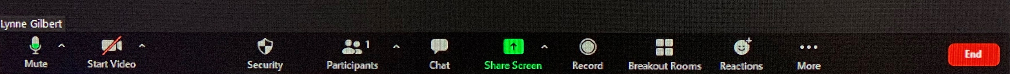

Slide 4
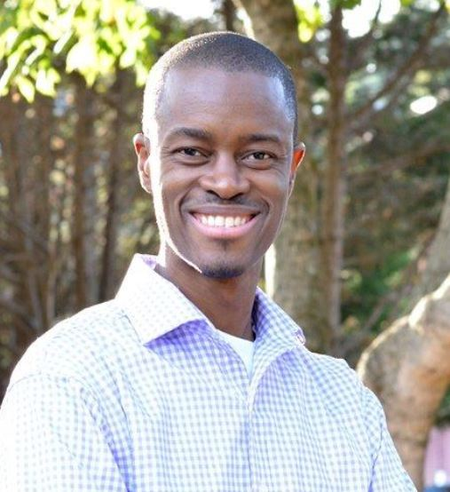

Ibrahim Dabo
Monday, October 26
Enterprise Business Systems Finance and Administration
idabo@umcmission.org

Slide 5

Switzerland
World Council of Churches
Building gender justice between men and
women through regional gender trainings

Slide 6


BASIC TEXT IN KOREAN AND SPANISH

Slide 7


TEXTS FOR CHILDREN AND YOUTH

Slide 8

Sandrea Williamson, Facilitator
Credit: This presentation was developed in close collaboration with
GLORY DHARMARAJ, Ph.D.
President, World Association For Christian Communication,
North-America
Director of Spiritual Formation & Mission Theology, (Retired) United Methodist Women
Sandrea Williamson, Facilitator

Slide 9
PURPOSE AND GOALS
To recognize and acknowledge the prevalence of anxiety today and its impact
To explore ways to find peace through scriptural and spiritual disciplines
To increase our “rootedness” in God: Proverbs and the Gospel
To consider ways one can practice peace as a way of life
To energize us to live fully as disciples of Jesus Christ

Slide 10
The Serenity Prayer
God, grant me the Serenity
To Accept the things I cannot change...
Courage to change the things I can,
And Wisdom to know the difference.

Slide 11

Mobius Strip Movement: Back-and-forth reading act, from the Gospel stories around Jesus on one side, to the Book of Proverbs on the other side
JESUS OF THE GOSPEL
SERENITY PRAYER
PROVERBS
Image: commons.wikimedia.org/wiki/File:Möbius_strip.jpg; Content: Glory Dharmaraj

Slide 12
PRAXIS AS THE MAKE UP OF THE THEOLOGY OF EVERYDAY LIFE
SERENITY PRAYER
WISDOM FROM THE PROVERBS
IN LIGHT OF THE JESUS OF THE GOSPEL
EVERYDAY LIVED EXPERIENCE

Slide 13
CLASS COVENANT
LISTEN: Focus on truly hearing what is being said rather than immediately forming a response
SHARE: Thoughtfully join in the conversation, but don’t dominate it. And even though you may be a quiet person, share your thoughts; it may help someone else.
RESPECT: Everyone’s voice is important, even if you disagree.
CONFIDENTIALITY: Keep what is shared in confidence, unless given specific permission to share

Slide 14
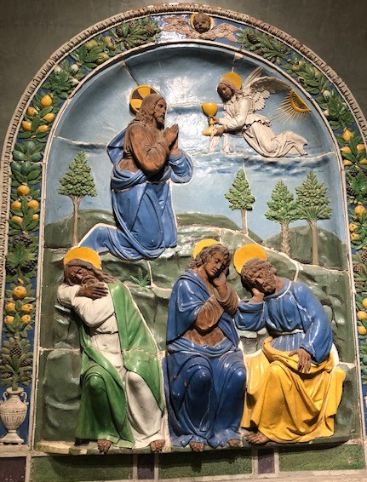
“In The Garden,” United Methodist Hymnal no. 314 Credit: Words by C. Austin Miles, 1913. Music by C. Austin Miles, 1913; adapt by Charles H. Webb, 1987. ©1989 United Methodist Publishing House. All rights reserved. Used with permission. CCLI #11221925
Musician: Catherine Ritch
In The Garden
1. I come to the garden alone
While the dew is still on the roses,
And the voice I hear
Falling on my ear
The Son of God discloses.
Chorus:
And He walks with me,
And He talks with me,
And He tells me I am his own;
And the joy we share
As we tarry there,
None other has ever known.
2. He speaks and the sound
Of His voice
Is so sweet the birds hush their singing,
And the melody
That He gave to me
Within my heart is ringing.
Chorus:
And He walks with me,
And He talks with me,
And He tells me I am his own;
And the joy we share
As we tarry there,
None other has ever known.
3. I’d stay in the Garden with Him
Though the night around me be falling,
But He bids me go;
Through the voice of woe,
His voice to me is calling.
Chorus:
And He walks with me….
Image: Glory Dharmaraj

Slide 15
Session 1: SERENITY
Review Proverbs as an instructional tool to increase serenity in life
Explore how prayer interrupts anxiety and leads to further intimacy with God
Introduce calming practices
  the Breath Prayer
    Increase serenity by breath control
    Focus on a calming word or phrase
  The Examen
  Review of events with intention and gratitude
  Increase awareness of God’s presence in daily life

Slide 16
So what is SERENITY?
Meriam-Webster: “the quality or state of being serene”
Oxford Dictionary: “the state of being calm, peaceful, and untroubled”
Our text:
  “Serenity is a state that knows no disturbance, brooks no intrusion, and offers a deep oneness with both oneself and the creation of the universe…As God’s peace, ‘which passes all understanding,’ serenity is something most of us have experienced for at least a moment or two somewhere along the way.” (p. 17)

Slide 17
PROVERBS 3:13-18
Blessed are those who find wisdom,
those who gain understanding,
¹⁴ for she is more profitable than silver
and yields better returns than gold.
¹⁵ She is more precious than rubies;
nothing you desire can compare with her.
¹⁶ Long life is in her right hand;
in her left hand are riches and honor.
¹⁷ Her ways are pleasant ways,
and all her paths are peace.
¹⁸ She is a tree of life to those who take hold of her;
those who hold her fast will be blessed.

Slide 18
FOR REFLECTION
Throughout Proverbs, Wisdom (hokma in Hebrew and sofia in Greek) is personified as a woman. She “cries out in the street” (Proverbs 1:20) and says “hear, for I will speak noble things” (Proverbs 8:6). In Proverbs 8, Wisdom tells the reader that she was created “at the first, before the beginning of the earth” (verse 23) and that she was present with the Lord at creation: “I was beside him, like a master worker, and I was daily his delight” (verse 30). How does this Biblical characterization help you to think about what it means to have wisdom?
Discuss the question above in your breakout groups for about 8 minutes.

Slide 19
Luke 2:41-52
⁴¹ Every year Jesus’ parents went to Jerusalem for the Festival of the Passover. ⁴² When he was twelve years old, they went up to the festival, according to the custom. ⁴³ After the festival was over, while his parents were returning home, the boy Jesus stayed behind in Jerusalem, but they were unaware of it. ⁴⁴ Thinking he was in their company, they traveled on for a day. Then they began looking for him among their relatives and friends. ⁴⁵ When they did not find him, they went back to Jerusalem to look for him.

Slide 20
Luke 2:41-52 continued
⁴⁶ After three days they found him in the temple courts, sitting among the teachers, listening to them and asking them questions.
⁴⁷ Everyone who heard him was amazed at his understanding and his answers. ⁴⁸ When his parents saw him, they were astonished. His mother said to him, “Son, why have you treated us like this? Your father and I have been anxiously searching for you.”
⁴⁹ “Why were you searching for me?” he asked. “Didn’t you know I had to be in my Father’s house?”^{[a]} ⁵⁰ But they did not understand what he was saying to them.
⁵¹ Then he went down to Nazareth with them and was obedient to them. But his mother treasured all these things in her heart. ⁵² And Jesus grew in wisdom and stature, and in favor with God and man.

Slide 21
Anxiety in Scripture -- Luke 2:41-52
Imagine that you are either Mary or Joseph.
It’s been three whole days since they had seen Jesus. Three whole days of searching and he has not been found! As his parent, what does your internal dialogue sound like? What do you say to yourself as a parent? What do you think the community thinks of you? What about little Jesus do you worry about?
How does worry or anxiety show up for Mary and Joseph? What does anxiety feel like to you? What does serenity feel like to you?
Discuss the questions above in your breakout groups for about 8 minutes.

Slide 22
Increasing Serenity:
The Breath Prayer
Choose a word or phrase from the Proverbs scripture (examples: “peace,” “path of peace,” “tree of life”)
Breathe in for 5-6 seconds, silently repeating your word or phrase. Relax. Repeat for 1 minute.
Simultaneously focuses the mind, body and spirit
Intentionally helps to get in touch with the rhythms of your body
Interrupts a cycle of unhelpful thoughts

Slide 23
Spiritual Practice:
The EXAMEN
Daily spiritual practice commended by St. Ignatius of Loyola
Encourages reflection on daily life, like Proverbs does
Helps us be more present, “in the moment”
Reduces the power of anxiety
Identifies and increases the serenity of God in our lives

Slide 24
The Examen
(continued)
Sit down at the end of each day and think through what has happened, looking for places where you particularly felt the presence or absence of God.
“,,,like sitting down on the couch with Jesus to tell him about your day.”

Slide 25
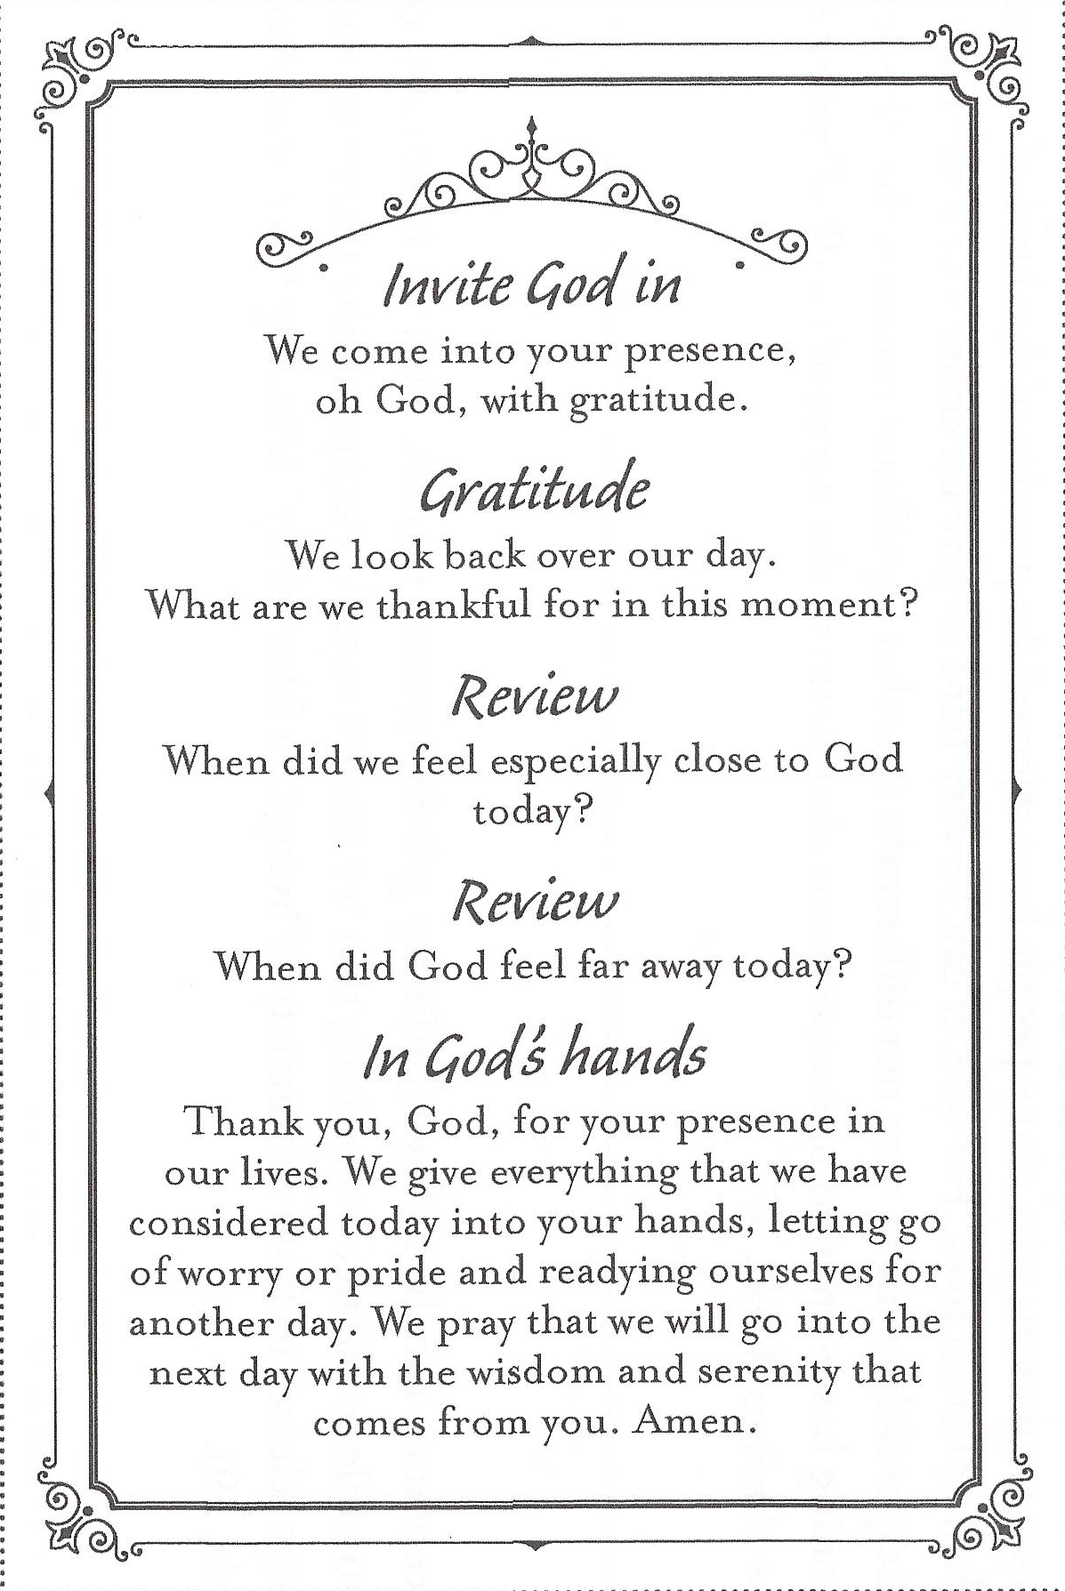
The Examen (continued)
The review of the day can be done in your mind, written in a journal, or spoken aloud, depending on what feels most comfortable and fruitful for you.
There are even apps you can download to your phone!

Slide 26
Closing Prayer
Thank you, God, for your presence in our lives. We give everything that we have considered today into your hands, letting go of worry or pride and readying ourselves for another day. We pray that we will go into the next day with the wisdom and serenity that comes from you. Amen.

Slide 27
God Is Here Today
God is here today; as certain as the air I breathe, as certain as the morning sun that rises, as certain when I sing you'll hear my song.
Dios está aquí tan cierto como el aire que respire, tan cierto como la mañana se levanta, tan cierto como que le canto y me puede oír.
“God Is Here Today/Dios Está Aqui.” Source: Mexican Traditional. Arranged by C. Michael Hawn & Arturo Gonzalez. Translation by C. Michael Hawn ©1999 Choristers Guild. All rights reserved. Used with permission. CCLI #11221925.
Musician: Catherine Ritch
Image: Glory Dharmaraj

