Slide 1
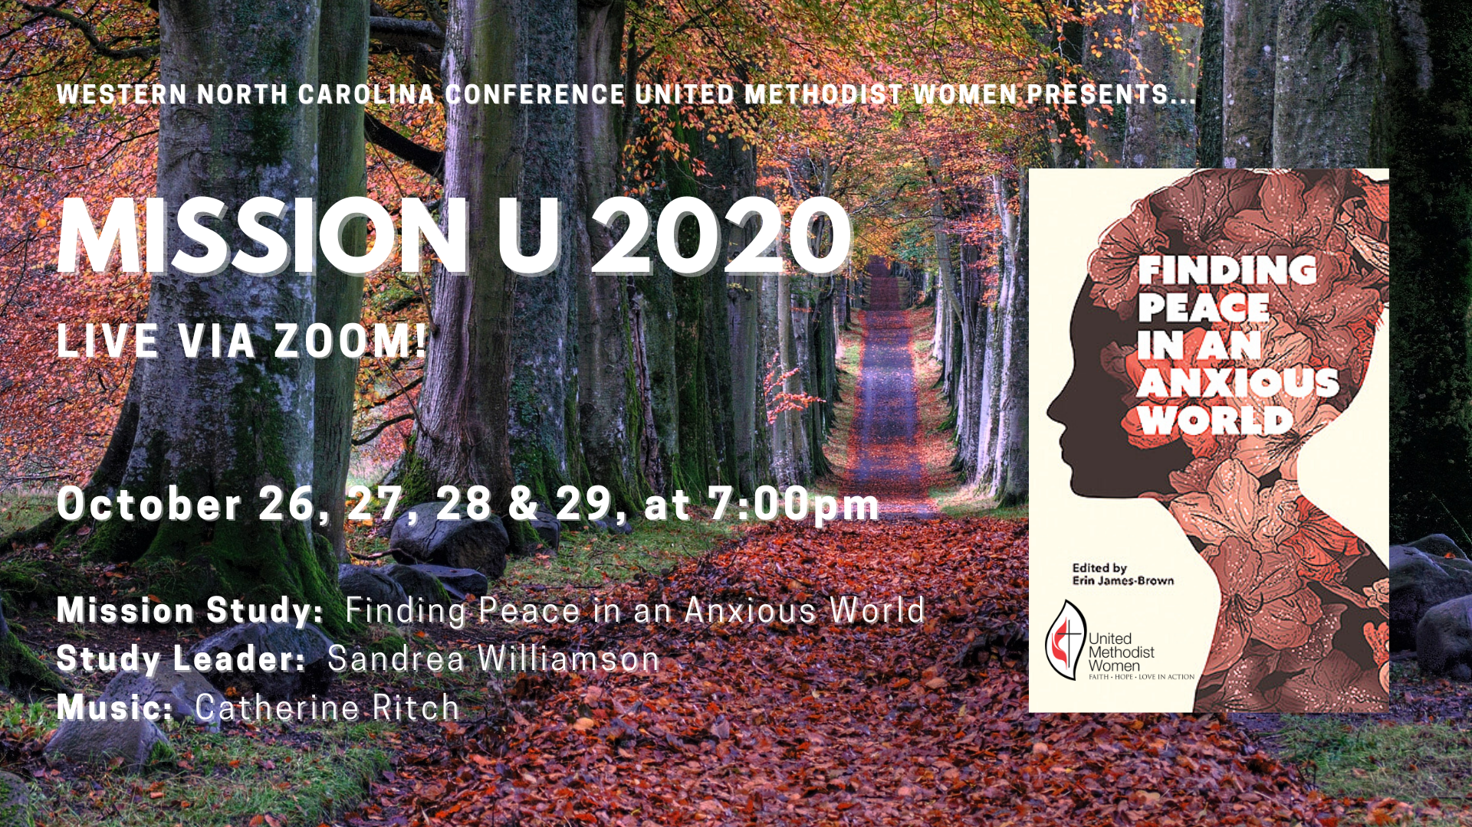

Slide 2


SESSION 4:
WISDOM
“Leaning on the Everlasting Arms,” The United Methodist Hymnal, no. 133
Credit: “Leaning on the Everlasting Arms.” Music by Anthony J. Showalter, 1887. Words by Elisha A. Hoffman, 1887. Public domain.
Musician: Catherine Ritch

Slide 3

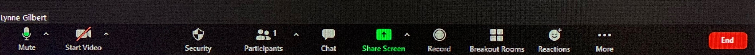

Slide 4
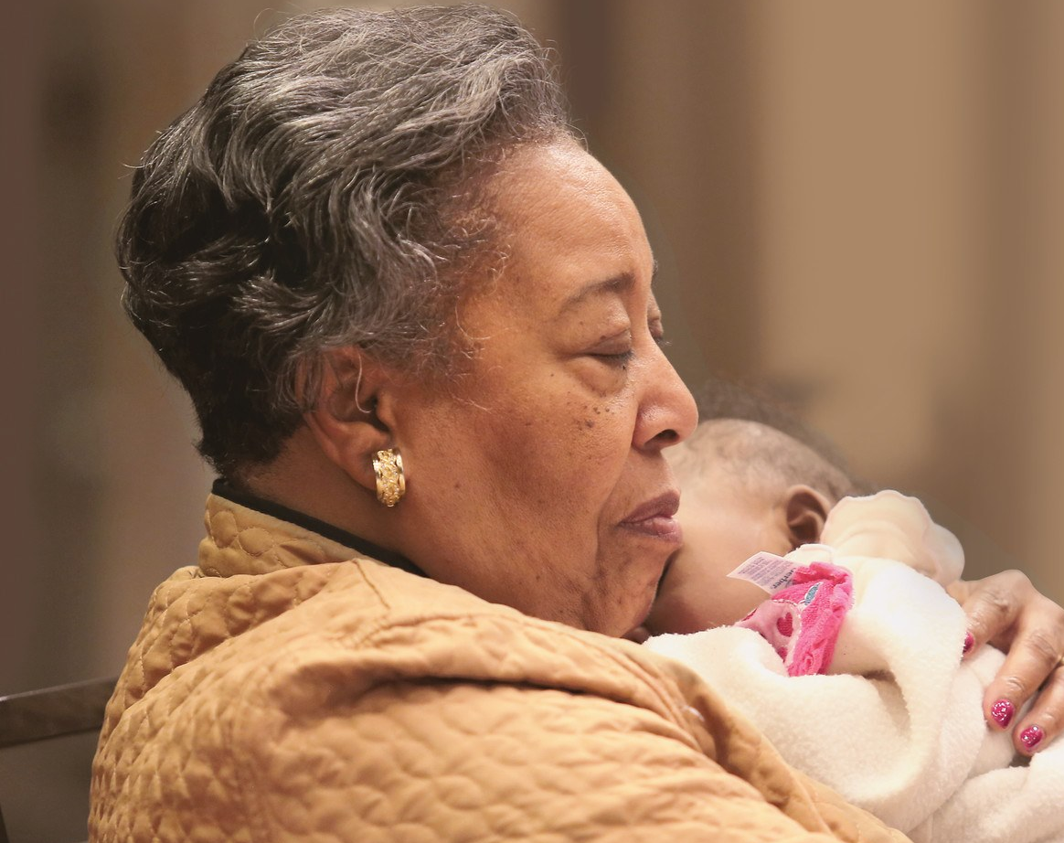


The Legacy Fund
Endowment Campaign
wnccumw.org/legacyfund/

Slide 5
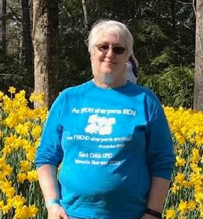

Thursday, October 29
Judy Kelley
Senior Accountant
Finance & Administration
jkelley@umcmission.org
”I have been very active in Missions for many years.
I am so thankful to work for a such a great organizations that amplifies
my personal passion for missions.”

Slide 6
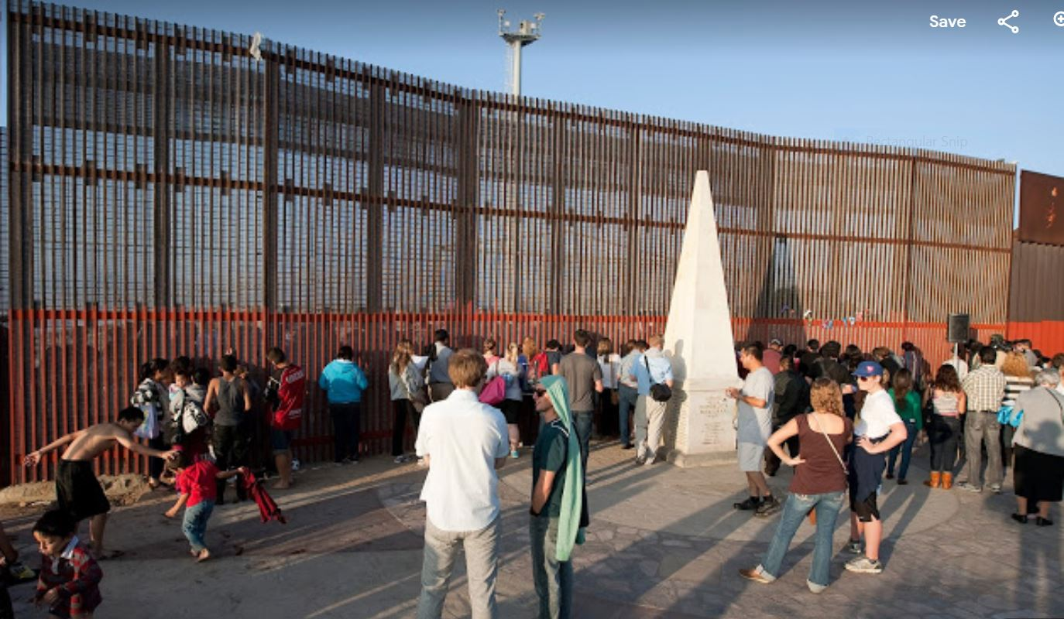
United States
Methodist Border
Friendship
Commission
Promoting friendship, fellowship, evangelism and mission
along the U. S. And Mexico border

Slide 7

Sandrea Williamson, Facilitator
Credit: This presentation was developed in close collaboration with
GLORY DHARMARAJ, Ph.D.
President, World Association For Christian Communication,
North-America
Director of Spiritual Formation & Mission Theology, (Retired) United Methodist Women
Sandrea Williamson, Facilitator

Slide 8
The Serenity Prayer
God, grant me the Serenity
To Accept the things I cannot change...
Courage to change the things I can,
And Wisdom to know the difference.

Slide 9
Session 4: WISDOM
Explore what it means to seek after the wisdom of God
Examine what elements go into wise living
Experience the spiritual practice of trustful wayfinding through a labyrinth walk
Review the various practices for alleviating anxiety that we have discussed throughout the study

Slide 10
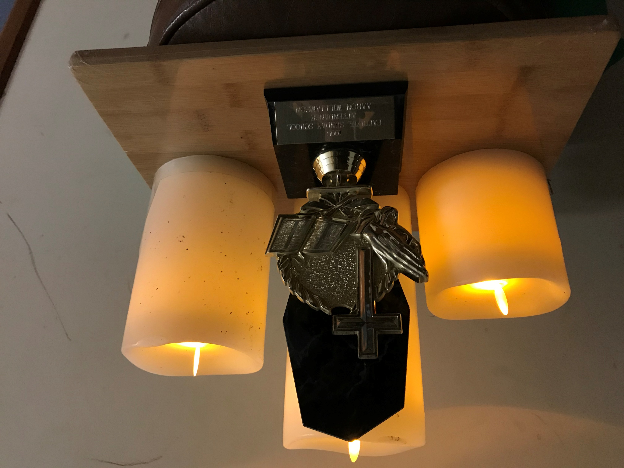

Slide 11
SESSION 4: WISDOM
Gathering and Opening Ritual
Body Prayer
Begin by standing or sitting in a comfortable position, with feet about shoulder width apart, and hands at your sides.
Holy God, you call us to lives of courage and wisdom, not lives of anxiety.
Raise both arms above your head.
We raise our hands high, because you ask us to work with willing hands.
Stretch you hands out in front of you, palms up.
We stretch our hands in front of us, because you call us to reach out to those in need.
Bring your hands to your brow, above your eyes, as if searching the distance.
We bring our hands to our brow, that we may face the future without fear.
Slowly bring your hands to your chest, pressed together in the traditional prayer pose.
We move to a posture of centering prayer, because we ask for your wisdom.
Amen.
(Text inspired by Proverbs 31)

Slide 12
REFLECTION on
Body Prayer
Spend some time thinking about what you just did.
Anxiety and wisdom, as well as other qualities that we have discussed, often manifest in the body.
What do they feel like?
What does it feel like to embody prayer, rather than anxiety?

Slide 13
Leaning on the Everlasting Arms
1. What a fellowship, what a joy divine,
leaning on the everlasting arms.
What a blessedness, what a peace is mine
Leaning on the everlasting arms.
Chorus:
Leaning, leaning,
safe and secure from all alarms;
Leaning, leaning
Leaning on the everlasting arms.
2. O how sweet to walk, in this pilgrim way,
leaning on the everlasting arms.
O how bright the path grows from day to day.
Leaning on the everlasting arms.
Chorus:
Leaning, leaning,
safe and secure from all alarms;
Leaning, leaning
Leaning on the everlasting arms.
3. What have I to dread, what have I to fear,
leaning on the everlasting arms.
I have blessed peace with my Lord so near,
Leaning on the everlasting arms.
Chorus:
Leaning, leaning,
safe and secure from all alarms;
Leaning, leaning
Leaning on the everlasting arms.
“Leaning on the Everlasting Arms,” The United Methodist Hymnal, no. 133
Credit: “Leaning on the Everlasting Arms.” Music by Anthony J. Showalter, 1887. Words by Elisha A. Hoffman, 1887. Public domain.
Musician: Catherine Ritch

Slide 14

Mobius Strip Movement: Back-and-forth reading act
GOD’S PEACE
JOHN 20:26
WISDOM
PROVERBS 2
Image: commons.wikimedia.org/wiki/File:Möbius_strip.jpg; Content: Glory Dharmaraj

Slide 15
PROVERBS 2:1-11
My child, if you accept my words
and treasure up my commandments within you,
² making your ear attentive to wisdom
and inclining your heart to understanding;
³ if you indeed cry out for insight,
and raise your voice for understanding;
⁴ if you seek it like silver,
and search for it as for hidden treasures—
⁵ then you will understand the fear of the Lord
and find the knowledge of God.
⁶ For the Lord gives wisdom;
from his mouth come knowledge and understanding;
⁷ he stores up sound wisdom for the upright;
he is a shield to those who walk blamelessly,
⁸ guarding the paths of justice
and preserving the way of his faithful ones.
⁹ Then you will understand righteousness and justice
and equity, every good path;
⁸ guarding the paths of justice
and preserving the way of his faithful ones.
⁹ Then you will understand righteousness and justice
and equity, every good path;
¹⁰ for wisdom will come into your heart,
and knowledge will be pleasant to your soul;
¹¹ prudence will watch over you;
and understanding will guard you.

Slide 16
What is Wisdom?
Merriam-Webster: knowledge that is gained by having many experiences in life; the natural ability to understand things that most other people cannot understand; knowledge of what is proper or reasonable; good sense or judgment
Oxford Dictionary: the quality of having experience, knowledge, and good judgment; the quality of being wise; the soundness of an action or decision with regard to the application of experience, knowledge, and good judgment;

Slide 17
What is Wisdom?
It is not simply gathering information: “…while knowledge and wisdom are close cousins, they are not one and the same. Knowledge—even knowledge about ourselves—is information, at its base level…. Knowledge, intelligence, and logic are important, but there is still something missing that keeps it from passing into the realm of wisdom: morals and compassion. As followers of Jesus, we call this Christian wisdom.” (Text, p. 73)
Quiet reflection: When have you sought, or helped someone seek, Christian wisdom? What was that process like?

Slide 18
What is Christian Wisdom?
Proverbs 9:10 (Reverence for God)
The fear of the Lord is the beginning of wisdom,
and the knowledge of the Holy One is insight.
John 20:26 (Peace with God)
A week later his disciples were again in the house, and Thomas was with them. Although the doors were shut, Jesus came and stood among them and said, “Peace be with you.”

Slide 19
Wisdom and the Christian Life
“Wisdom exists in a four-fold tension.” (Text, p. 78)
Christians work for wisdom, but it is God who grants wisdom.
Christians build a tolerance for disappointment but maintain determined hope.
Wisdom is a practice in which we participate, but it is a gift granted by God.
Wisdom does not do away with anxiety but provides tools to manage anxiety.
Consider these alongside Proverbs 2:1-11. Do you agree with these statements? What does each say about wise living?
Discuss your answers in your breakout groups for about 10 minutes.

Slide 20
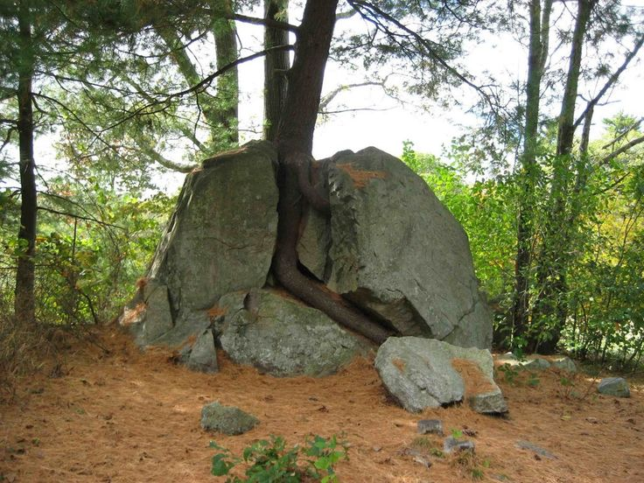
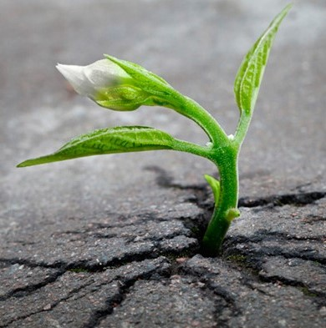
DETERMINED HOPE
Image: Glory Dharmaraj
Image: drsaradennis.com

Slide 21
Spiritual Practice: Labyrinth Meditation
Wayfinding: information systems that guide people through a physical environment and enhance their experience and understanding of the space.
  Christian wayfinding: As Christians, our way is found through Jesus Christ—sometimes easily, sometimes not—but is always supposed to be a journey of trust.
  Follow Jesus’ Gethsemane example: As Christ did in the Garden, we can trust in a wisdom that is beyond our own, gifted by a God who loves us deeply.

Slide 22
Labyrinth Meditation (continued)
Labyrinth: a sacred place to reflect, look inside, pray, and negotiate new behavior. (Text, p. 84) Not a maze or a race, it can be experienced in three stages:
  Entering: Walk toward the center, releasing cares and concerns, emptying and quieting ourselves before God.
  Centering: As we reach the center, we pray and meditate, seeking clarity for our lives. We can stay as long as we like.
  Returning: As we walk out on the same path, we are empowered by the Spirit to be more authentic in ourselves and in our service to the world.
Spend about 8 minutes “walking” our finger labyrinth.

Slide 23


Slide 24
Reflection
What was “walking” a labyrinth like for you?
Have you had an experience like this before?
What wisdom did you discover about prayer during your labyrinth walk?
Is this a practice that you may want to experience again?

Slide 25
Reflection and Review
Breath Prayer
Examen
Welcoming Prayer
Praising in song/Corporate singing
Kataphatic Prayer
Emotional Freedom Technique/Tapping
Body Prayer
Labyrinth walking/walking meditation
Which practice resonates most with you? What other tools do you use in prayer?

Slide 26
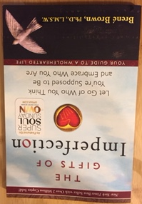
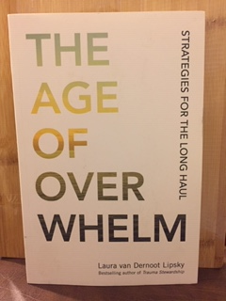
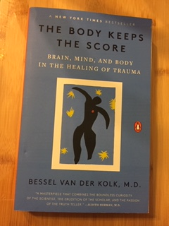
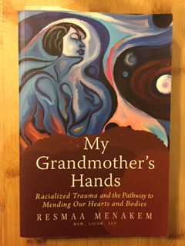
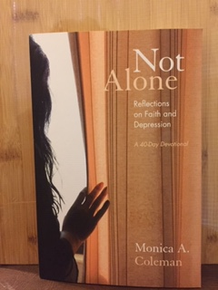
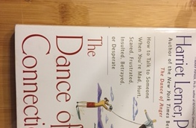
Suggested Reading

Slide 27
Reflection and Review
Transformative
Spirituality:
Accruing Christian Praxis as a resource for daily walk
Being present to our experiences
Acting on our newly gained insights from reflection
In conversation with the Jesus of the Gospel & wisdom of the Proverbs
Asking questions that apply to our situation
Concept: “A Theological Spiral of Action/Reflection” originated from National Assembly of Women Religious, USA, 1984. Updated by Letty M. Russell and J.S. Clarkson, Yale Divinity School, 1994. Image: Rashida Craddock; Content: Glory Dharmaraj

Slide 28
Transformative
Spirituality:
Praxis itself as everyday theology for transformation
Being present to our experiences
Practicing determined HOPE
In conversation with the Jesus of the Gospel & wisdom of the Proverbs
Scripture, Tradition, Reason & Experience
Concept: “A Theological Spiral of Action/Reflection” originated from National Assembly of Women Religious, USA, 1984. Updated by Letty M. Russell and J.S. Clarkson, Yale Divinity School, 1994. Image: Rashida Craddock; Content: Glory Dharmaraj

Slide 29
Moving to Action
What action is God calling us to do, here and now, for the transformation of the world?
What will be your personal “next faithful step” in following God’s call?
Take a minute or two to consider this call to action and write it down for yourself.

Slide 30
Closing Litany
One: Sometimes we are anxious, God. We long for your peace.
All: God, grant us wisdom.
One: God, we ask that we might have the serenity of Jesus when he was in the temple, knowing that he was in his father’s house.
All: God, grant us wisdom.

Slide 31
One: God, we know that we must trust in you, even when it is difficult. Let us practice acceptance. And God, we also ask for courage, knowing that we will be called to act.
All: God, grant us wisdom
One: May we go forth with the power of your Spirit, ready to work for justice; ready to put faith, hope and love into action.
All: Amen

Slide 32
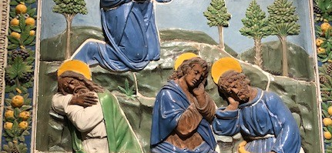
Leaning on the Everlasting Arms
1. What a fellowship, what a joy divine,
leaning on the everlasting arms.
What a blessedness, what a peace is mine
Leaning on the everlasting arms.
Chorus:
Leaning, leaning,
Safe and secure from all alarms;
Leaning, leaning
Leaning on the everlasting arms.
2. O how sweet to walk, in this pilgrim way,
leaning on the everlasting arms.
O how bright the path grows from day to day.
Leaning on the everlasting arms.
Chorus:
Leaning, leaning,
Safe and secure from all alarms;
Leaning, leaning
Leaning on the everlasting arms.
3. What have I to dread, what have I to fear,
leaning on the everlasting arms.
I have blessed peace with my Lord so near,
Leaning on the everlasting arms.
Chorus:
Leaning, leaning,
Safe and secure from all alarms;
Leaning, leaning
Leaning on the everlasting arms.
“Leaning on the Everlasting Arms,” The United Methodist Hymnal, no. 133
Credit: “Leaning on the Everlasting Arms.” Music by Anthony J. Showalter, 1887. Words by Elisha A. Hoffman, 1887. Public domain.
Musician: Catherine Ritch

Slide 33
God Is Here Today
God is here today; as certain as the air I breathe, as certain as the morning sun that rises, as certain when I sing you'll hear my song.
Dios está aquí tan cierto como el aire que respire, tan cierto como la mañana se levanta, tan cierto como que le canto y me puede oír.
“God Is Here Today/Dios Está Aqui.” Source: Mexican Traditional. Arranged by C. Michael Hawn & Arturo Gonzalez. Translation by C. Michael Hawn ©1999 Choristers Guild. All rights reserved. Used with permission. CCLI #11221925.
Musician: Catherine Ritch

