Slide 1
MISSION U::
Learning Together for the Transformation of the World

Slide 2
Opening Worship
“O For a Thousand Tongues to Sing”
O for a thousand tongues to sing,
my great Redeemer’s praise,
the glories of my God and King,
the triumphs of his grace!

Slide 3
My gracious Master and my God, assist me to proclaim, to spread through all the earth abroad the honors of thy name.
UMH #57

Slide 4
"How Great Is Our God" The splendor of the king Clothed in majesty Let all the earth rejoice All the earth rejoice

Slide 5
He wraps Himself in light, And darkness tries to hide And trembles at His voice Trembles at His voice

Slide 6
How great is our God – sing with me How great is our God
and all will see how great,
how great is our God

Slide 7
Age to age He stands And time is in His hands Beginning and the end Beginning and the end

Slide 8
The Godhead Three in One Father, Spirit, Son Lion and the Lamb Lion and the Lamb

Slide 9
How great is our God – sing with me How great is our God
and all will see How great, how great is our God

Slide 10
He speaks, and listening to his voice, new life the dead receive; the mournful, broken hearts rejoice, the humble poor believe.

Slide 11
Hear him, ye deaf; his praise, ye dumb, your loosened tongues employ; ye blind, behold your savior come, and leap, ye lame, for joy.

Slide 12
How great is our God – sing with me How great is our God
and all will see how great,
how great is our God
Chris Tomlin, CCLI license #4348399

Slide 13
Call to Worship (inspired by Psalm 119: 1-8)
Happy are those who walk
in God’s ways. Blessed are those who observe
God’s commandments.

Slide 14
Faithful are those whose eyes are fixed on righteousness. Joyful are those whose hearts are filled with praise.

Slide 15
Come, let us love the Lord
our God. We come to worship the One
who leads us in the ways of life.
re:Worship.blogspot.com

Slide 16
Serving Two Masters?
God or Mammon
-Trusting
Loving
Resembling

Slide 17
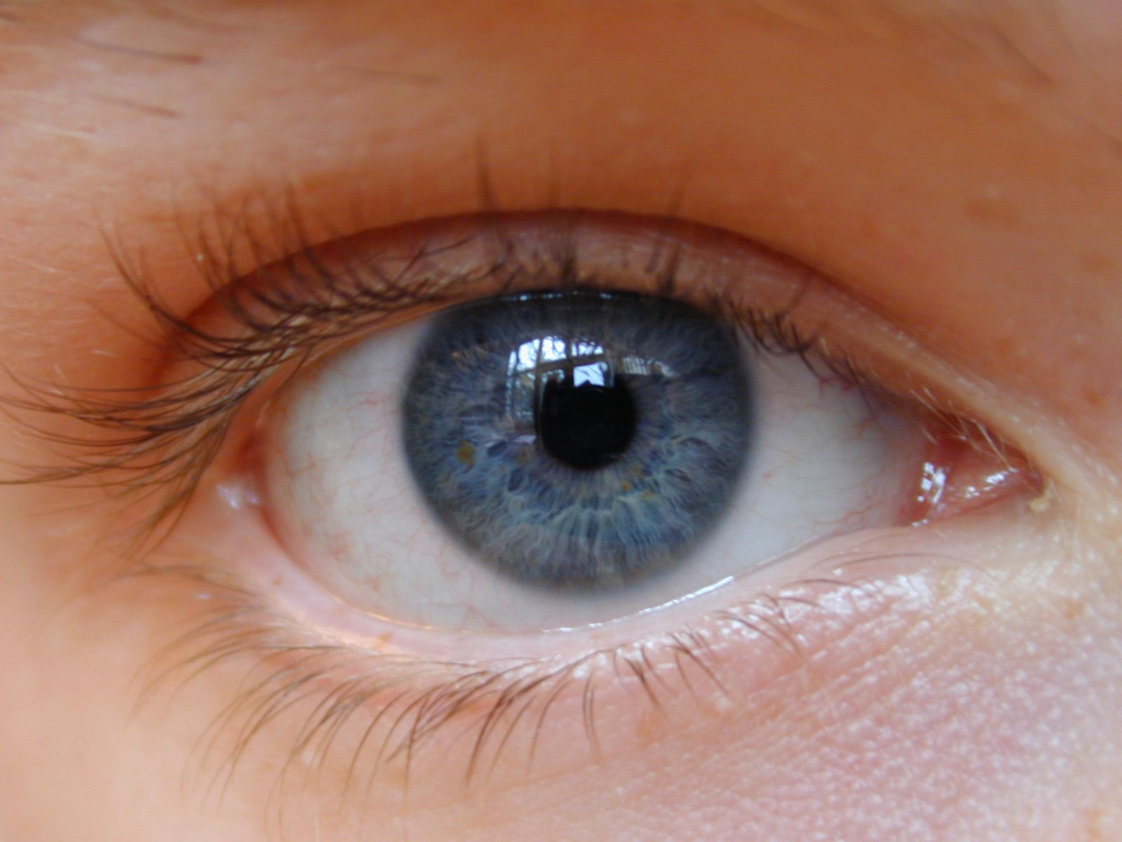
Single Eye
Matthew 4:1-11

Slide 18
How much is enough?

Slide 19
“ Gain all you can, save all you can, give all you can.”
John Wesley

Slide 20
Gratitude
Gratitude unlocks the fullness of life. It turns what we have into enough, and more.
It turns denial into acceptance, chaos to order, confusion to clarity. It can turn a meal into a feast, a house into a home, a stranger into a friend. Gratitude makes sense of our past, brings peace for today, and creates a vision for tomorrow. - Melody Beattie

Slide 21
Simplicity
There are more than 2.35 billion square feet of self-storage in the U.S., or a land area equivalent to three Manhattan Islands under one roof.

Slide 22
Individual Action Plans
Church or Group Action Plans

Slide 23
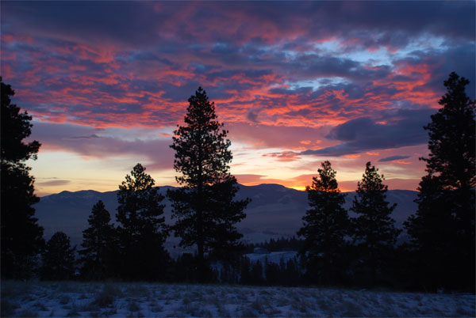
As Holy as the Day is Spent – Carrie Newcomer
Holy is
the dish and drain
the soap and sink,
the cup and plate
Warm wool socks,
cold white tile
Showerheads
and good dry towels

Slide 24
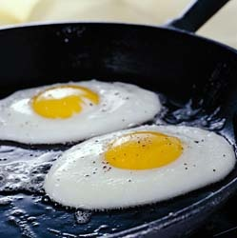
And frying eggs sound like psalms
With bits of salt measured in my palm
It’s all a part of a sacrament
As holy as a day is spent

Slide 25
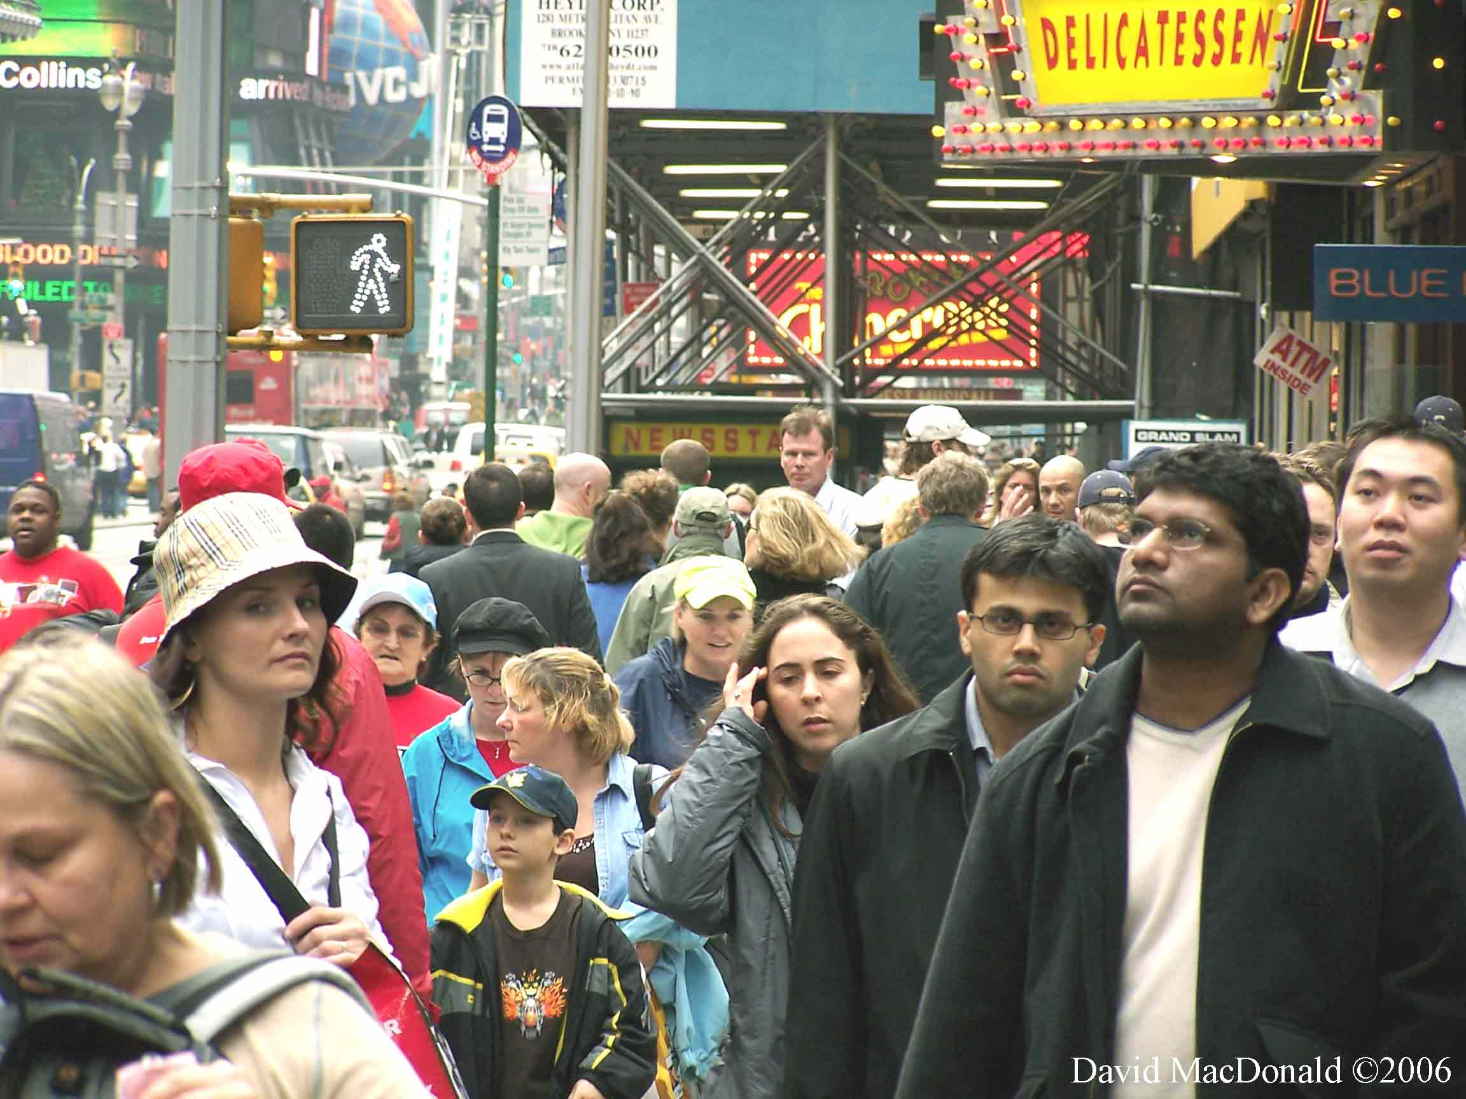
Holy is the busy street
And cars that boom with passion’s beat
And the check out girl, counting change
The hands that shook my hands today.

Slide 26
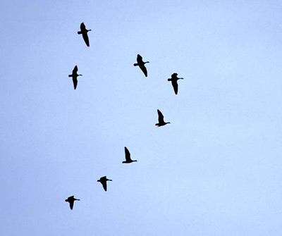
And hymns of geese fly overhead
And stretch their wings like their parents did
Blessed be the dog
That runs in her sleep
To chase some wild, elusive thing

Slide 27
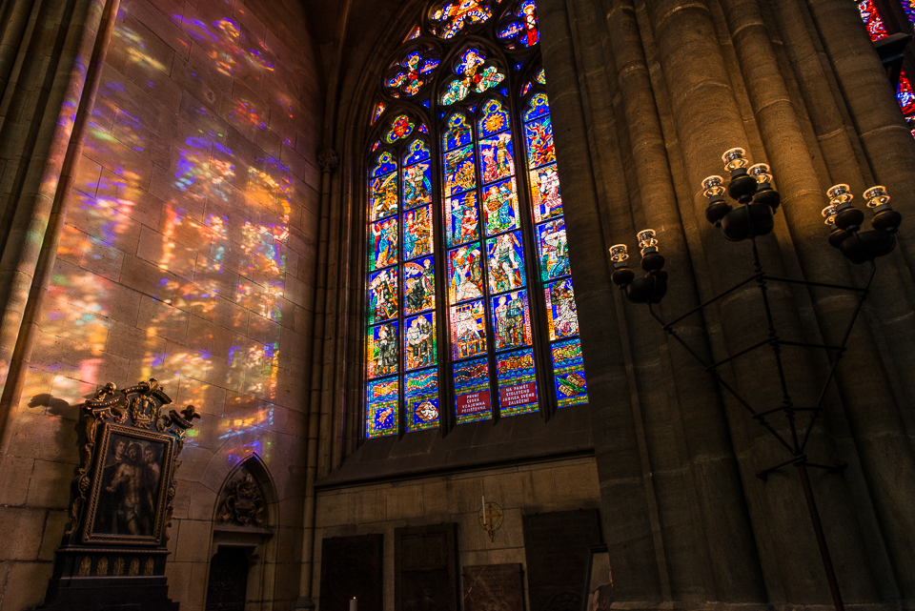
Holy is a familiar room
and the quiet moments in the afternoon
And folding sheets like folding hands
To pray as only laundry can

Slide 28
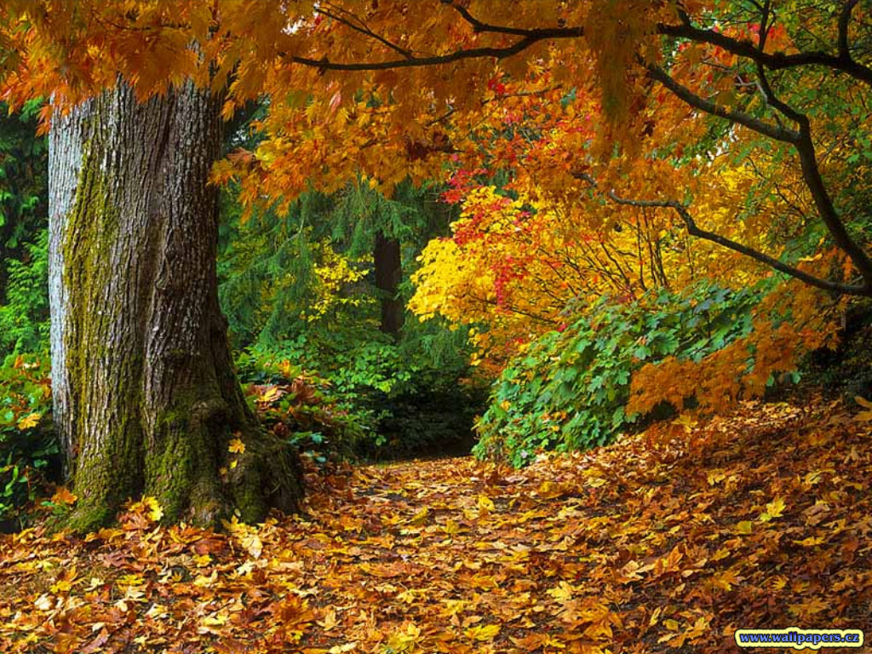
I’m letting go of all my fear
Like autumn leaves made of earth and air
The summer came and the summer went
As holy as a day is spent

Slide 29
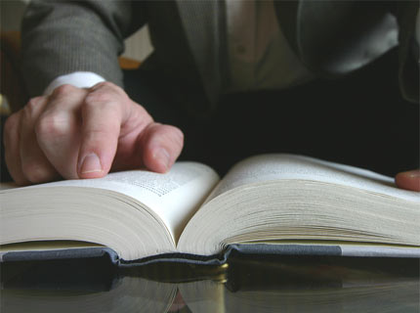
Holy is the place I stand
To give whatever
small good I can
The empty page,
the open book
Redemption everywhere I look

Slide 30
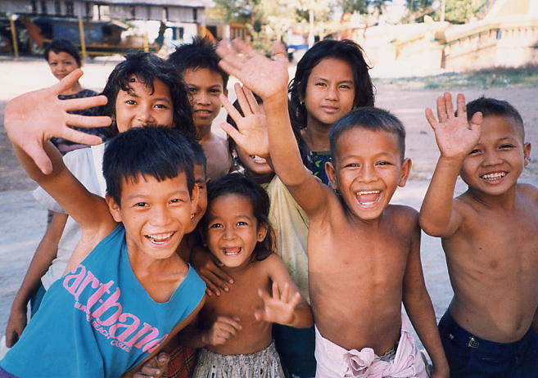
Unknowingly we slow our pace
In shades of unexpected grace
And with grateful smiles and sad lament
As holy as a day is spent

Slide 31
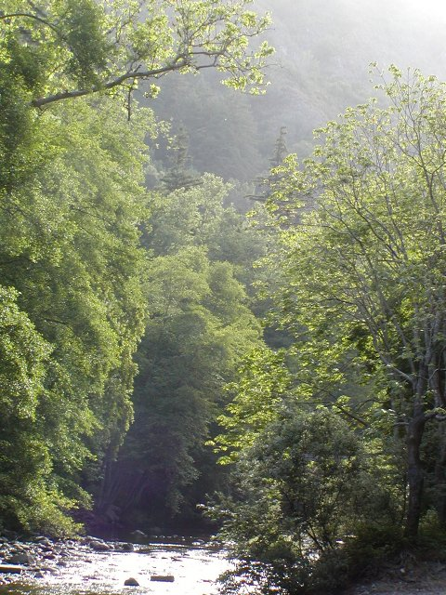
And morning light
sings “providence”
As holy as a day is spent…

Slide 32
MISSION U::
Learning Together for the Transformation of the World

