Slide 1
GOD the Equipper and God’s Covenant Nation
Session 3

Slide 2
Goals for session 3
To increase understanding of the laws handed down by Moses as a detailed articulation of the elements of the covenant for community/nation.
To ponder the relevance of the commandments and laws to our lives today.

Slide 3
Read aloud in unison:
“I am the Lord your God, who brought you out of the land of Egypt, out of the house of slavery; you shall have no other gods before me.”
EX 20: 2-3

Slide 4
Read aloud in unison:
“You shall love the Lord your God with all your heart and with all your soul and with all your mind, and with all your strength…You shall love your neighbor as yourself.”
MK 12:30-31

Slide 5
Sing “What does the Lord Require of You?”
# 2174

Slide 6
What does the Lord require of you? (2x)
Justice, kindness, walk humbly with your God.
To seek justice and love kindness and walk humbly with your God.

Slide 7
Do Christians need the commandments?
Poll:

Slide 8
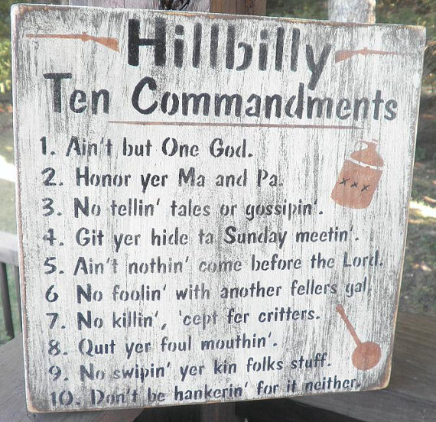

Slide 9
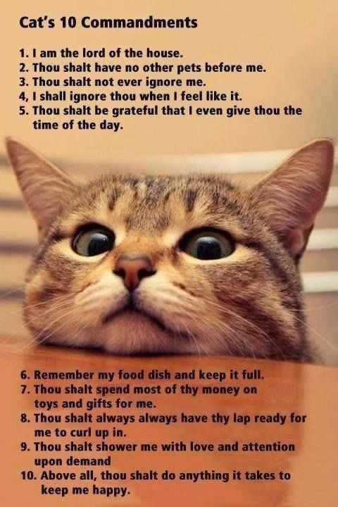

Slide 10
Ten Commandments of Human Relations
Speak to people. There is nothing so nice as a cheerful word of greeting.
Smile at people. It takes 72 muscles to frown, only 14 to smile.
Call people by name. The sweetest music to anyone’s ears is the sound of their own name.
Be friendly and helpful. If you want friends, you must be one.
Be nice. Speak and act as if everything you do is a joy.
Be genuinely interested in people. You can like almost everybody if you try.
Be generous with praise and cautious with criticism.
Be considerate with the feelings of others. There are usually three sides to a controversy: yours, the other person’s, and the right side.
Be eager to lend a helping hand. Often it’s appreciated more than you know. What counts most in life is what we do for others.
Add to this a good sense of humor, a huge dose of patience, and a dash of humility. This combination will open many doors and the rewards will be enormous.

Slide 11
¹Then the Moderator posted all these words on the messenger board:
²"I am the Moderator, who increased your bandwidth and liberated you from internet censorship;
³You are not allowed to join any message boards other than mine.
⁴You shall not post a message in a forum other than mine
⁵for I can see all and will summarily ban you from further postings in our chat room. This ban will stay on your IP address for generations to come and not even your children's children will be able to get past this firewall,
⁶but those who honor my desires will find themselves in favor and will be granted a multitude of Bitcoins.
⁷Do not speak poorly of me; in doing so, you will cause my name to be marred in chat rooms everywhere.

Slide 12
⁸Do not fry the motherboards in your computers by spending too much time online.
⁹You will post stories on end so that people may receive the latest memes
¹⁰But remember to give your hard drives a break so that they may rest and refresh. Always remember to install updates on the 1st and 15th of the month.
¹¹When I created my own computer, the system needed to restart afterward so I rested.
¹²Obey your parents because they pay your bills.
¹³Do not unplug a computer while it is operating.
¹⁴Do not create private messages.
¹⁵Do not logon to someone else's account.
¹⁶Do not speak of fellow members offline.
¹⁷Do not solicit followers.

Slide 14
Ponder the biblical texts
Moses made seven (7) trips up the mountain to get the 10 commandments (see EX 19)
Seven (7) years of wandering in the desert at this point.
Community’s fear of seeing God directly.
Moses’ absence from them for forty days.
Their temptation with idols as a way to relive their fears.

Slide 15
The commandments are independent but have different foci:
Commandments about the relationship to God and loving God.
Commandments about living in the community.

Slide 16
In groups of 4, review the following scriptures
“I am the Lord your God, who brought you out of the land of Egypt, out of the house of slavery; you shall have no other gods before me.” EX20:2-3
“You shall love the Lord your God with all your heart, and with all your soul, and with all your might.” DT 6:5
“You shall not make wrongful use of the name of the Lord your God, for the Lord will not acquit anyone who uses the holy name.” EX 20:7

Slide 17
With these verses in mind, discuss these questions in your group:
What does it mean to love God with your whole heart?
How does an individual live up to this commandment?
What are some examples of what it might mean?
Is it about acts of worship or acts of justice?
What are the temptations for idol worship?
How well are we really doing at loving God?

Slide 18
With these verses in mind, discuss these questions in your group:
What does it mean to love God with your whole heart?
Putting God First
Love within, love whole surroundings, neighbor, self
Look to places in your heart God needs to heal
Intimate relationship / Spend time

Slide 19
With these verses in mind, discuss these questions in your group:
How does an individual live up to this commandment?
Something that we do each day…today, I’m going to…
Holy Spirit / prioritize our lives putting God first / Listen to God
Reflect the love of God in what we do
Spend time with God – worship / prayer / conversation
Be God-Centered / in a spirit of obedience / not harmful
Self-reflective – Examine ourselves
Making a difference
Reading the scripture / learn the nature of God

Slide 20
With these verses in mind, discuss these questions in your group:
What are some examples of what it might mean?

Slide 21
With these verses in mind, discuss these questions in your group:
Is it about acts of worship or acts of justice?
YES! Both / And!
Spiritual Disciplines / Christian Doing and Being
Micah 6:8
Know God
Faith without works is dead.
Attending church / fellowship with others / programs in issues, advocacy / communication / write Congress / Action

Slide 22
With these verses in mind, discuss these questions in your group:
What are the temptations for idol worship?
Jobs / Lust / Greed – Things that take away from God
More about me than about God
Worship pleasure
Things we think we “deserve” – water/electricity go off
Things that replace God – treating God as Santa Claus
The idol of security – not having enough
Grass is greener on the other side – is it worth it?
Wanting to be “entertained” by the preacher/choir
Envy / jealousy / keep up with the Jones

Slide 23
With these verses in mind, discuss these questions in your group:
How well are we really doing at loving God?
“Are you going on to perfection?”
Self examination
Christian perfection…being a work in progress
We will never be perfect on this earth…but keep striving.

Slide 24
Being a Good Neighbor, Commandments 4-10
10 topics addressed in these 6 verses
Divide into groups. Each group has one of these 10 topics. Use pertinent material in DT, EX, and LEV, your books, other resources you may have or google to consider what it means to be a good neighbor in a global sense. How does it affect “justice for all?” What does it say about our structures, institutions, and nations? What does it say about our values.

Slide 25
10 topics in community part of the 10 commandments
Work
Slavery
Rest
Honoring parents
Murder
6. Adultery
7. Stealing
8. False witness
9. Coveting someone’s spouse
10. Coveting someone’s property

Slide 26
Being a good neighbor cont.
Write your group’s responses on large newsprint.
Leave space for additional comments to be added.
Have someone in your group give Sara or Lynne your group’s notes.

Slide 27
Being a good neighbor
Workplace:
Bible study
Moment of silence
Prayer all inclusive to whole group – don’t say Jesus
Church preschools – understood - Christian Influence

Slide 28
Being a good neighbor
Global Slavery:
Slave labor in foreign countries – we buy products cheaply
Fair wages in the US and better conditions (except immigrants)
Human trafficking – empower our youth to be aware / protect themselves and be aware of people you might meet who need help to get out.
Speak up when se something wrong. Treat people right.
Making slaves out of people who don’t make living wage
Creating slaves because people working 3-4 jobs & still not making a living wage
Start ripples!

Slide 29
Being a good neighbor
Rest:
Rest interacts with all of the other issues being discussed.
Give permission for people to rest. Children / Youth / Young Adults / All Ages
Really rest – not artificial
Encourage not to be in EVERY activity.
Take care of self to avoid health issues – obesity / Cancer / Stress
Rest promotes better mental health / healthy living
More accidents caused by fatigue/sleep than alcohol

Slide 30
Being a good neighbor
Honor your parents:
Vigilant to make sure not scammed / taken advantage of
Commandment comes with a promise – covenant
Parent doesn’t necessarily mean biological parent – Also other significant persons in your life.

Slide 31
Being a good neighbor
Murder:
Good neighbor / Global Sense
More than one way to murder – murder their spirit through abuse, etc.
Show the love of God to everyone
Get involved
Be supportive
Be educated
Give our time to help with victims of abuse, etc.

Slide 32
Being a good neighbor
Adultery:
Need for stronger families / keeping marriage covenant
Divorce easy / commonplace
Repentance / forgiveness
Listening / supporting
Providing couples retreats / counseling

Slide 33
Being a good neighbor
Stealing:
Stealing of time…from God
Exploitation – stealing resources from other countries for our comfort
Stealing of human dignity & human rights…as in against “aliens” in our country

Slide 34
Being a good neighbor
False Witness:
Lots of it in our world today / no one wants to take responsibility
Dig for the facts as we can
Advocate for what is right / be a part of peaceful organization

Slide 35
Being a good neighbor
Coveting your neighbor’s spouse:
Focusing on physical features of celebrity / others
Wanting something in another that you are not finding in your own spouse
Being aware of male / female friendships

Slide 36
Being a good neighbor
Coveting Someone’s Property:
Lusting – putting a show on
Work more hours
Covet to the point of death
To steal land for financial gain (Missionary conference examples)
Covers anything that God created

Slide 37
Economic & Environmental Justice for a Nation
Leviticus 25: 1-7
Sabbatical Year
Leviticus 25: 8-9
Jubilee Year
Read these verses silently and meditatively.
How do these laws build economic and environmental justice?

Slide 38
Some contemporary examples of the work of the covenant community
Mass incarceration
Racism; profiling
Sexism
Ageism
Health care availability
Immigration laws
7. Reproductive health
8. Equal pay for men and women, minimum wage – any kind of economic justice
9. Death penalty
10. Hunger
11. Unemployment
12. Gun violence
Others

Slide 39
In your same groups, use PS 106 as your guide to name your concerns and understanding of the ongoing history of the covenant community’s need to address the challenges and troubles that people experience.
Using one sheet of paper for the group, each person take a turn at writing one challenge or trouble and how God has/will use the community to address those troubles/challenges. (demonstrate)

Slide 40
ONE thing I learned is:
THEREFORE, I will:

Slide 41
When everyone in the group has written something, take turns reading them aloud one by one. After each one, the whole group say together:
Thanks be to God, the Covenant Keeper, who showed us how to be a blessing and receive a blessing from our community.
We will dedicate these to God. Please have one group member bring your paper to me after the session.

Slide 42
What does the Lord require of you? (2x)
Justice, kindness, walk humbly with your God.
To seek justice and love kindness and walk humbly with your God.

Slide 43
For the next session Read chapters 5 and 6 in the book as well as these scriptures:
2 Samuel 7: 1-17
Jeremiah 31
Chronicles 17
PS 89: 34
1 Samuel 18-20
Acts 10: 34-43
Philippians 2:1-5

