Slide 1
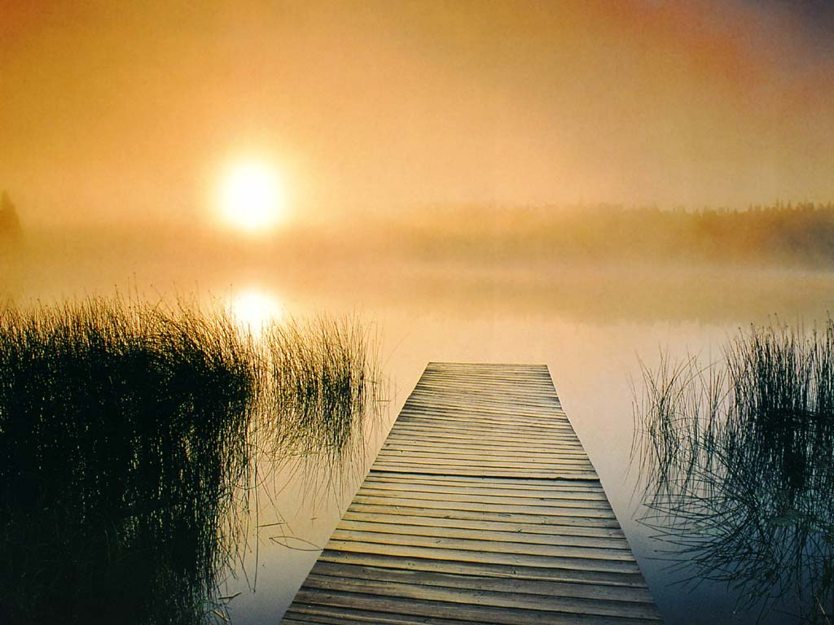
Dan Fogelberg
To the Morning
From the album: Home Free

Slide 2
Opening Worship
“When Morning Gilds the Skies”
When morning gilds the skies, My heart awaking cries: May Jesus Christ be praised! Alike at work and prayer, To Jesus I repair; May Jesus Christ be praised!

Slide 3
The night becomes as day When from the heart we say: May Jesus Christ be praised! The pow’rs of darkness fear When this sweet chant they hear: May Jesus Christ be praised!

Slide 4
Let all the earth around ring joyous with the sound: May Jesus Christ be praised! In heaven's eternal bliss the loveliest strain is this: May Jesus Christ be praised!

Slide 5
Be this, while life is mine, my canticle divine: May Jesus Christ be praised! Be this th' eternal song through all the ages long: May Jesus Christ be praised!
UMH #185

Slide 6
Call to Worship (from Psalm 100)
Come before the Lord with joyful songs, because he is good, because he is generous, because we lack nothing.
Let us enter his gates with thanksgiving and his courts with praise.

Slide 7
Serve the Lord with gladness, because of his greatness and justice, because he puts an end to war, and to all forms of violence.
Let us enter his gates with thanksgiving and his courts with praise.

Slide 8
Come before the Lord with joy because he is faithful to his promises, because his Word is eternal.
Let us enter his gates with thanksgiving and his courts with praise.

Slide 9
Know that the Lord is God, and we are his people, his community, his family.
Let us enter his gates with thanksgiving and his courts with praise.
(from the World Council of Churches website)

Slide 10
Share a Scripture passage that has made a difference in your life

Slide 11
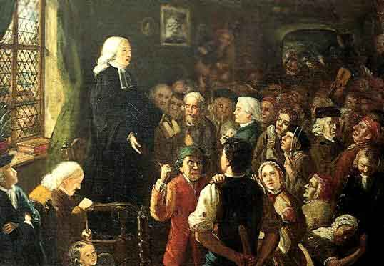

Slide 12
Holiness and Happiness

Slide 13
A Methodist is one who has "the love of God shed abroad in his heart by the Holy Ghost given unto him;" one who "loves the Lord his God with all his heart, and with all his soul, and with all his mind, and with all his strength. God is the joy of his heart, and the desire of his soul; which is constantly crying out,

Slide 14
"Whom have I in heaven but thee? and there is none upon earth that I desire beside thee! My God and my all! Thou art the strength of my heart, and my portion for ever!"

Slide 15
He is therefore happy in God, yea, always happy, as having in him "a well of water springing up into everlasting life," and overflowing his soul with peace and joy. "Perfect love" having now "cast out fear," he "rejoices evermore." He "rejoices in the Lord always," even "in God his Saviour.”
- The Character of a Methodist, 1742

Slide 16
“As the more holy we are upon earth the more happy we must be.”
-God’s Love to Fallen Man,
John Wesley

Slide 17
Group A: The Image of God, Salvation and Happiness (pgs. 59-64)
Group B: Happiness through Holiness, Happiness as a Feeling, Heaviness (pgs. 65-71)
Group C: Social Religions (pgs. 75-79)

Slide 19
Happy: The Movie
Chapters 9, 10 & 11

Slide 20
Chapters
9, 10 & 11
Happy: The Movie
Directed by Roko Belic

Slide 21
Cultural Diversity and Happiness

Slide 22
“Let it Rise”
Let the glory of the Lord Rise among us Let the glory of the Lord Rise among us Let the praises of the King Rise among us Let it rise

Slide 23
Let the songs of the Lord Rise among us Let the songs of the Lord Rise among us Let the joy of the King Rise among us Let it rise
Oh oh oh, let it rise
Holland Davis, CCLI License #2240585

Slide 24
Be Happy!

